Slide 1
IPTsc adaptation Uganda
Jane Nabakooza, Uganda NMED
Joaniter Nankabirwa, Infectious Diseases Research Collaboration (IDRC)
26th February 2026

Slide 2
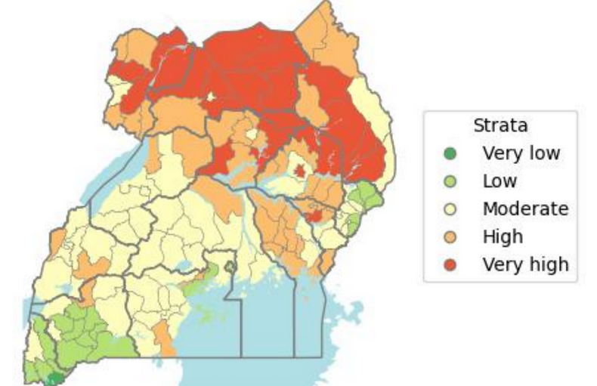
Malaria Situation in Uganda
Uganda accounts for 5% of global malaria cases and 2.7% of global malaria deaths (WMR 2025).
11,997,33 cases, 675,154 admissions and 2,196(4.8/100,000) deaths
Incidence dropped from 308/1000 (2020) to 274/1000 (2024) and 261/1000 (2025/26).
Prevalence overtime 42% (2009), 19% (2014), 9% (2018/19) and 12% (2024).
Noted progressive epidemiological burden shift to children > 5 years
Sustaining transmission –moderate to high transmission
Severe Malaria (atypical presentation ) and death – low transmission
Shift in vector dominance from Anopheles gambiae to Anopheles funestus.
Parasite species P.Falciparum- 96% , P.Malariae – 4% and Mixed infections -13%.
Reducing funding landscape and call for accelerated efforts towards elimination.
Transmission/risk strata | Number of Districts
Very High | 26
High | 56
Moderate | 45
Low | 19
Notes:
This may have been highlighted a lot in earlier presentation, so could remove even just before the talk if it is too repetitious

Slide 3
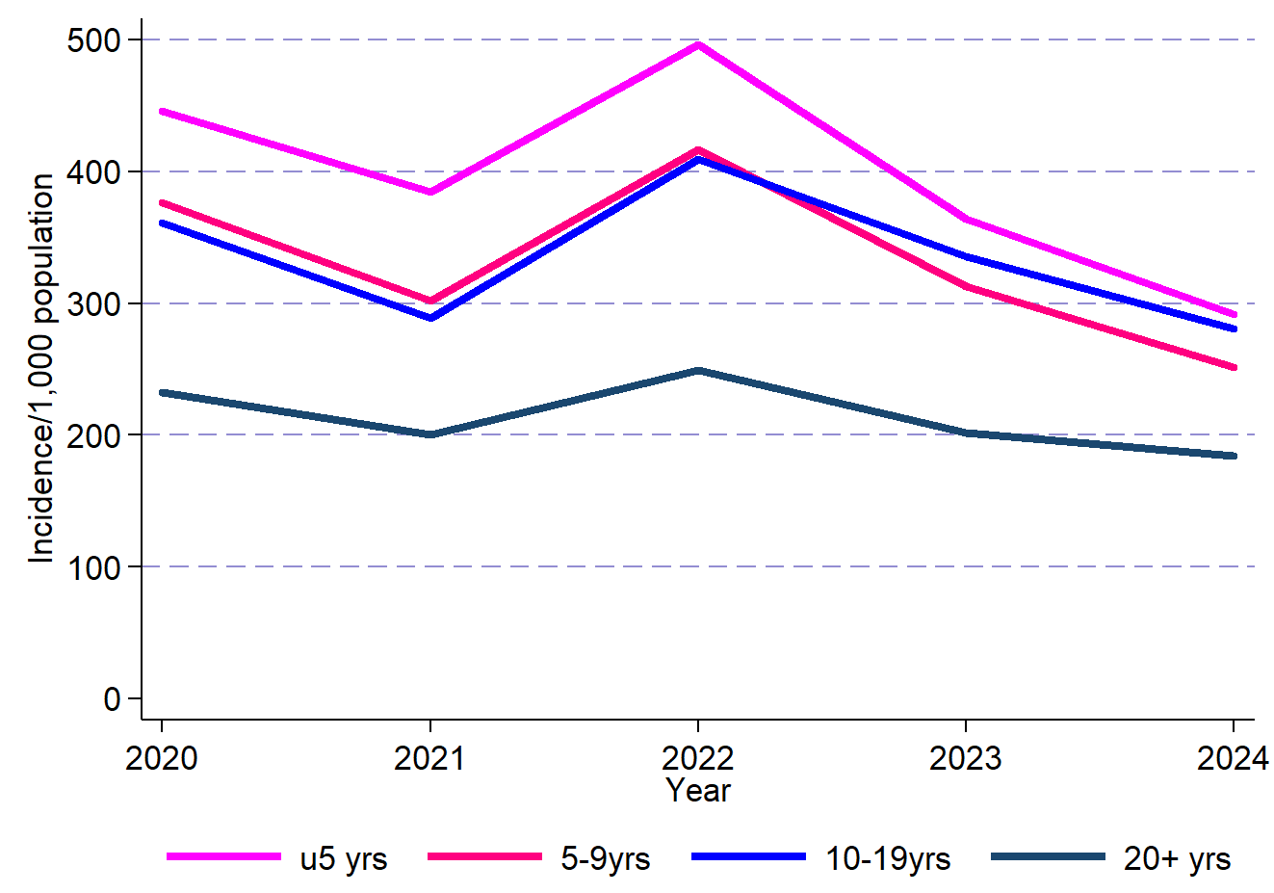
School-age children are a key target population
High prevalence in school-age children
43% of outpatient malaria cases are in school-age children
Increasing burden of hospitalization and severe disease
Main driver of transmission
Incidence notable increasing among the age groups of 5-9years ,10-19 years

Slide 4
Seminal research studies of IPT-sc were conducted in Uganda
START IPT Trial by Staedke et al
IPT-sc using monthly DP Nankambirwa et-al
Eighty-four schools participated in this study half to the intervention and half were control schools (June –Dec 2014).
Weight based dosing of monthly DP as a directly observed therapy.
10,079 (43.3%) aged 5-20 years received at least one dose of DP.
Improved health indices were noted;
Reduced parasiteamia, gametocytes, fever episodes, symptomatic malaria in intervention arm.
Community-level parasite prevalence was lower in the intervention clusters than in the control clusters (19% vs 23%).
IPT of schoolchildren with DP would benefit individual children and may reduce transmission in the community.
740 School-age children (6-14 years) in a high transmission setting were recruited.
Provided with monthly Dihydrortemisnin Piperaquine (DP) monthly as IPT-sc.
IPTm reduced the incidence of malaria by 96%
Reduced the prevalence of asymptomatic parasitemia by 94%.
Reduced the prevalence of anemia by 40%.
IPTst reduced the prevalence of asymptomatic parasitemia by 54%

Slide 5
Proposed pilot in GC7
Chemoprevention therapies including IPT-sc were a priority consideration for the UMRESP 2021- 2030.
There was need to provided significant evidence on the feasibility and acceptability .
The IPT-sc pilot was proposed under various funding sources; GC7,USAID –PMI ,UNICEF.
Was one the interventions under the specific interventions with IPTp, PDMC,SMC
Considered among items prioritized for above allocation awaiting availability of funds in GC7.
Pilot was to be conducted in 3 districts within Busoga region (one of those with the highest prevalence).
It remains a non –funded priority under GC7 to-date and this YR-3 of the 3 year GC7 grant.
But malaria among school children and it’s effect continue to be a worsening yet neglected challenge.

Slide 6
Current policy status
Ministry of Health Uganda –National Malaria Elimination Division (NMED) is currently guided by the National Malaria Elimination strategic Plan 2025-2030(UNMEP 2025-2030).
UMMEP has considered Chemoprevention therapies as one of the Malaria interventions under strategic objective –one (SO1).
SO1:Universal access to prompt, effective malaria case management to all + chemoprevention to eligible people.
It is strategic intervention 1.5: Protect high-risk groups with targeted chemoprevention and vaccines.
One of the Chemoprevention therapies referred to is – Intermittent Preventive Treatment of Malaria among school-age children (IPT-sc).
Pilot to evaluate feasibility, acceptability was conducted in Teso region-Soroti district (4 schools) –awaiting results to guide adoption.

Slide 7
Evidence gaps hindering policy
Cost effectiveness of using Dihydroartemisinin-Piperaquine (DP) compared to Sulfadoxine Pyrimethamine-Amodiaquine (SPAQ). Except for the prolonged efficacy why should a given country use SPAQ and not DP.
Safety challenges associated with the prolonged frequent use of antimalarial (SPAQ &DP) as IPT-sc.
Health systems factors that can limit or facilitate the quality of IPT-sc implementation or delivery.
Comparing capacity building (Training) and delivery models for IPT –sc frontline providers,
Understanding the additive benefit of including IPT-sc in the Malaria reduction and elimination package.
Exploring alternative (new) medicines of anti malarials that can be used for chemoprevention /IPTsc
Identification of appropriate approaches for engaging the key stakeholders that are involved in the delivery of IPT-sc
Comparing the effectiveness of IPTsc for boarding school vs day scholars
Notes:
Could add age stratification graphs from Rek

Slide 8
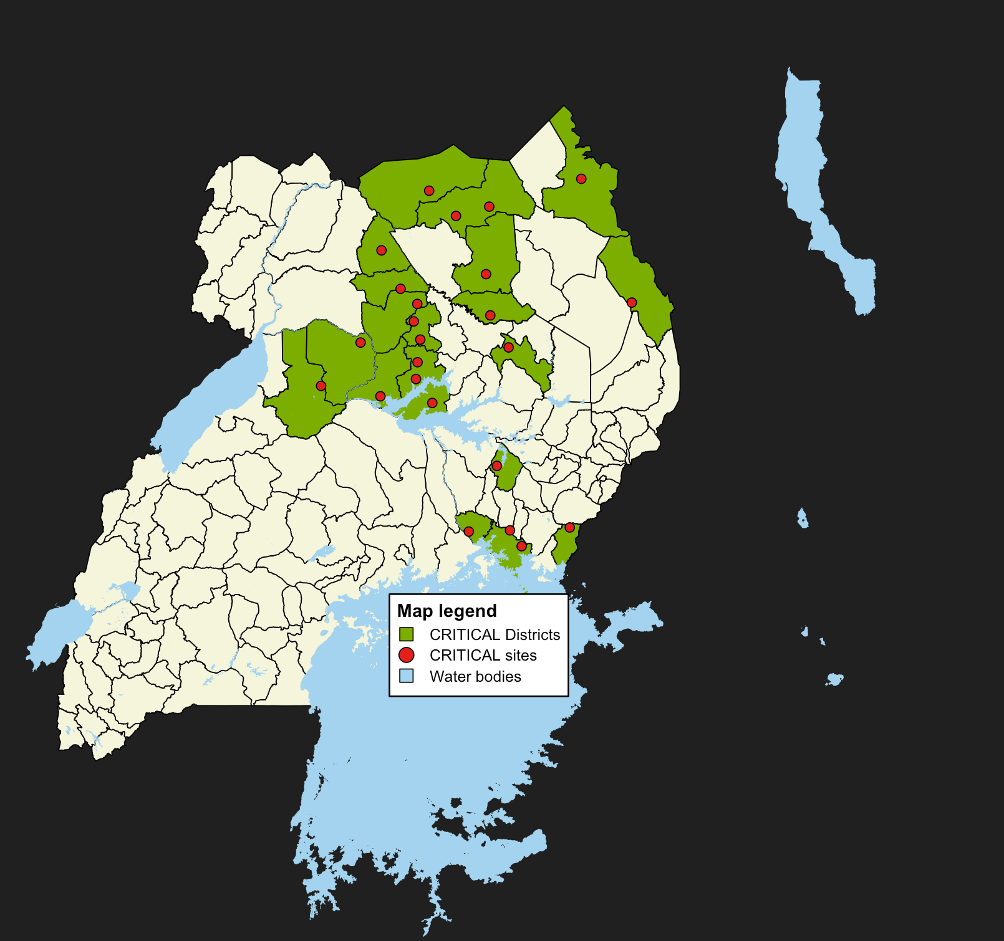
Cluster randomized trial of IPTsc to improve the health of students and decrease community transmission (CRITICal) – Study Design
Objectives: To evaluate
Community level impact on malaria burden
Individual level impact (burden and education)
Cost effectiveness
Resistance markers
24 clusters (12 intervention, 12 control)
Cluster = health center and all primary schools within target area of MRC
Intervention
DP every 2 months for 2 years
All eligible primary schoolchildren within a cluster
~39,000 children in intervention or control schools
Notes:
Could be 2 slides on critical and could include other studies if either pilot is happening or if Pilgrim Africa has developed anything

Slide 9
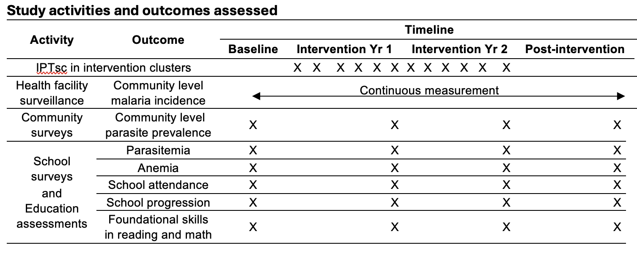


Cluster randomized trial of IPTsc to improve the health of students and decrease community transmission (CRITICal) – Outcomes
Primary
Outcome
Secondary
Outcomes
*
*
*
Economic
Incremental cost per DALY averted, Benefit:cost ratio*
*pending funding
Notes:
Primary: Incidence of clinical malaria in the health center catchment area
Secondary
Parasite prevalence among schoolchildren & community residents
Prevalence of molecular markers of DP resistance
Prevalence of anaemia among schoolchildren
Rate of school attendance and grade-level progression
Rate of acquisition of foundational skills in reading and math
Incremental cost per DALY averted

Slide 10
Next steps for IPTsc in Uganda
Results dissemination for the IPTsc Pilot done in the 4 boarding schools in the 4 districts – Teso region.
Development, approval and adaptation of the IPT-sc scale up implementation plan.
Plan will include–M&E framework especially list of research agenda items that answer IPTsc Policy gaps.
Advocacy and resource mobilization for IPT-sc adaptation.
Include IPTsc into the G-C8 application, other funding mechanisms.
Routinely document and share information on IPTsc implementation progress.

