Slide 1

Post-discharge Malaria Chemoprevention (PDMC) Overview
Profs Jenny Hill & Kamjia Phiri
Chemoprevention Alliance 2026, Uganda

Slide 2
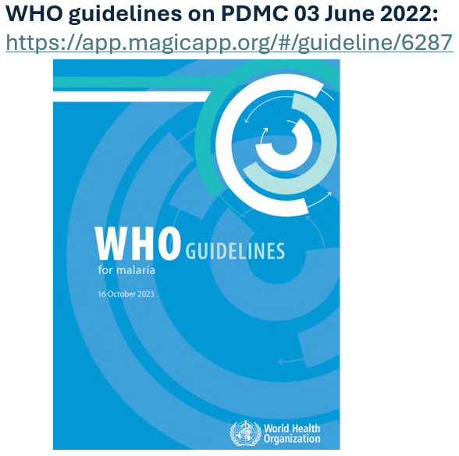
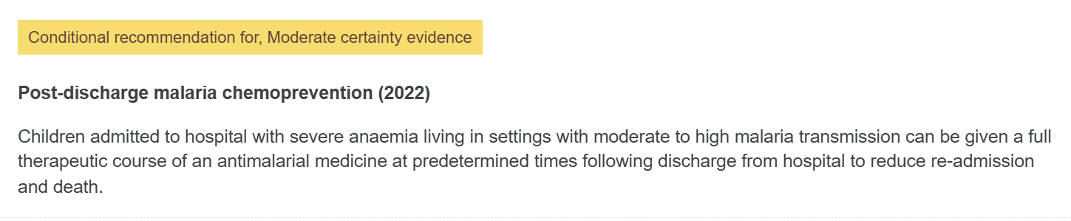
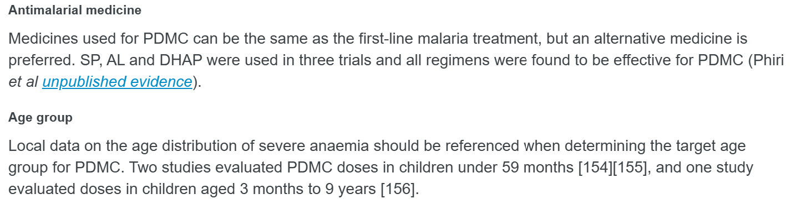
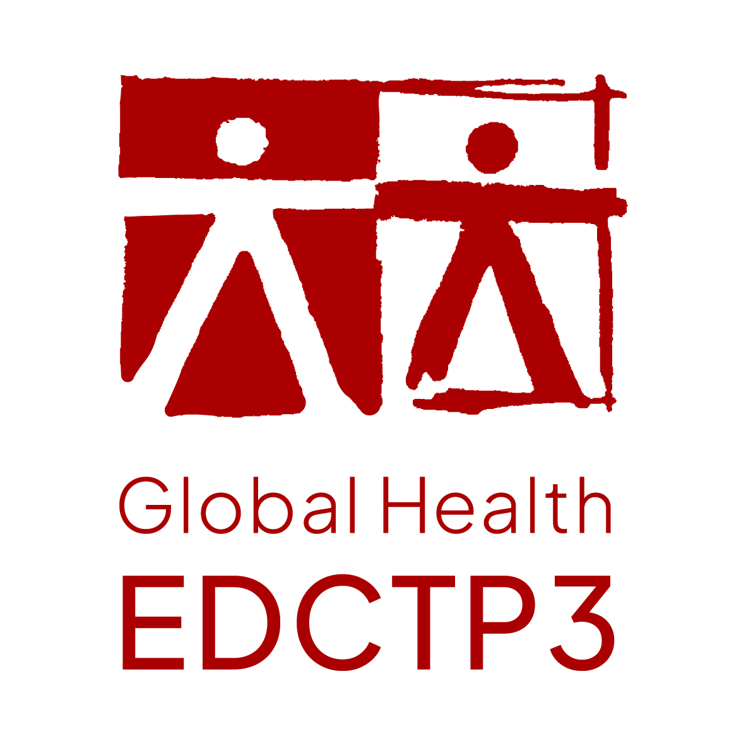








PDMC Guidelines
Notes:
WHO recommend PDMC in children with severe anaemia.
The recommendation falls short of recommending a specific drug or age group
It provides no guidance on how PDMC should be delivered.

Slide 3
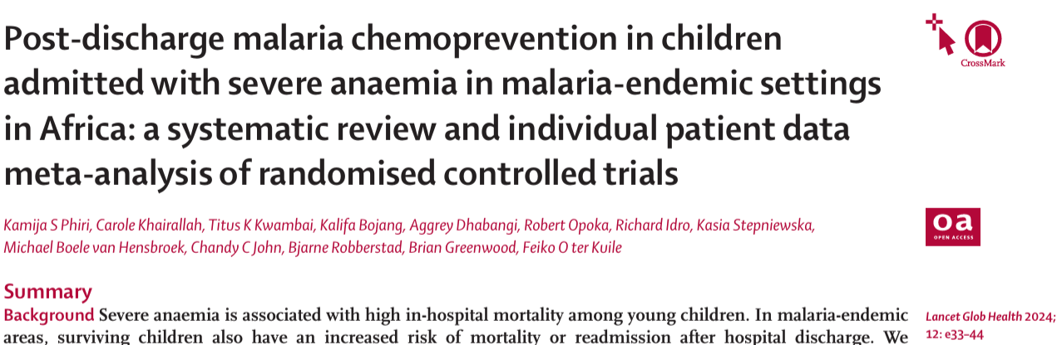
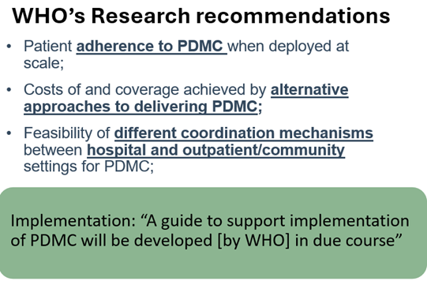
PDMC Evidence
Children admitted with severe anaemia at substantial risk of readmission or death within six months post-discharge.
PDMC reduced all-cause mortality by 77% and all-cause readmissions by 55% in the intervention period.
PDMC - full treatment courses of long-acting antimalarials at scheduled intervals, irrespective of malaria status at discharge.
Evidence gap – Implementation strategies and considerations
Notes:
The evidence for PDMC came from an IPD metanalysis of three trials using SP, AL and DP, respectively.
Results showed that three months of PDMC was associated with a 77% (95% CI 30-98) reduction in mortality during the intervention period (primary endpoint) (p=0.009), a 55% (44-64) reduction in all-cause readmissions (p<0.001) in the intervention period.
Additional evidence on delivery, adherence and cost effectiveness from a single trial in Malawi.
WHO recommended further research on alternative delivery and coordination mechanisms between hospital and outpatient or community care, and patient adherence in real world settings.

Slide 4
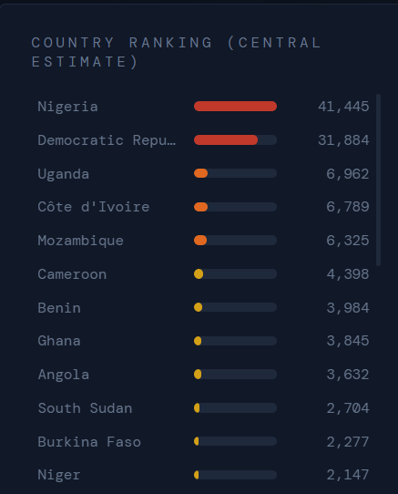
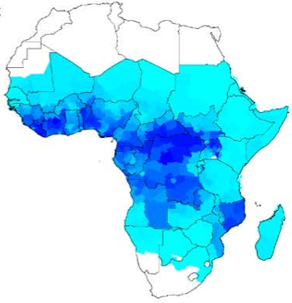
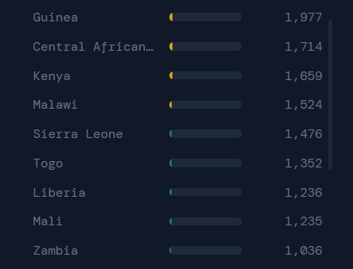
PDMC benefits and demand
Readmissions are 20-60 times higher than in community peers
Could benefit 123,000 children yearly (54,000 – 283,000)
Could avert ~36,000 (range 16,000-82,000) readmissions per year
Number needed to treat (NNT) to: Prevent one malaria readmission
  Nigeria: NNT = 3.1
  DRC: NNT = 2.9
  Countries PfPR_{2–10} >10% =<10
Prevent one death
  <100 in 23 countries
  55 Nigeria
  53 DRC
Okell LC, et al. Nat Commun. 2023 doi: http://10.1038/s41467-023-35939-w
Notes:
Okell LC, et al. Projected health impact of post-discharge malaria chemoprevention among children with severe malarial anaemia in Africa. Nat Commun. 2023 Jan 25;14(1):402.
Figure on Right: The number of children eligible for PDMC ranked by country from highest to lowest (children under 5 years old per year who are hospitalised with SMA and survive, across all subnational regions with PfPR2–10 > 10% in Africa).
Map on left: Figure S10. Forecast PDMC demand: the estimated number of treatments required per year per 100 children aged 0-5 years in subnational (admin-1) regions of malaria-endemic countries. Calculations based on incidence of hospitalised SMA in 0–5-year-old children, assuming a 7.4% in-hospital case fatality rate. Panels A, B and C show the lowest, base scenario and highest forecasts of demand, respectively, based on varying assumptions about the proportion of patients with SMA that access hospital.

Slide 5
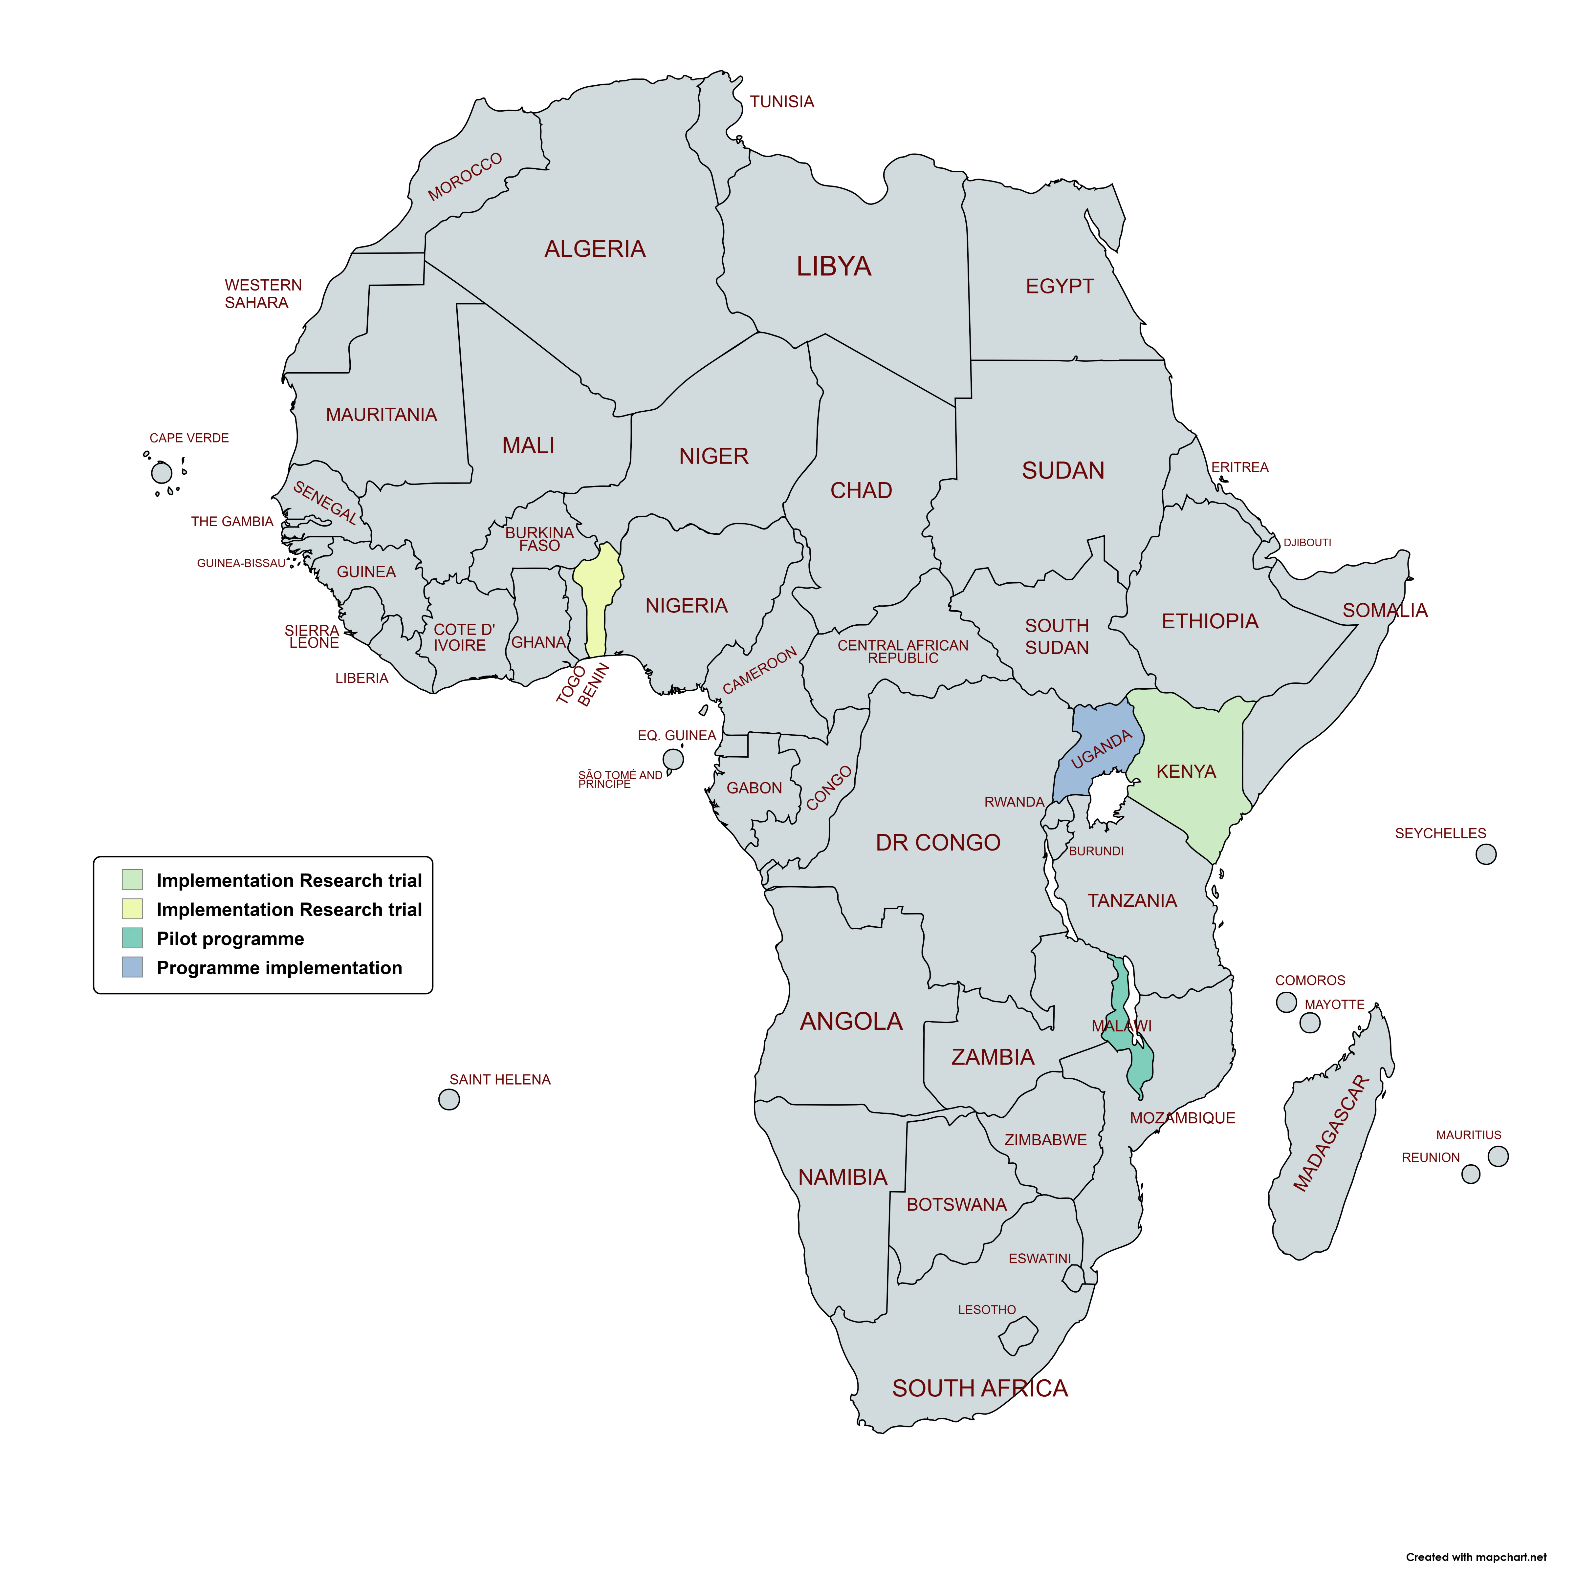
Status of PDMC policy uptake and research
Kenya
Formative research & cluster randomised implementation trial
PDMC + Azithromycin RCT
PDMC vs R21 booster RCT
Uganda
Programme implementation (Smart discharge)
PDMC + Azithromycin RCT
PDMC in severe acute malnutrition RCT
PDMC vs R21 booster RCT
Benin
- Formative research & cluster randomised implementation trial
Malawi
Pilot implementation (PDMCC)
PMDC + Azithromycin RCT
PDMC in severe acute malnutrition RCT
PDMC vs R21 booster RCT
Map created with mapchart.com

Slide 6
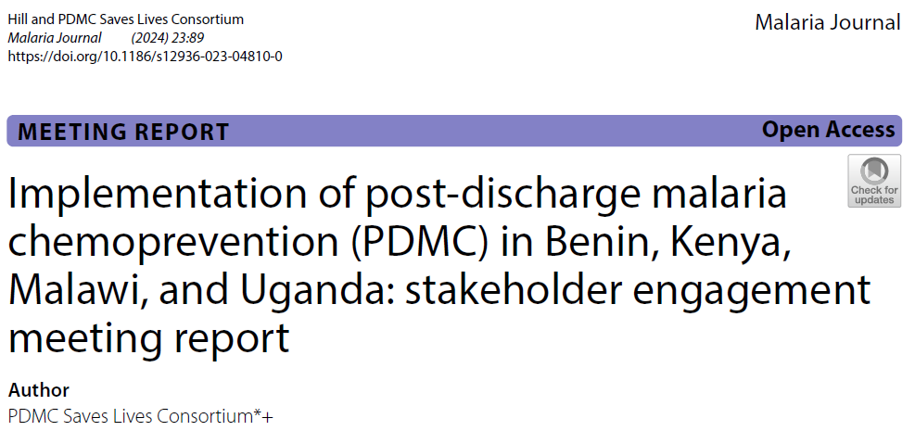
National policy considerations
$
1. Drug selection for PDMC
  promote continuity of care
  treatment & prevention policies (SMC, PMC, IPTsc, CCM)
  drug resistance patterns
  drug supply/availability
  drug registration and national regulations
2. Target disease/condition – expand to severe malaria?
  epidemiological data and implementation feasibility
3. Target age group – expand to children >5 years?
  age distribution and implementation feasibility
4. Delivery strategy – no existing platform
  Centralised versus decentralised drug delivery – community linkage**
  Adherence reminder support – community linkage**
5. HMIS indicators
  coverage – proportion of eligible children who receive 1, 2, 3 courses of PDMC
  impact – no. of deaths averted, hospital readmissions reduced, blood transfusion data
Notes:
1. Number of children with severe anaemia.
2. Number of children with severe malaria.
3. Number of children who receive PDMC (coverage).
a. First course
b. Second course
c. Third course
4. Number of deaths averted.
5. Number of re-admissions reduced.
6. Trace blood transfusion data.

Slide 7
Knowledge gaps & next steps
1. Develop policy roadmap for each country reflecting current planning stage and additional evidence requirements
Determine PDMC target group (i.e., age range/underlying condition)
Determine drug
Integration across SMC, PMC, IPTsc, CCM
Pilot implementation trials to generate country-specific approaches that optimise adherence
coordination mechanisms between health facility and community structures
Economic studies to support national health budgeting & Global Fund applications
  Cost savings owing to PDMC; Cost per life saved
  Cost‑effectiveness of alternative delivery strategies
2. Use evidence from implementation programmes, pilots and trials to develop globally available implementation guidance to support country scale-up

Slide 8
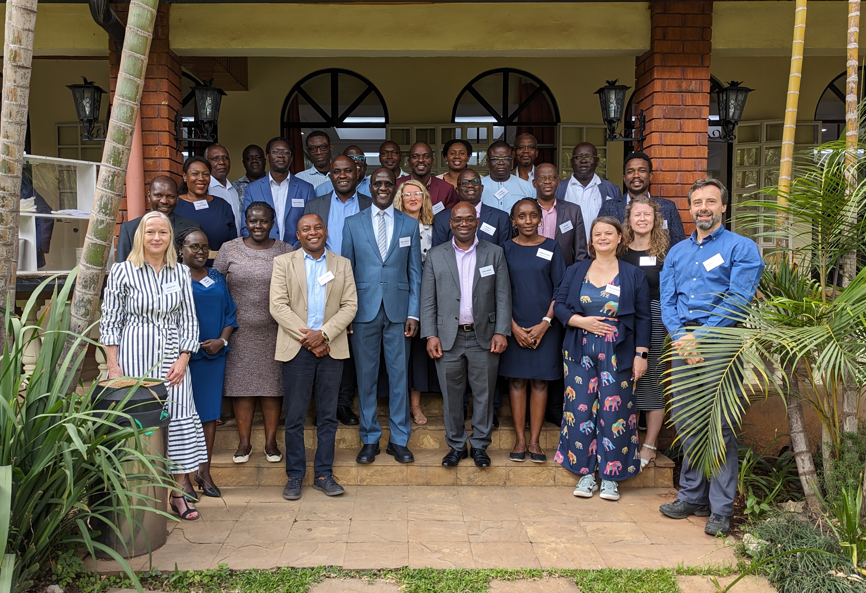
Thank you!
PDMC stakeholder engagement meeting with Benin, Kenya, Malawi, and Uganda held in Nairobi (September 2023) Photo credit: Jenny Hill
Notes:
The first four countries to come together to consider PDMC adoption at a meeting in Nairobi in 2023.
We will hold another stakeholder engagement meeting for the wider African region in 2027.

Slide 9
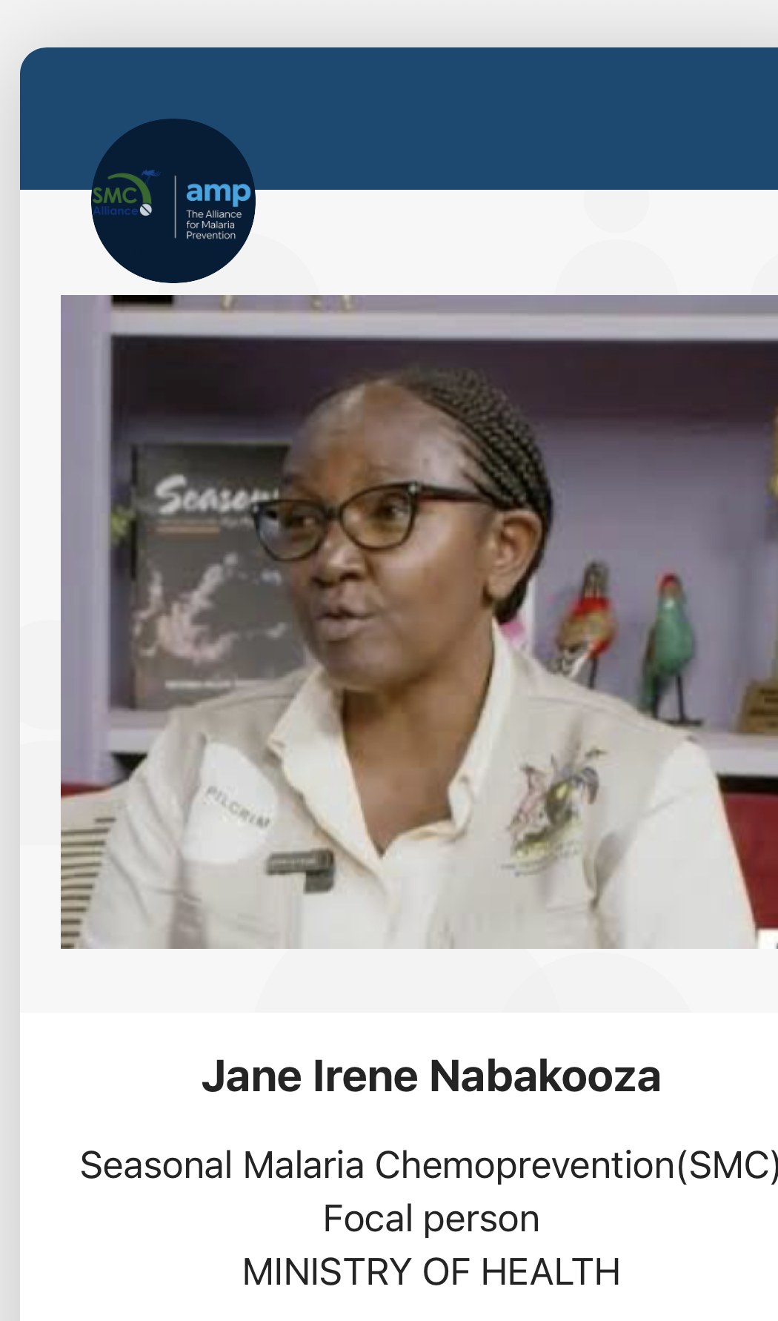

PDMC Program Implementation: Panel Discussion
Uganda
Malawi

