Slide 1
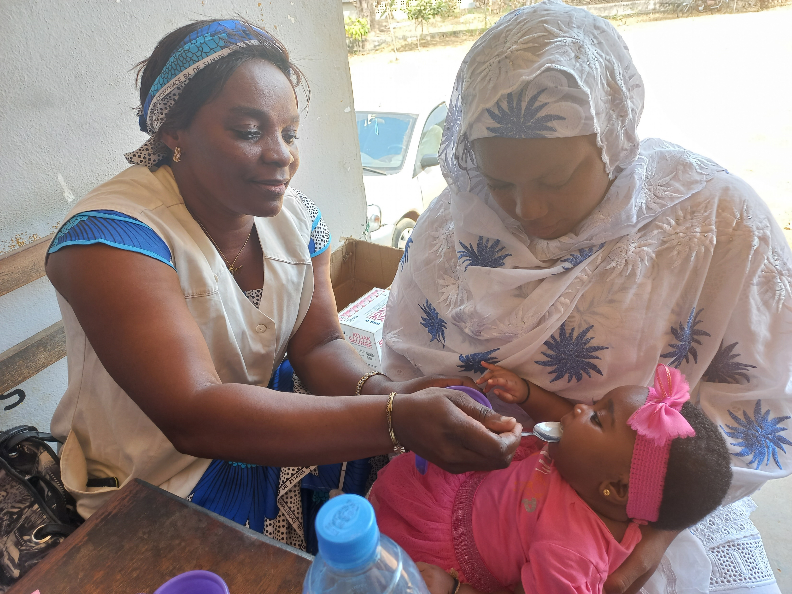
Overview of the PMC
Community of Practice (COP)
Dr Junior Voundi Voundi NMCP Cameroon
Co-chair of the PMC COP
Chemoprevention Alliance Meeting
February 2026
Mother Arama and Baby Ruamiswaa attending EPI vaccination clinic to receive PMC, Cameroon

Slide 2
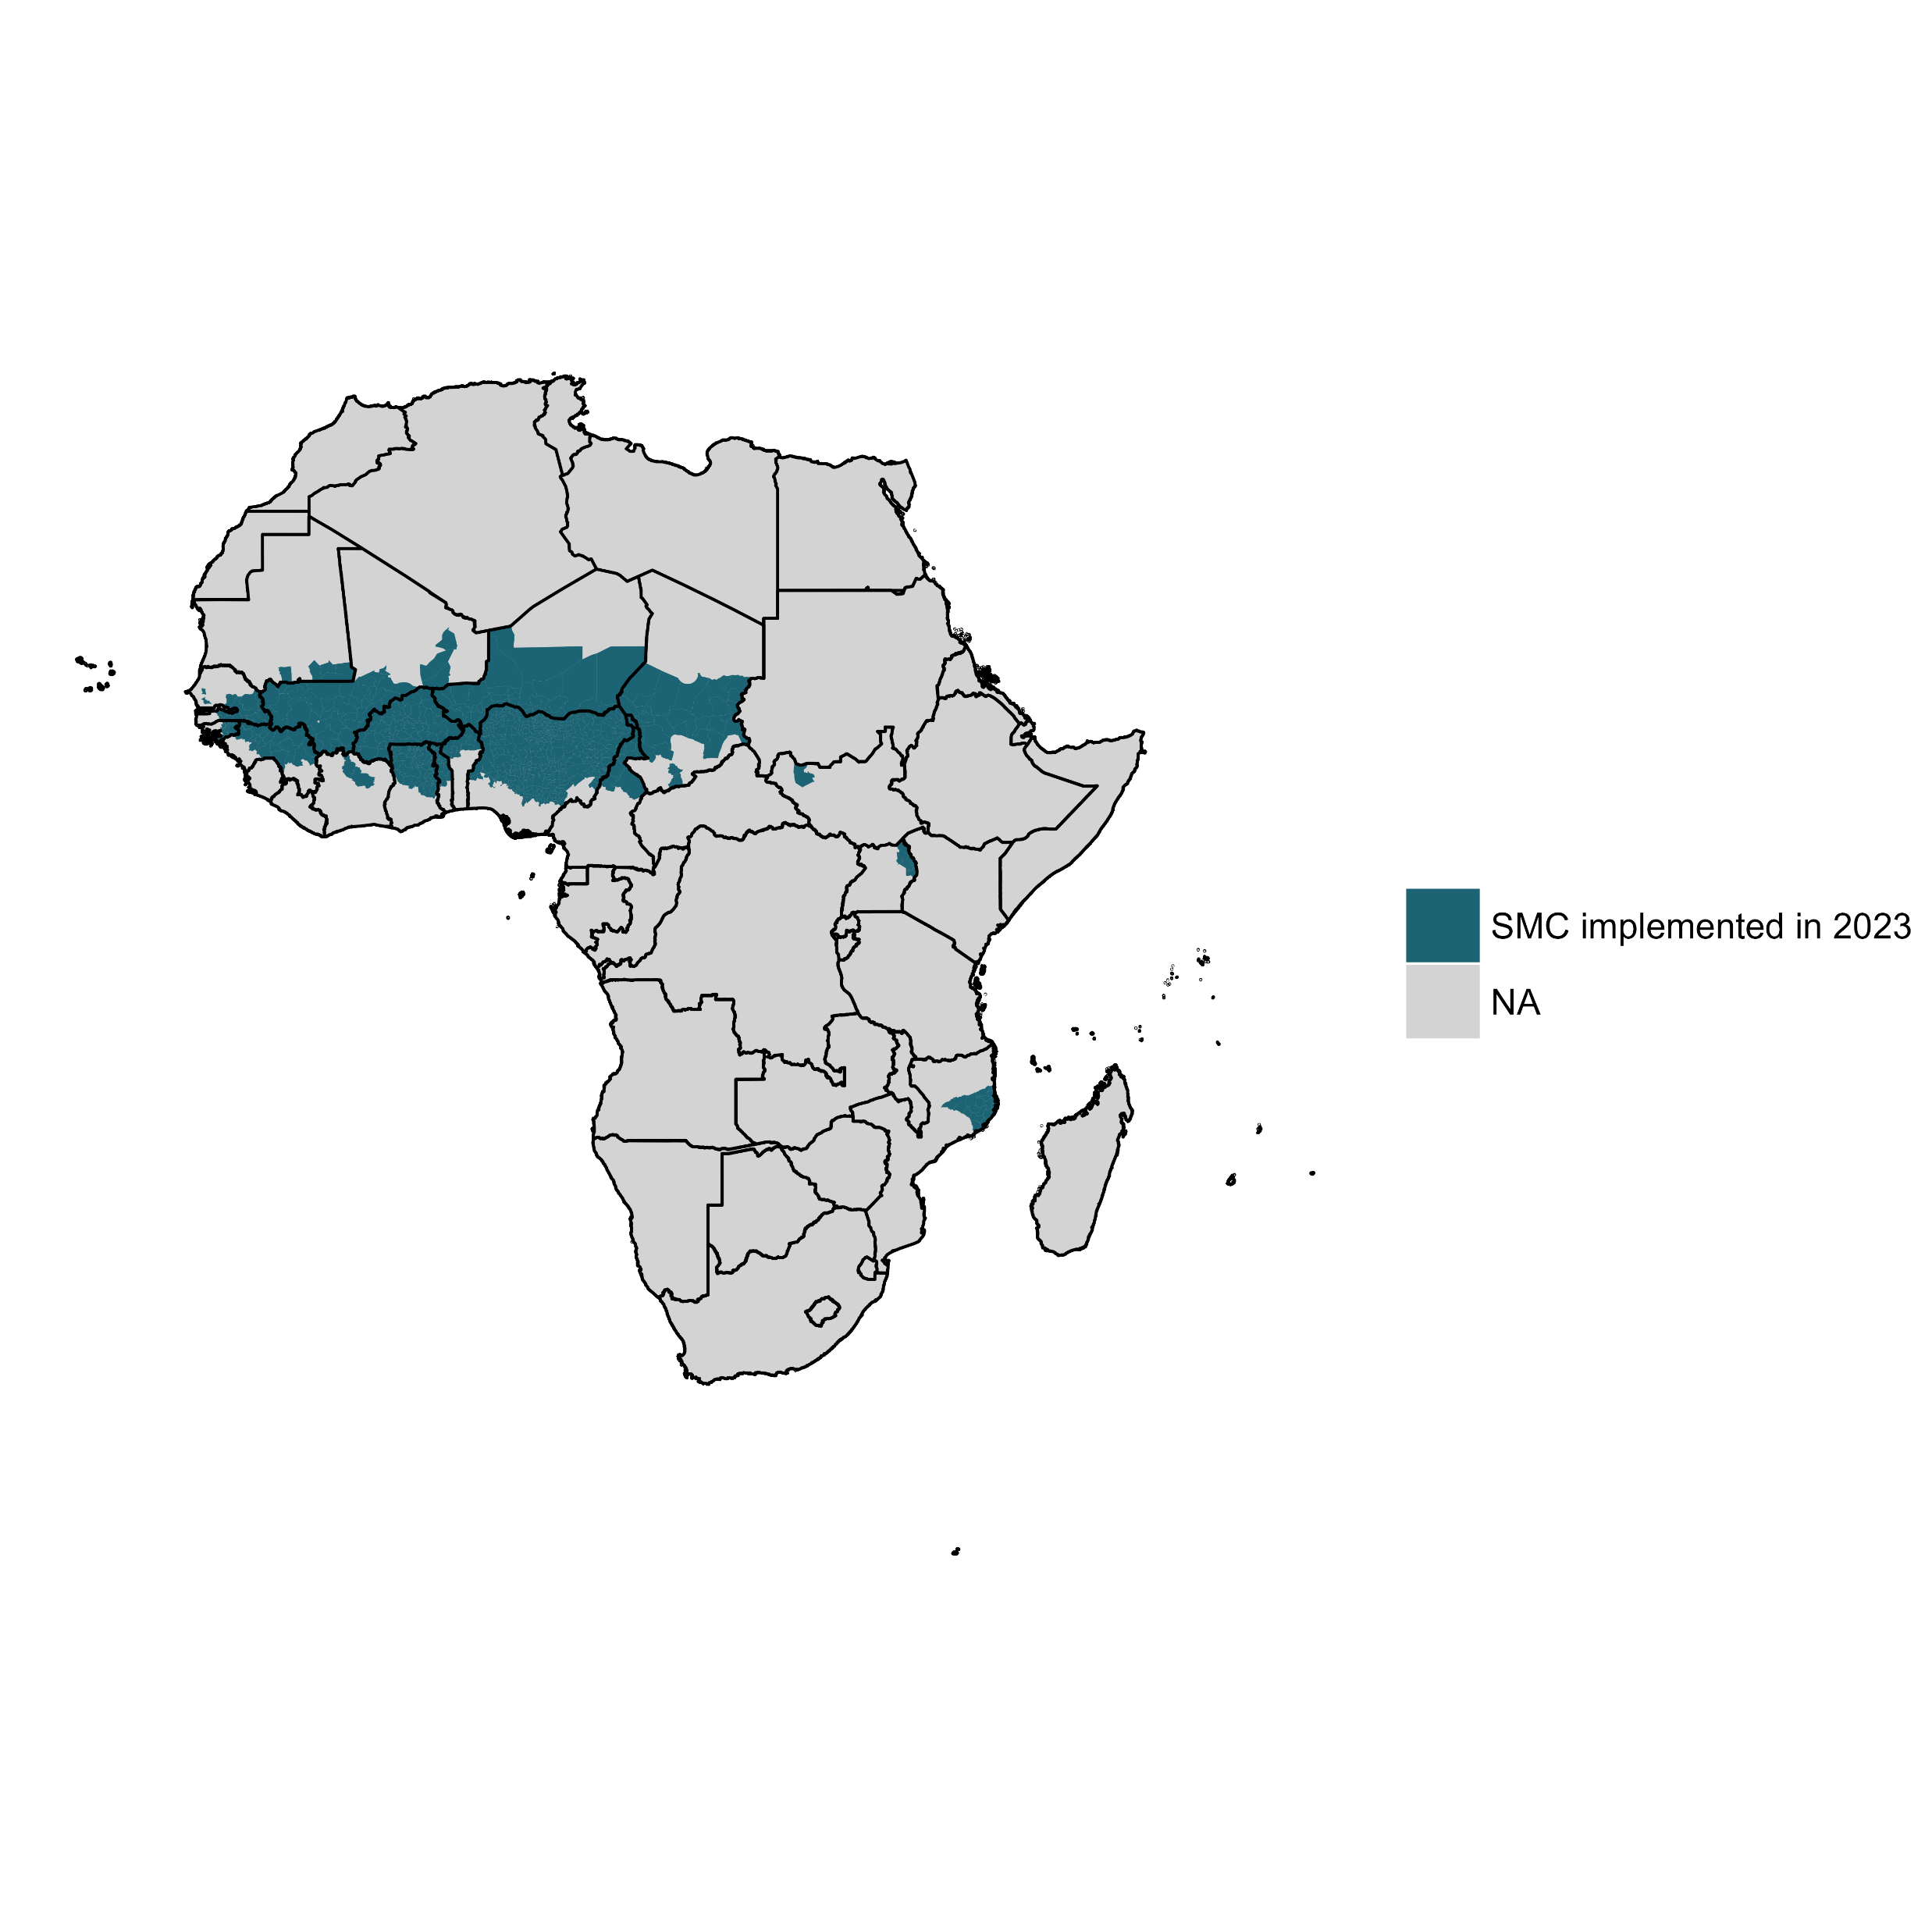
Context and justification
SMC implementing zones in 2023
Malaria transmission is moderate or high in a large swath of Africa
20 million children under 2 live in admin-1 regions where SMC is implemented

Slide 3
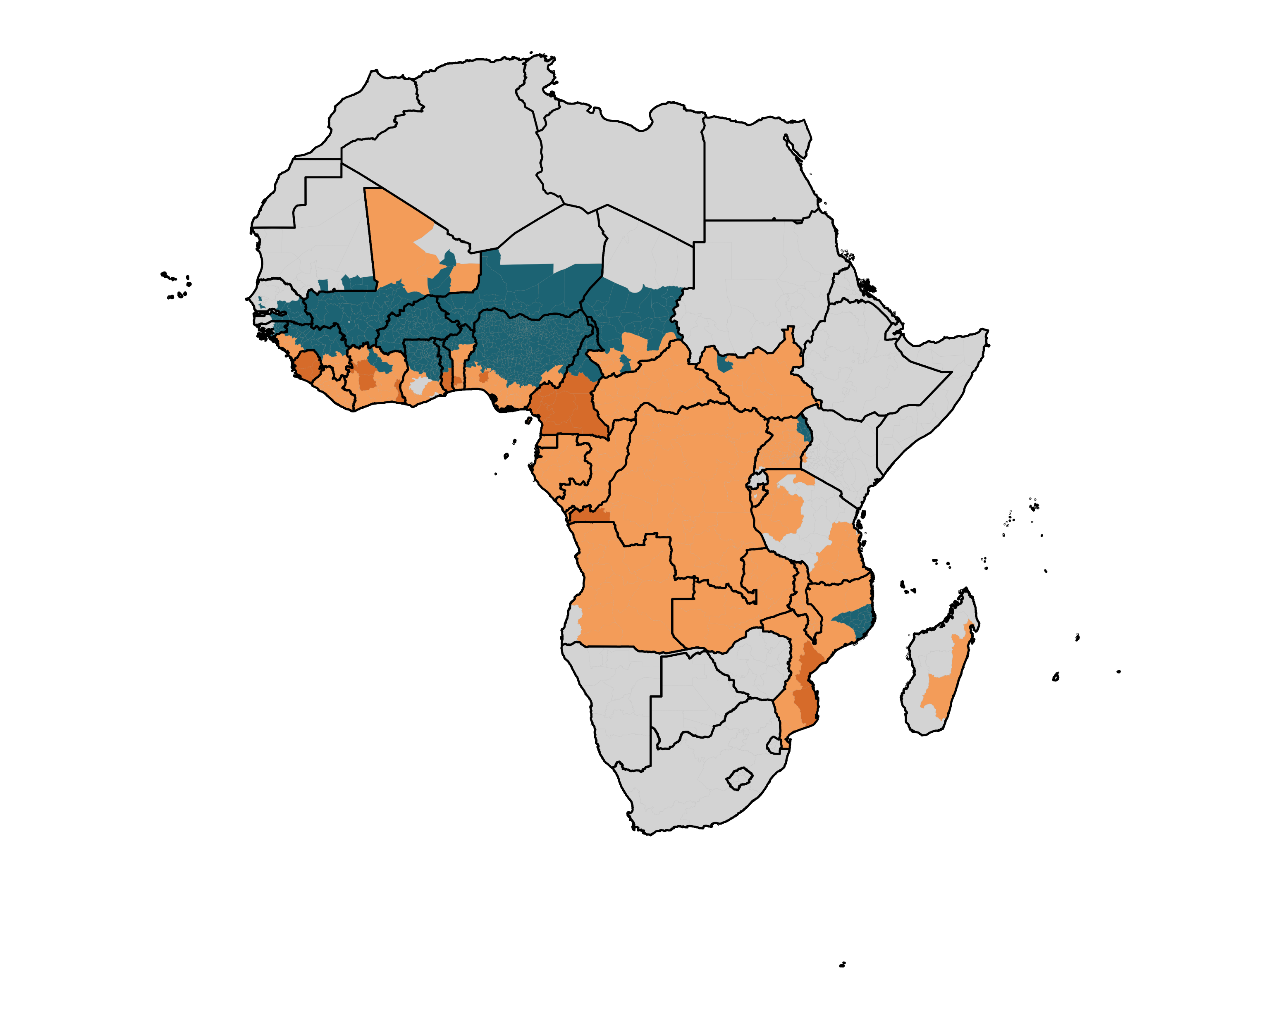
Context and justification
SMC implementing zones in 2023
PMC implementing zones in 2023
Moderate/high transmission areas (≥0.10% PfPR2-10)
39 million children under 2 in 25 countries live in admin-1 areas with moderate to high transmission without SMC.
Of these, less than 4 million live in admin-1 areas with PMC.
>35 million children could be eligible for PMC but do not have access to it.
PMC should be considered as an additional control tool in the following areas

Slide 4
What is Perennial Malaria Chemoprevention?
In areas of moderate to high perennial malaria transmission, children belonging to age groups at high risk of severe malaria can be given antimalarial medicines at predefined intervals to reduce disease burden.
PMC schedules should be informed by the age pattern of severe malaria admissions, the duration of protection of the selected drug, and the feasibility and affordability of delivering each additional PMC course.
SP has been widely used for chemoprevention in Africa, including for PMC. ACTs have been effective when used for PMC, but evidence is limited on their safety, efficacy, adherence to multi-day regimens, and cost-effectiveness in the context of PMC.
Previously, PMC was recommended in infants (<12 months of age) as IPTi. Since the initial recommendation, new data have documented the value of malaria chemoprevention in children aged 12 to 24 months.
The EPI platform remains important for delivering PMC. Other methods of delivery can be explored to optimize access to PMC and integration with other health interventions.
Moderate to high perennial malaria transmission settings are defined as areas with P. falciparum parasite prevalence greater than 10% or an annual parasite incidence greater than 250 per 1000. These thresholds are indicative and should not be regarded as absolutes for determining applicability of the PMC recommendation.
Source: WHO guidelines for malaria - 16 October 2023 (magicapp.org)

Slide 5
What is the medicine used? Pediatric dispersible SP
There are five manufacturers that are prequalified for SP dispersible tablets 12.5mg/250mg for PMC
https://extranet.who.int/prequal/medicines/prequalified/finished-pharmaceutical-products.
Product Type | Dosage Form | Basis of Listing | Date of PQ
Pyrimethamine/Sulfadoxine Tablet, Dispersible 12.5mg/250mg | S Kant Healthcare Ltd. | Tablet, Dispersible | 12 Apr, 2021
Pyrimethamine/Sulfadoxine Tablet, Dispersible 12.5mg/250mg | Macleods Pharmaceuticals Ltd | Tablet, Dispersible | 1 Jul, 2021
Pyrimethamine/Sulfadoxine Tablet, Dispersible 12.50mg/250mg | Universal Corporation Ltd | Tablet, Dispersible | 22 Aug, 2022
Pyrimethamine/Sulfadoxine Tablet, Dispersible 12.50mg/250mg | Guilin Pharmaceutical Co Ltd | Tablet, Dispersible | 30 Jul, 2023
Pyrimethamine/Sulfadoxine Tablet, Dispersible 12.50mg/250mg | Ipca Laboratories Ltd | Tablet, Dispersible | 25 Apr, 2024
Age | Weight | SP 250/12.5mg tablet Dispersible | Route of administration
0-1 year old | Less than 5Kg | ½ tablet | Oral
 | 5 to 10 kg | 1 tablet | Oral
1-2 year old | 10 to 25Kg | 2 tablets | Oral

Slide 6
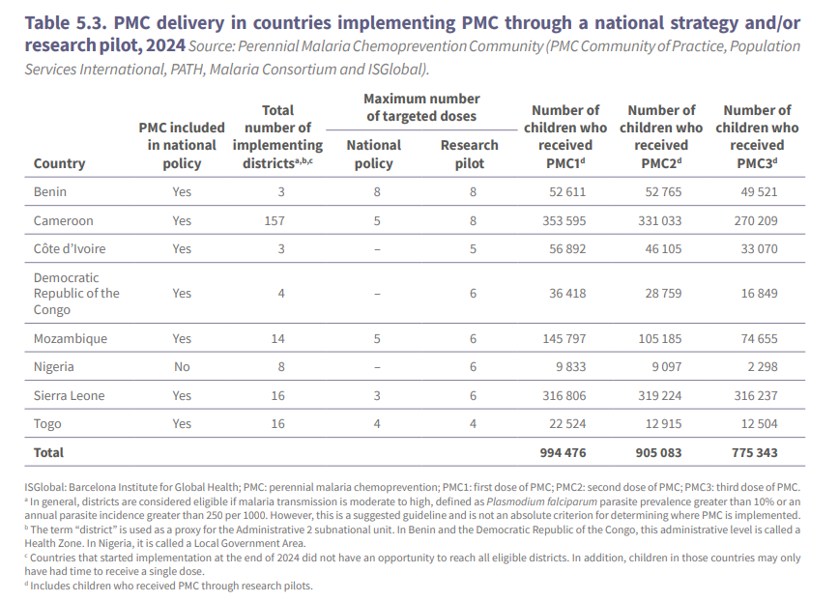
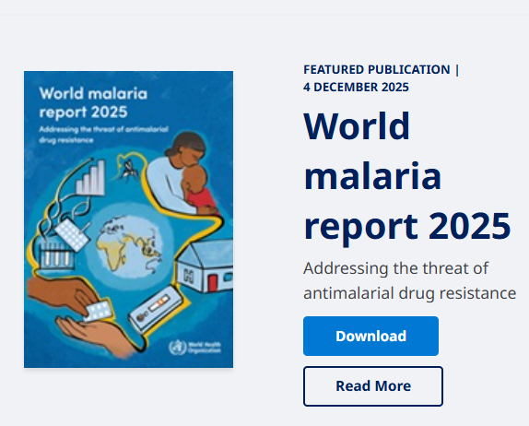
Which countries already implement PMC?

Slide 7



What is the PMC Community of Practice?
A collaborative platform for National Malaria Programs, Expanded Programs on Immunization, implementation partners and other stakeholders.
Aims to support the adoption and implementation of PMC across countries.
Objectives:
Exchange plans, lessons learnt, and good practices regarding PMC implementation
Discuss PMC implementation research evidence
Share resources to support PMC implementation
Current activity: The PMC COP was asked by WHO GMP to centralize and send PMC data for the World Malaria Report 2026
Chair:
Dr. Junior Voundi Voundi, NMCP Cameroon
Secretary:
Ms. Charlotte Eddis, PSI ceddis@psi.org
Biweekly Secretariat meetings: Fridays at 9am Abidjan / 10am Geneva
Secretariat Members:

Slide 8
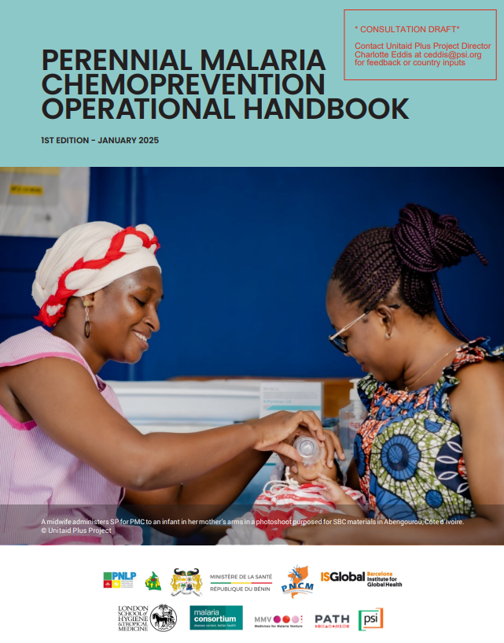
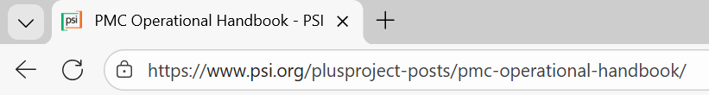
The PMC COP developed an Operational Handbook
A comprehensive operational guide for PMC planning, implementation, monitoring, and integration into national health programs
Based on experiences and lessons learned from ongoing PMC projects and programs across countries
Available in English, French and Portuguese

Slide 9


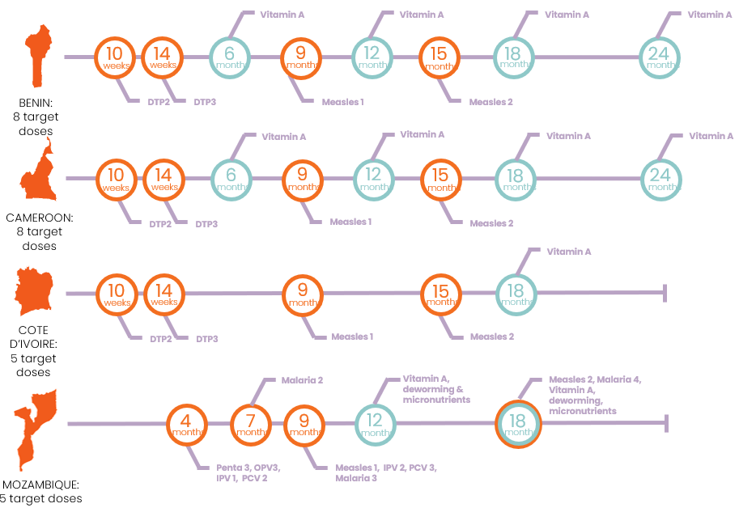
The 4 Plus Project Focus Countries chose the following schedules Note the 1st vs 2nd year of life contacts (and EPI vs vit A)
First year of life (0-11 months)
Second year of life (12-24 months)
Notes:
The more important thing to observe here is that each country adopts his calendar according to its capacity of ordering SP, coverage, opportunities to catchup and more informed by the age pattern of severe malaria
You can note that at the 2nd yol, the contacts are more aligned to vit A because of the hard-to-reach group age through the EPI

Slide 10
PMC doses administered during life of project
Every Project-supported country has reached some children with all doses per their respective schedules, but as children age, they fall off the schedule…

Slide 11
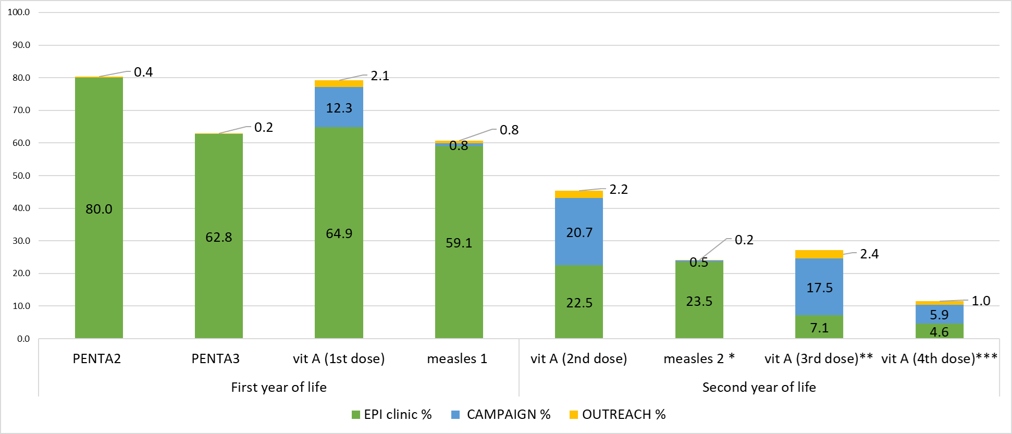
…as expected, because at baseline in Cameroon, this is what co-intervention coverage looked like
Notes:
Difference between coverage of individual dose and cumulative doses is due mostly by vit A being delivered by “nutrition and child week” (and not recorded in vaccination cards). 27% (82%-55%) of children receiving the first dose of vitamin A hadn’t received DPT2 & DPT3 (this is a potential way that could be used to find zero dose or dropped out children)
From our baseline it seems that the proportion of vaccines received by outreach delivery method is very low. Need to see if it is the same is happening in CdI/ Benin and at end of the study evaluations (we expect differences, seeing the support of PSI to outreach interventions)

Slide 12
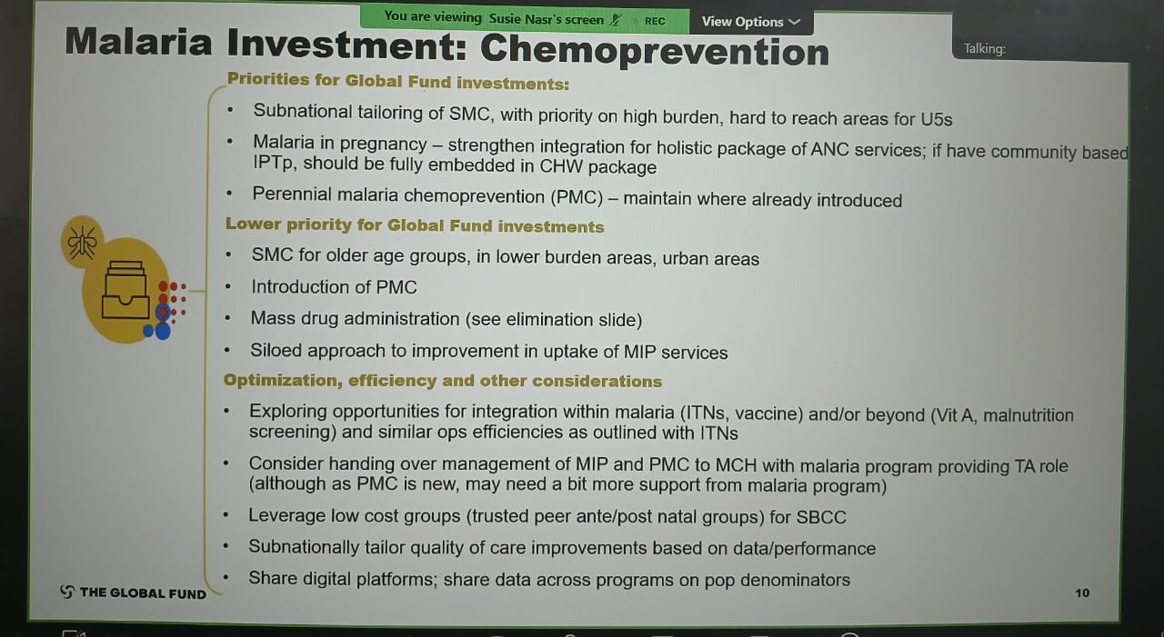
The Global Fund will pay for PMC in GC8

Slide 13
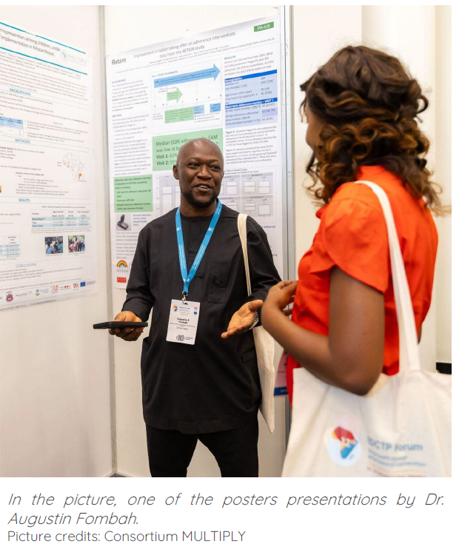
For more information…
There are 4 sessions which will share updates on PMC
The upcoming M&E session will describe PMC M&E in greater detail
The upcoming Research session will include the impact of genotype mutations on resistance to SP and SPAQ in Cameroon
Tomorrow morning there will be a session on the PMC Compass, a tool that incorporates a variety of research outputs to generate a ranked list of districts where PMC is likely to be cost-effective
Tomorrow morning there will be a panel on how Cameroon, Nigeria and Sierra Leone have increased uptake in the 2nd year of life
Any country that is interested in implementing PMC is invited to reach out to the PMC COP for support and acknowledgement

Slide 14




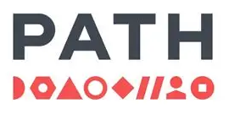




Acknowledgement…
All the MoH & NMCPs…
Working groups of the CoP for their contributions
WHO for the support and opportunity in the WMR
Technical partners PSI, LSHTM, Malaria Consortium, MMV, WHO, ISGlobal, PATH…
PLUS project, MULTIPLY project…
Unitaid, GiveWell, EDCTP and Gates Foundation for the financial support

