Slide 1
Intermittent preventive treatment in school-age children (IPTsc)
Overview 2025
Lauren Cohee, MD MS
Chemoprevention Alliance 2026, Uganda

Slide 2
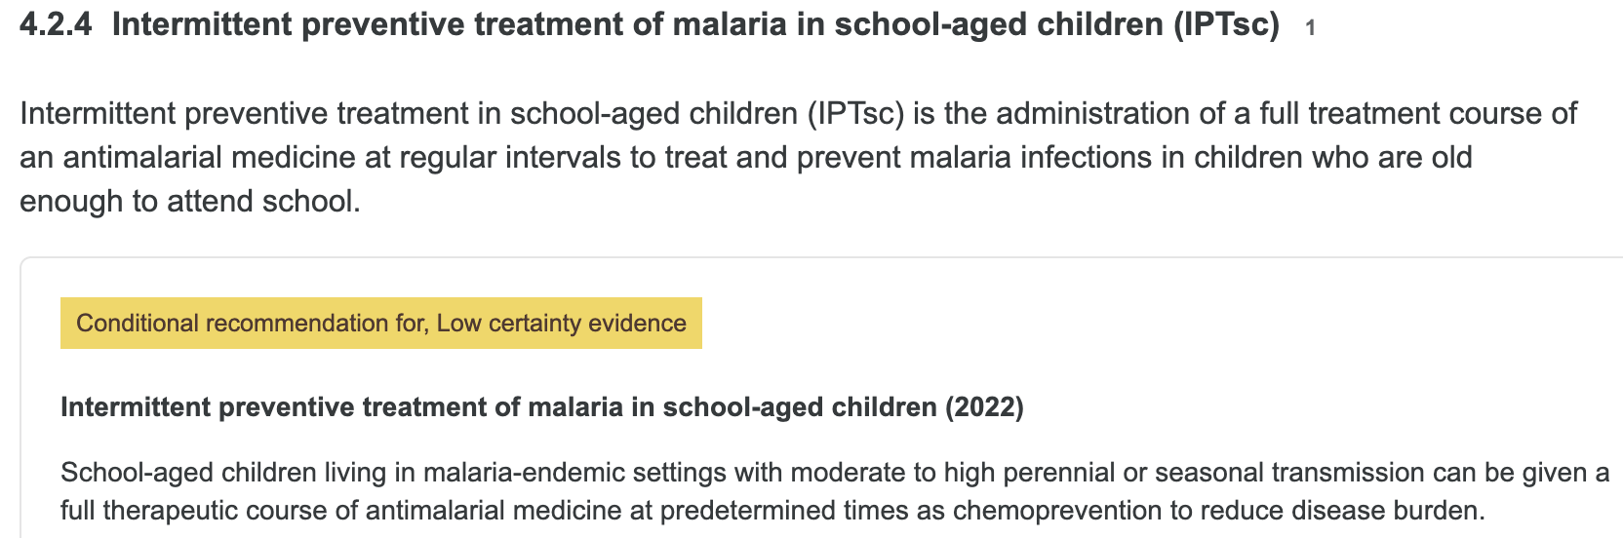
IPTsc Guidelines
Chemoprevention targeting school-aged children is:
Extended-age SMC – If SMC IS also provided to younger children
IPTsc – If SMC is NOT provided to younger children
WHO Guidelines for Malaria

Slide 3
Current Status of IPTsc in 2024-5
Country | IPTsc in national policy | Total # districts/sites |  | Max # annual doses |  | Total children received IPTsc
 |  | Programmatic implementation | Research pilot/study | Programmatic implementation | Research pilot/study | Programmatic implementation | Research pilot/study
Tanzania | Yes | 5 | - | 3 | - | 159,438 | -
Nigeria | No | 0 | 2 | - | 4 | - | 816
Burkina Faso | No | 0 | 1 | - | 4 | - | 6,512
Uganda | Yes | 0 | 1 | - | 3 | - | 5,408
Malawi | No | 0 | 1 | - | 4 | - | 788
TOTAL |  |  |  |  |  | 159,438 | 13,524
Thank you to: Dr. Geofrey Makenga and NMCP Tanzania, Drs. Nnenna Ogbulafor, Emmanuel Shekarau NMEP Nigeria, Dr. Aissata Berry Burkina Faso SP/Palu, Dr. Jane Achan Malaria Consortium, Dr. Jane Nabakooza NMED Uganda

Slide 4
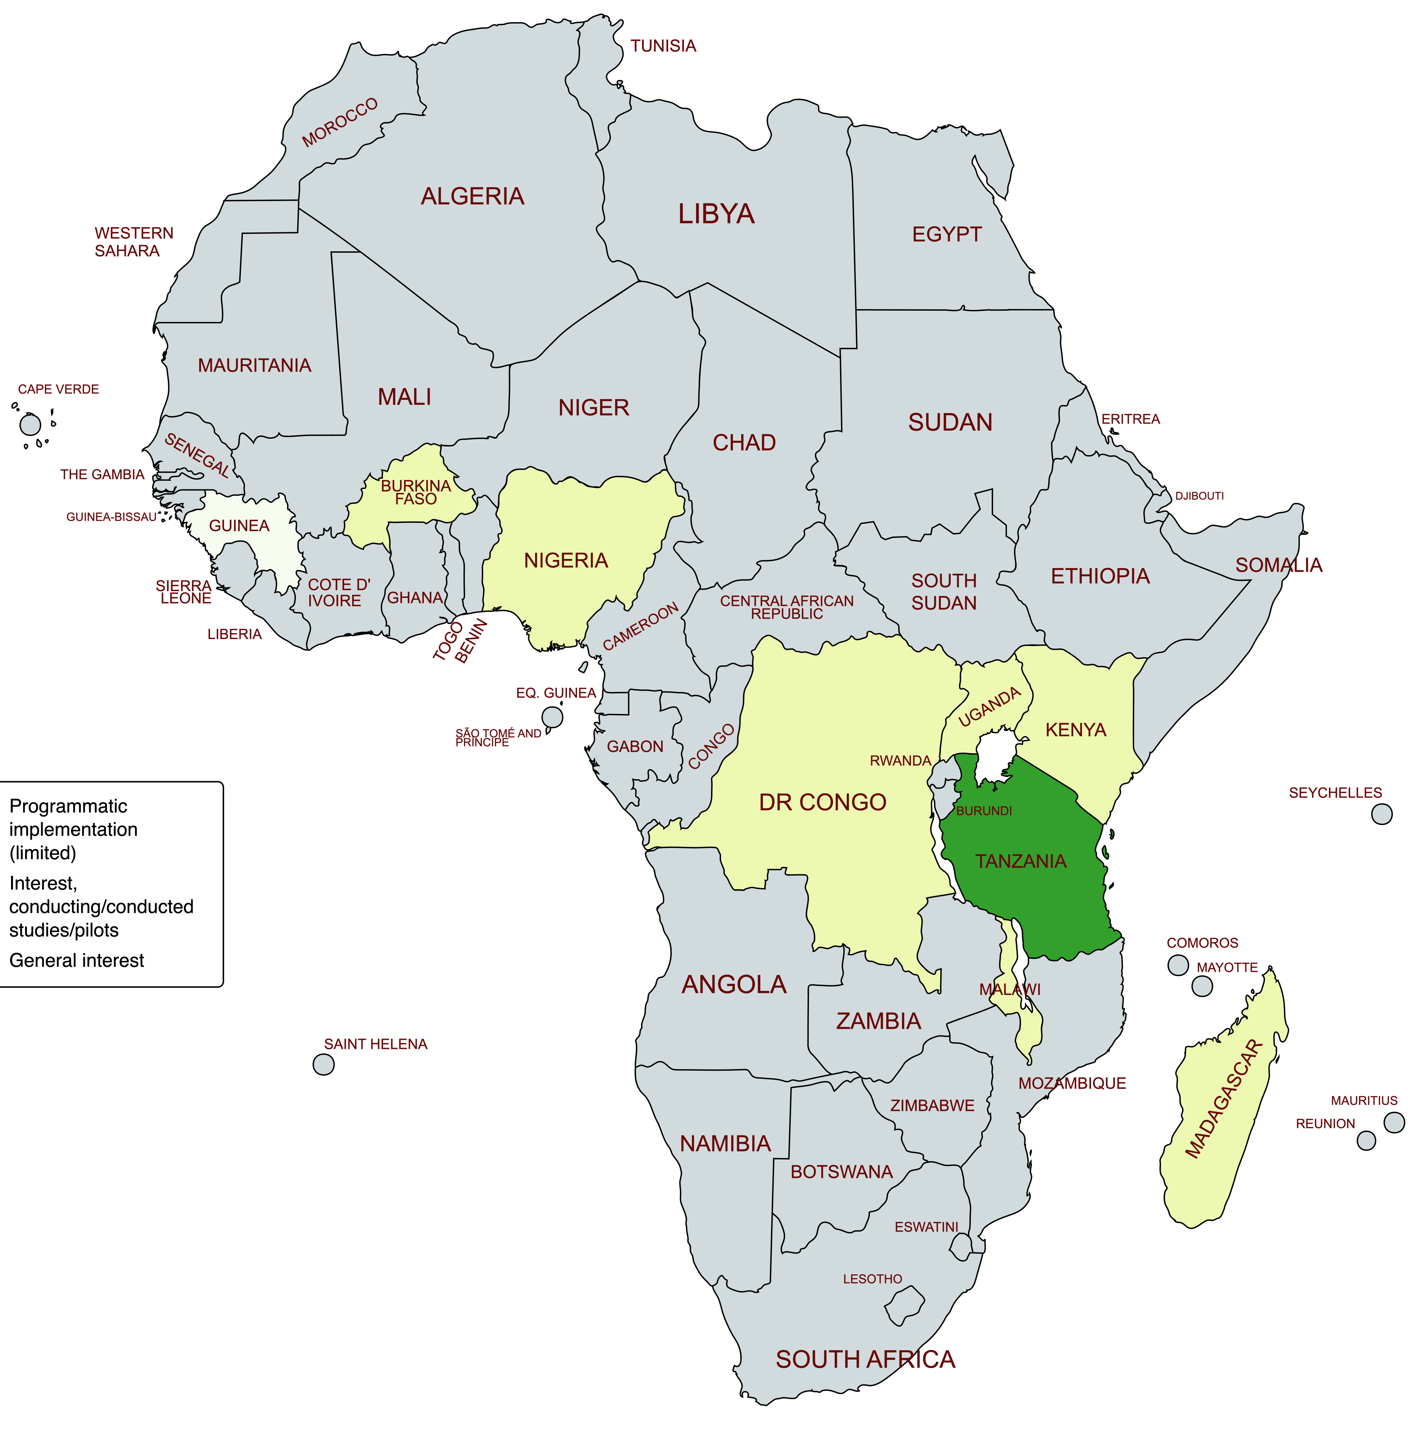
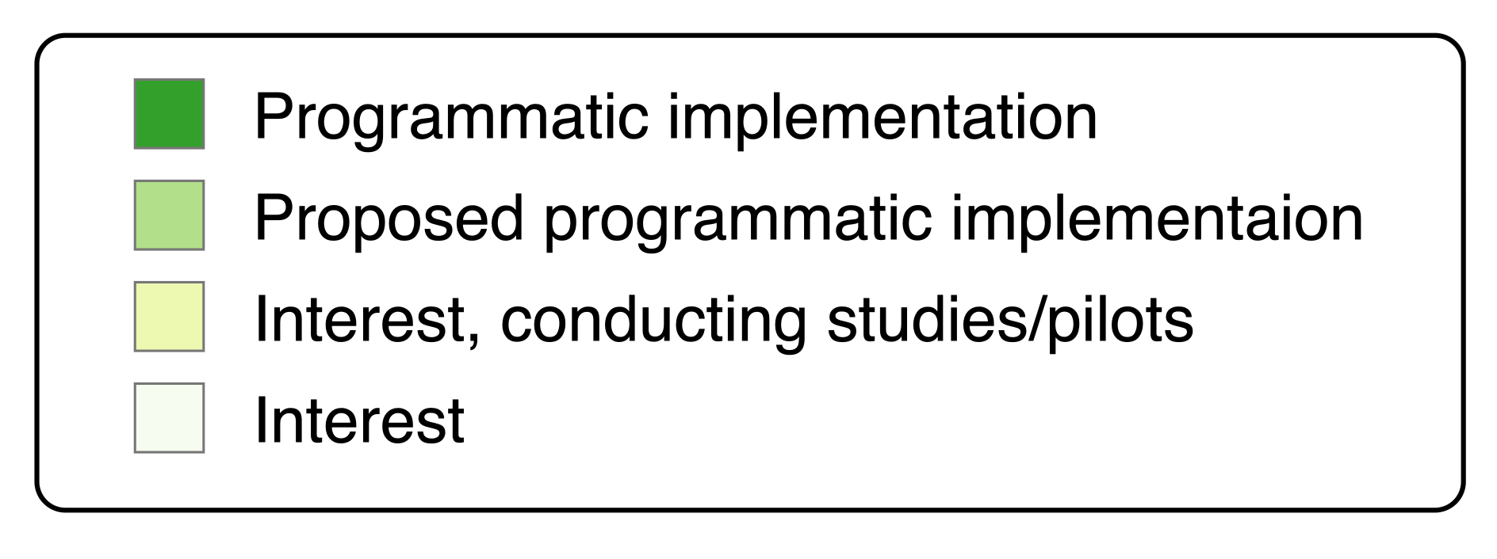
Summary of IPTsc programs and recent or planned research
Cluster randomized trial
to evaluate transmission impact
Dihydroartemisinin-piperaquine
Twice per school term (6 times/yr)
2026-8
Cluster randomized trial to evaluate
impact on incidence, compare drugs
15 villages (SPAQ, DP+IVM, control)
4 doses during transmission setting
Programmatic implementation
School-based, teacher delivered
Dihydroartemisinin-piperaquine
Once per school term (3 times/yr)
Randomized research/pilot to assess feasibility,
acceptability, and drugs
School-based, teacher delivered
SPAQ monthly, DP every 2 months, control
During peak transmission season
Individually randomized trial
to compare drugs
School-based, study delivered
SPAQ, DP, or control
Twice per school term (4 times/yr)
Map being developed by LEARN Malaria network;
created with mapchart.com

Slide 5

Why is implementation limited?
$
Funding
Knowledge gaps and economic analyses to inform prioritization
  Quantification of disease burden
  Impact on transmission
  Learning loss
Limited support for tailoring interventions to setting
Concerns about drug resistance
Economic analyses,
Prioritization (SNT)
Notes:
Elephant w $

Slide 6
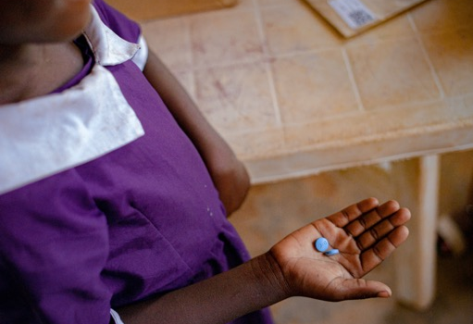


Critical next steps
Age-disaggregated data on disease to inform prioritization and funding
Harmonization across ext-age SMC and IPTsc for evidence generation and advocacy
Trials evaluating transmission and education
Alternative drugs, mAbs, vaccines
Leveraging Evidence and Advocacy to Reduce the burdeN of malaria in school-age children for broader coverage
and brighter futures
Join us:
Learn.malaria@lstmed.ac.uk

