Slide 1
Malaria Chemoprevention Alliance
Monitoring & Evaluation Sub-Group
Sub-group updates &
Integrating chemoprevention indicators into
the national M&E Framework
SMC Alliance Annual Meeting
Kampala, Uganda
M&E Sub-Group of the Chemoprevention Alliance
For questions or feedback, email: suzanne.vanhulle@cr.org or josepheddykipkoech@gmail.com

Slide 2

Agenda
  M&E Sub-group updates (5 mins)
  Overview of the existing SMC M&E Framework (including Q&A) (10 mins)
  Overview of PMC M&E from the PMC Community of Practice (including Q&A) (20 mins)
  Overview of IPTsc M&E Framework development (including Q&A) (15 mins)
  Discussion and feedback on 3 priorities for M&E sub-group for 2026 (35 mins)
  Wrap up and next steps (5 mins)

Slide 3
Sub-group updates
  Changes in funding environment slightly changed the composition of the sub-group including its focus. The sub-group has suggested the following key activities for 2026 (to be validated today by countries and partners):
    Initiative to have a ‘dictionary for SMC, PMC and IPTsc performance indicators’ or one common document for these indicators for easy access by countries
    Gathering sample country-level data collection tools for peer learning and exchange across countries. Tools would eventually be linked to indicators in the dictionary as example of tools that can be used to inform indicators.
    Organize a series of webinars

Slide 4
Overview of SMC M&E Framework
  Presenter: Suzanne Van Hulle, co-chair Malaria Chemoprevention Alliance M&E sub-group

Slide 5
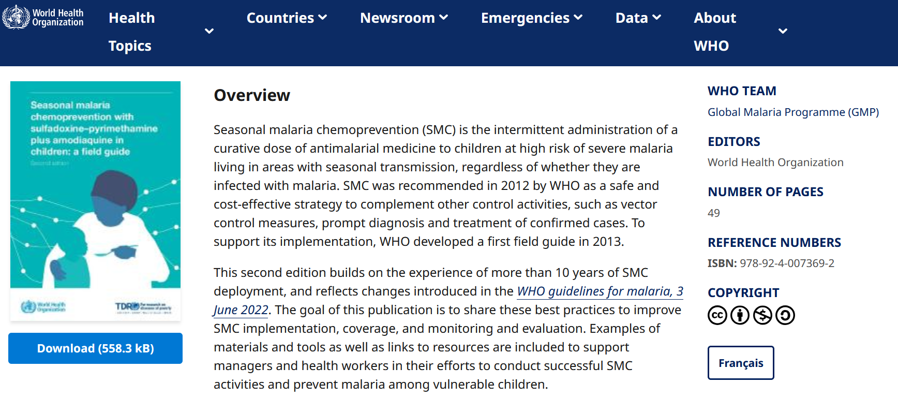
SMC M&E Performance Framework –
Available within the WHO SMC Field Guide (French + English)
  https://www.who.int/publications/i/item/9789240073692

Slide 6

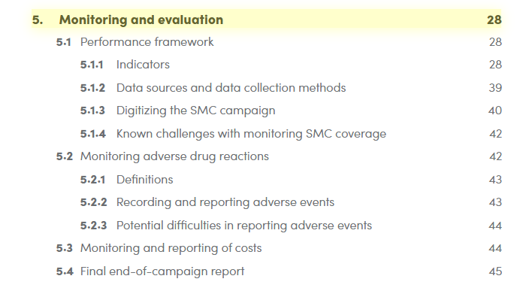
SMC M&E Performance Framework –
Available within the WHO SMC Field Guide (French + English)

Slide 7
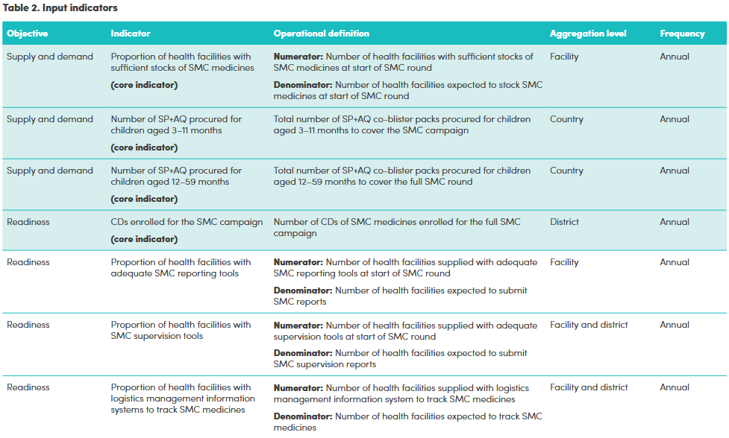
SMC M&E Performance Framework – Indicators
  SMART indicators categorized as either input, output, outcome, or impact indicators.
  Each indicator shows what is being measured, how, where and when.
  Indicators shaded in turquoise are considered as “core indicators” – those that should ideally be tracked by all malaria programmes implementing SMC

Slide 8
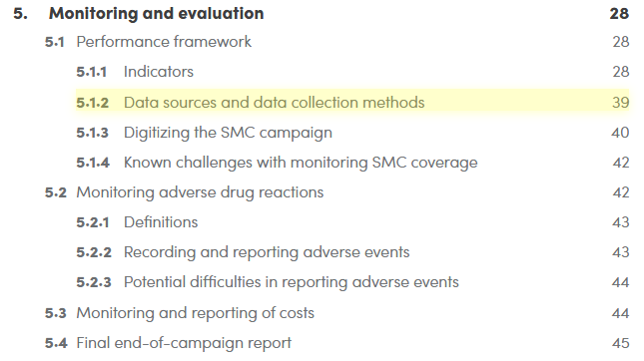
SMC M&E Performance Framework –
Data source & data collection methods
  Mix of routine administrative data & post-cycle or post-round household surveys
  Data source depends on whether tools are digitalized or paper-based

Slide 9
Opportunities for efficiencies &
challenges across malaria chemoprevention interventions
  Opportunities for efficiencies
    Several core indicators for SMC are similar to those for PMC and IPTsc – Examples: Readiness indicators on funding availability, supply needs (availability of drugs and stock-outs) and demand (SBC-related)
    Efficiencies can be gained with consolidating information and data
  Continuing challenges
    Age disaggregation for older children (5-10 years) at risk of severe malaria

Slide 10

Perennial Malaria Chemoprevention M&E
Dr Jacques Kouakou, Deputy Project Director, Unitaid Plus Project, PSI
Baby Souleymane receiving his first dose of SP for PMC in Abengourou,
Côte d’Ivoire.
Photo credit: Unitaid Plus Project Côte d’Ivoire

Slide 11

PMC COP Operational Handbook
A comprehensive operational guide for PMC planning, implementation, monitoring, and integration into national health programs
Based on experiences and lessons learned from ongoing PMC projects and programs across countries
Available in English, French and Portuguese

Slide 12
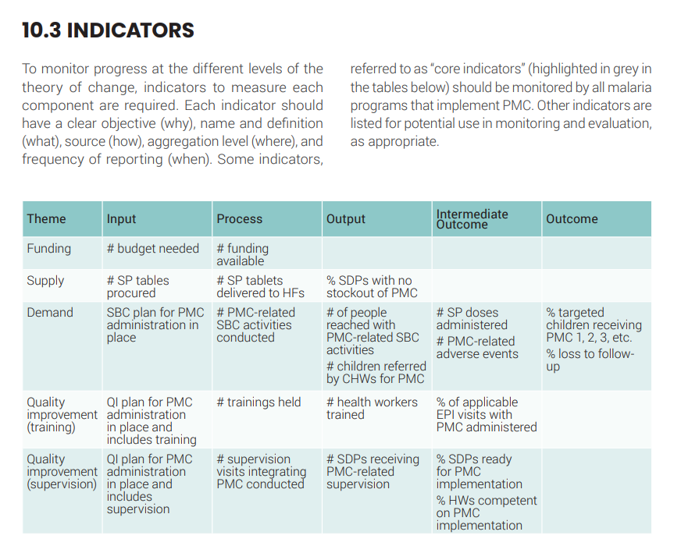
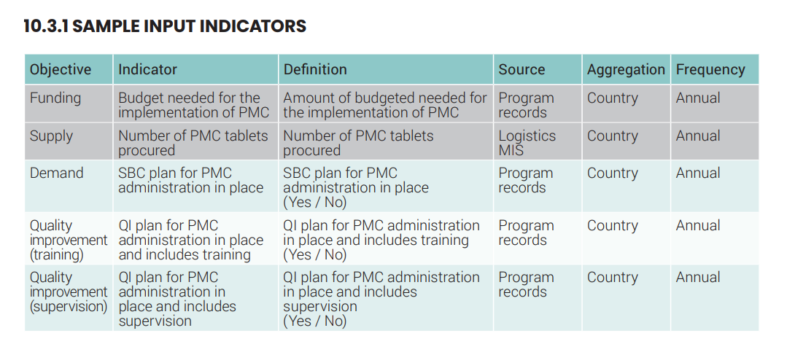
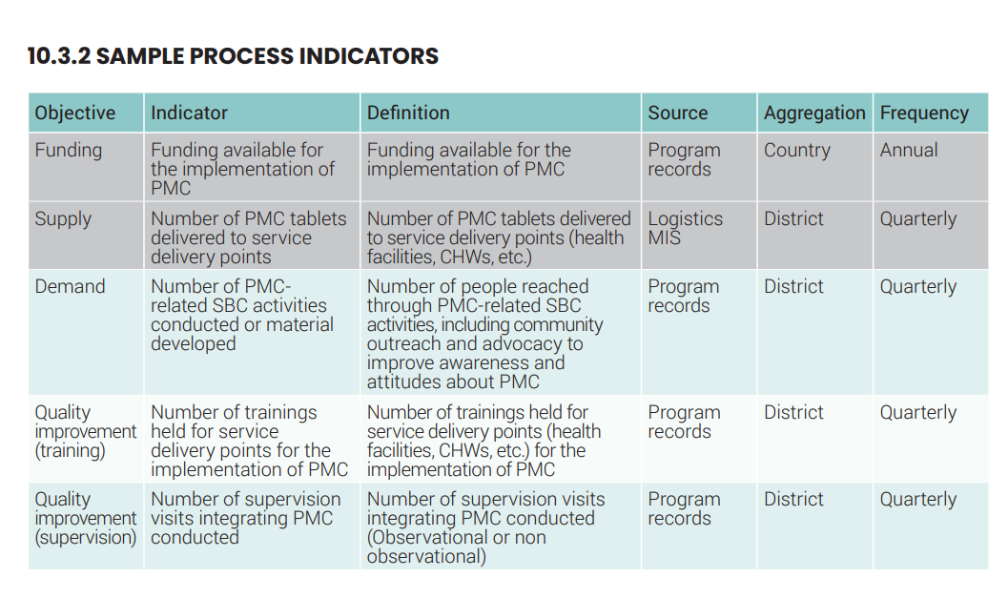
M&E Chapter of Operational Handbook (1/3)

Slide 13
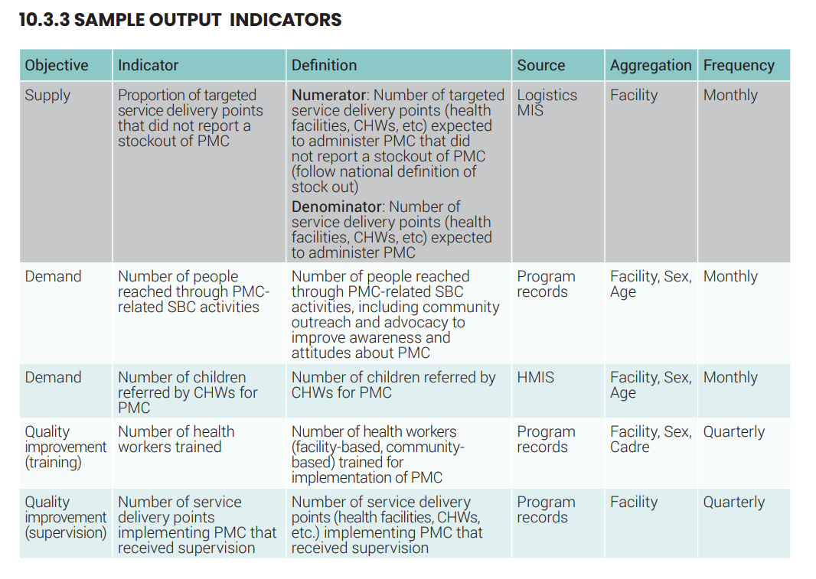
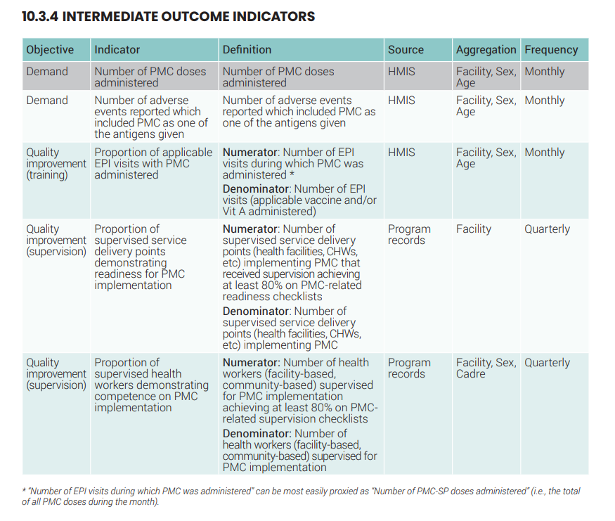
M&E Chapter of Operational Handbook (2/3)

Slide 14
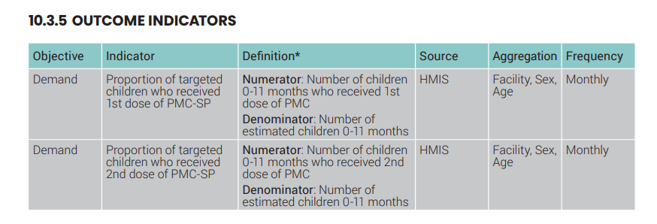
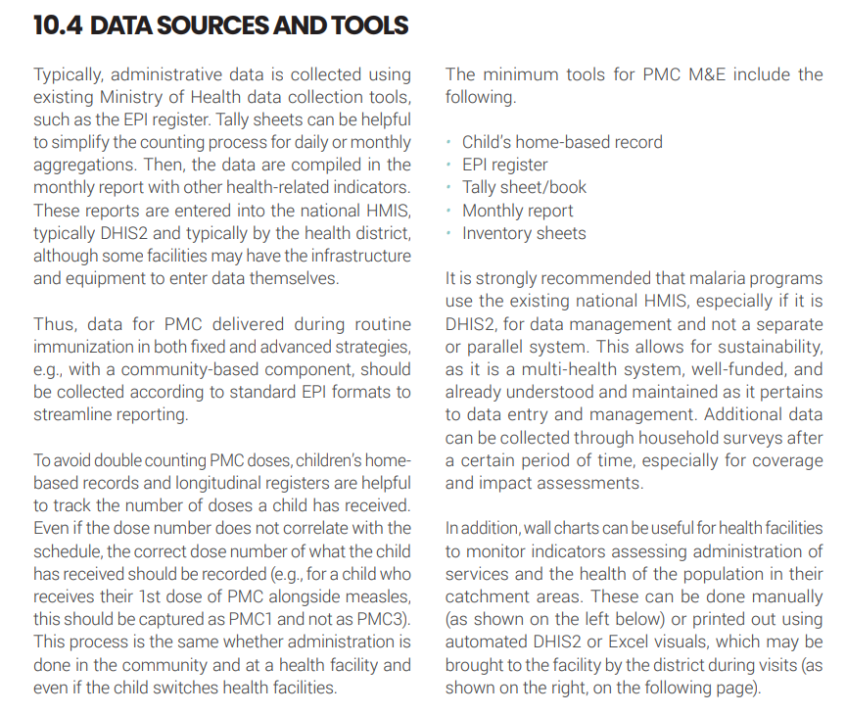
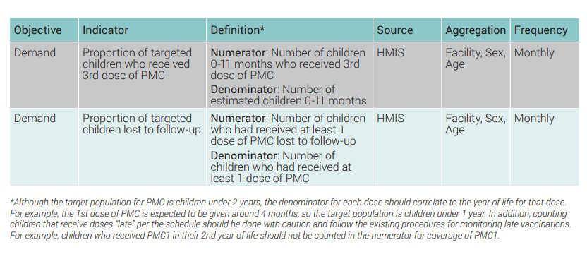
M&E Chapter of Operational Handbook (3/3)

Slide 15
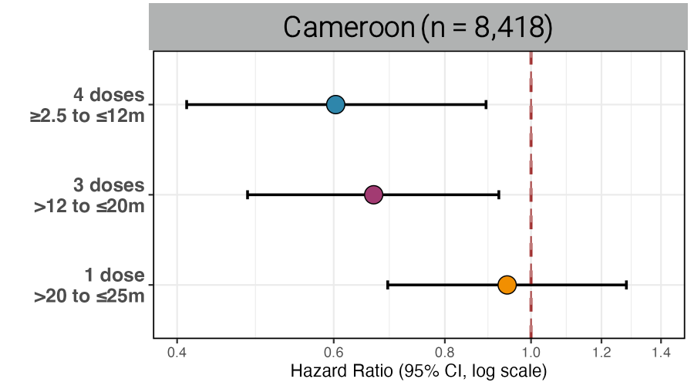
To measure PMC impact, age disaggregation is essential
Unitaid Plus Project saw a significant 40% & 33% reduction in Cameroon and Côte d’Ivoire respectively, among children eligible for SP (2.5-≤12 months) in intervention areas compared to non-eligible children (i.e. 0-2.5 month olds)
  We also saw a 33% reduction among >12 to 20 month olds in Cameroon, but not in 20-25 month olds

Slide 16
Data sources:
Components of the PMC delivery model in Cameroon
Co-interventions and schedule
PENTA-2
10 weeks
PENTA-3
14 weeks
VitA
6 m
*
*
*
MR 1
9 m
VitA
12 m
MR 2
15 m
VitA
18 m
VitA
24 m
* Plus Project Only
Community delivery of PMC
Delivered by CHWs to children >6 months who missed PMC dose, identified during home visits
Delivery channel, delivery point and health care provider
EPI- fixed (health facility)
Delivered by health workers
EPI- outreach strategy
Fixed health post, areas >5km from HF, delivered by health workers
Catch Up campaign- MR vaccine
Every 5 years/outbreak/coverage response, delivered fixed point
Child health & nutrition weeks- Vitamin A
2 per year, fixed point and door-to-door by HWs and CHWs, alongside other interventions

Slide 17
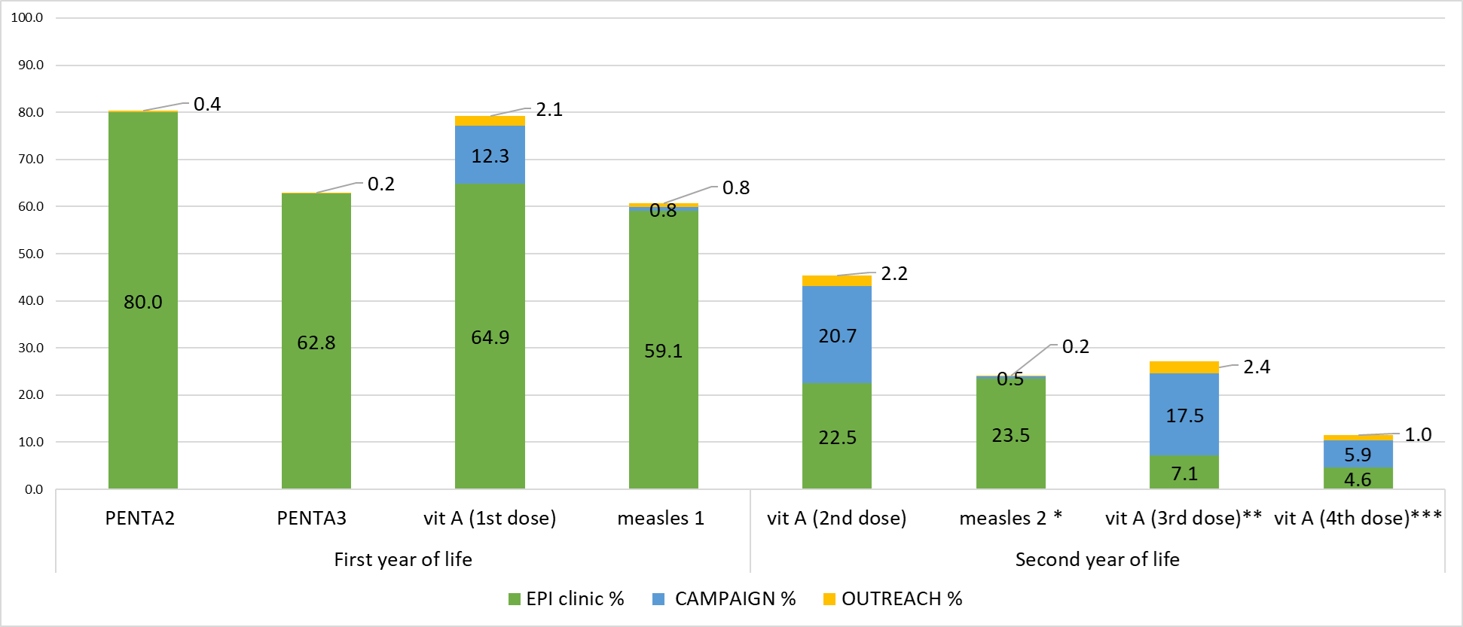
Location of PMC co-intervention and coverage before PMC was introduced ("readiness")
* Excluding the children younger than 15 months (denominator 1,049 instead of 1,199) ** Excluding the children younger than 18 months (denominator 898 instead of 1,199) *** excluding the children younger than 24 months (denominator 592 instead of 1,199)
Notes:
Difference between coverage of individual dose and cumulative doses is due mostly by vit A being delivered by “nutrition and child week” (and not recorded in vaccination cards). 27% (82%-55%) of children receiving the first dose of vitamin A hadn’t received DPT2 & DPT3 (this is a potential way that could be used to find zero dose or dropped out children)
From our baseline it seems that the proportion of vaccines received by outreach delivery method is very low. Need to see if it is the same is happening in CdI/ Benin and at end of the study evaluations ( we expect differences, seeing the support of PSI to outreach interventions)

Slide 18
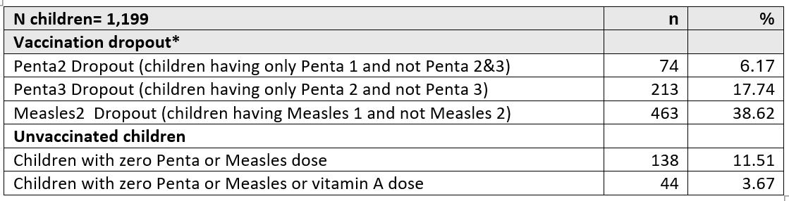
Note that at baseline (pre-PMC) in Cameroon, most “zero dose children” did get vitamin A in the community
*the proportion of children who did not get the subsequent vaccine among those who received the first vaccine
Zero dose children defined as children who did not receive any dose of Penta
...but vitamin A data tools in the community are not yet integrated with EPI
Notes:
Vaccination dropout was estimated as the proportion of children who did not get the subsequent vaccine among those who received the first vaccine. A generalized estimating equation was used to assess determinants of the dropout rate and findings were presented using an adjusted odds ratio with 95% confidence interval

Slide 19
Current Status of PMC M&E Country Systems
Indicators integrated within national HMIS/DHIS2 platforms.(Except CdI)
Data sources: facility registers, EPI tally sheets, CHW reports, stock and supervision tools.
Routine data review at district and national levels for validation and feedback.
Countries use adapted EPI tools / Healthy Child consultation register for PMC tracking.

Slide 20

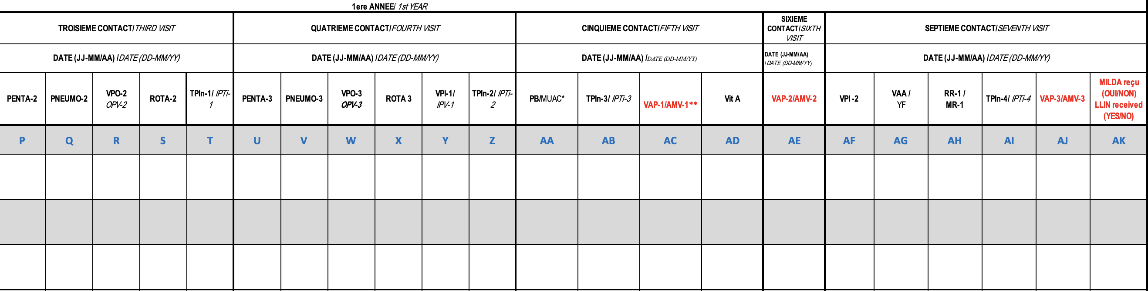

Co-implementation of RTS,S and PMC in Cameroon
2- Tally Sheet
1- Home based record
Integrated data collection and monitoring Tools
3- Register

Slide 21
Gaps identified
Fragmented reporting across EPI, malaria, and vitamin A channels.
Limited capture of data for second-year-of-life children, as many receive vitamin A and measles 2 in the community (catch up / child health campaigns).
Weak feedback loops between community and facility levels:
  Health data flow upward — from CHWs → health facilities → district → national level — but feedback rarely flows back down to the CHWs or community structures that generated the data
Limited pharmacovigilance linkage for SP adverse events (under reporting)

Slide 22
Integration opportunities
PMC with SMC: shared indicators (coverage, adherence, SP-AQ supply chain).
  In Cameroon, the NMCP is considering a single logistics quantification file that captures SP and SP–AQ consumption for both interventions, to align with the DHIS2 stock module.
PMC with IPTp/IPTsc/PDMC: harmonized DHIS2 modules and supervision tools :
  One training package covering data collection, pharmacovigilance, and stock tracking for all chemoprevention streams
Cross-program data review: joint dashboards under NMCP oversight.
Integration with EPI: leverage vaccination schedules to report PMC uptake:
  Add a PMC column in vaccination registers and child health cards
  Use EPI coverage maps to identify missed children (“zero-dose” and “PMC dropouts”)

Slide 23
IPTsc M&E
Lauren Cohee, MD, MS
Chair, LEARN Malaria Network
Liverpool School of Tropical Medicine
Chemoprevention Alliance
M&E Sub-group meeting
Annual Meeting 2026

Slide 24
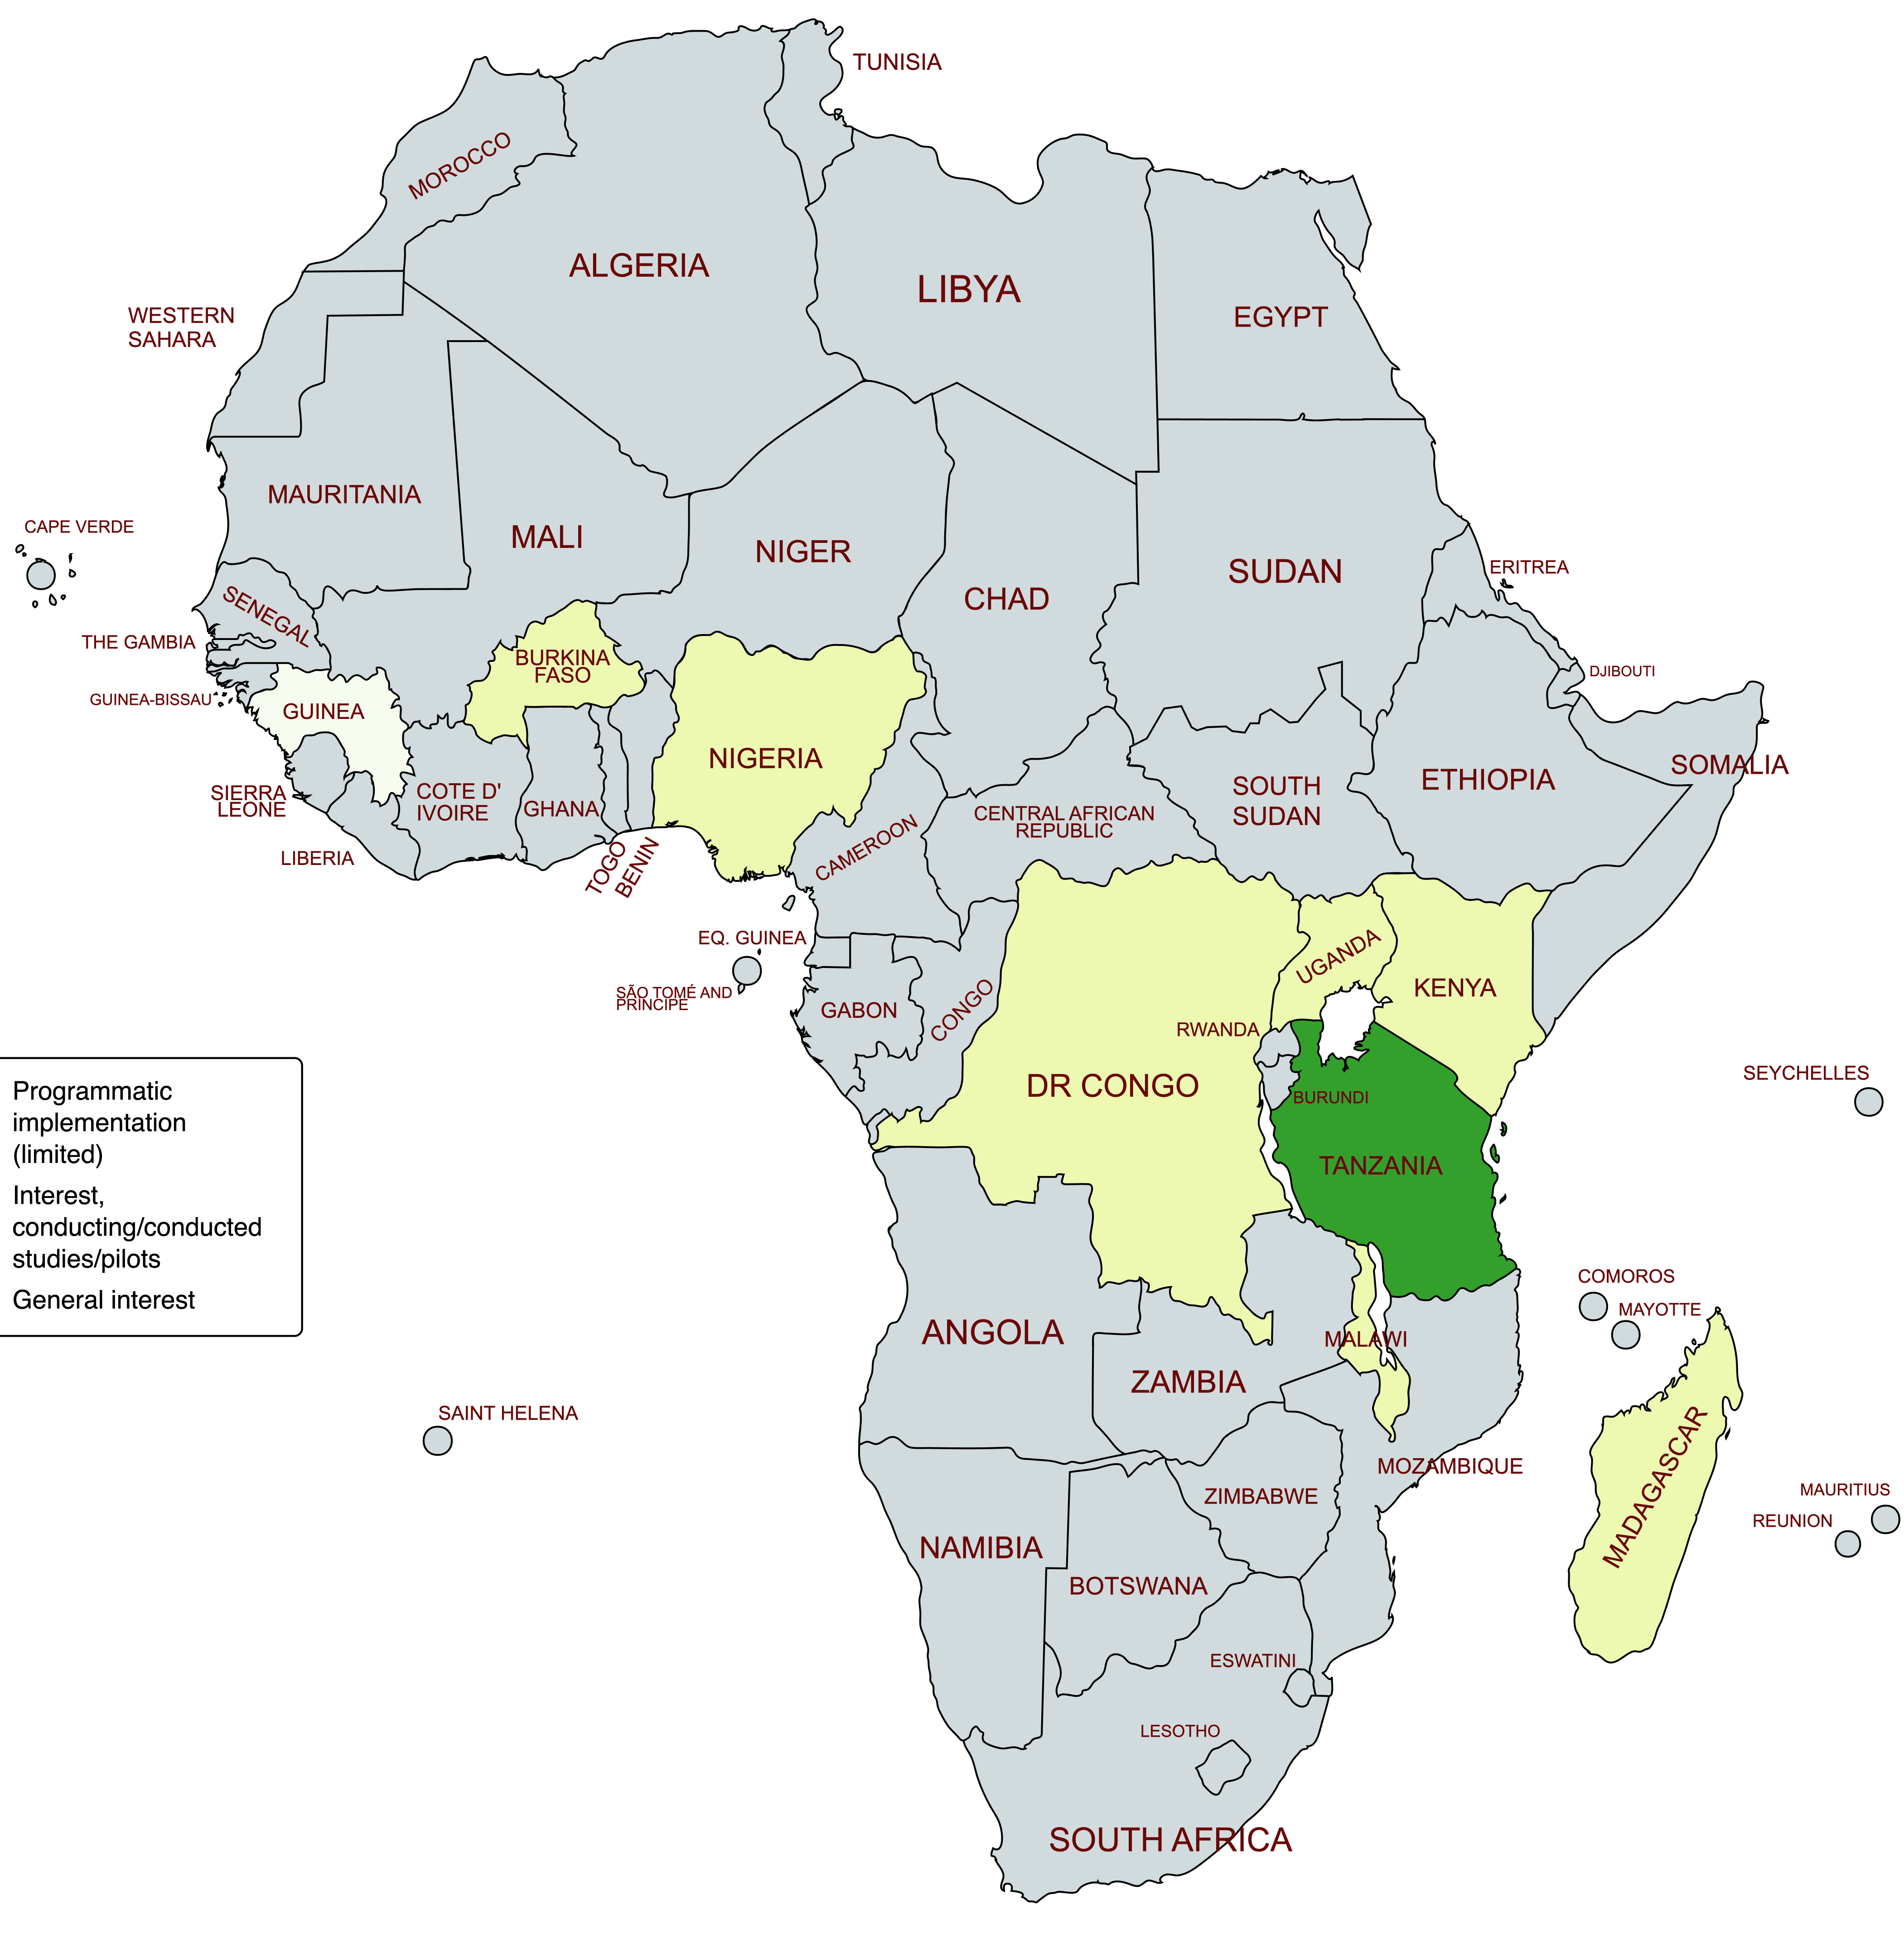
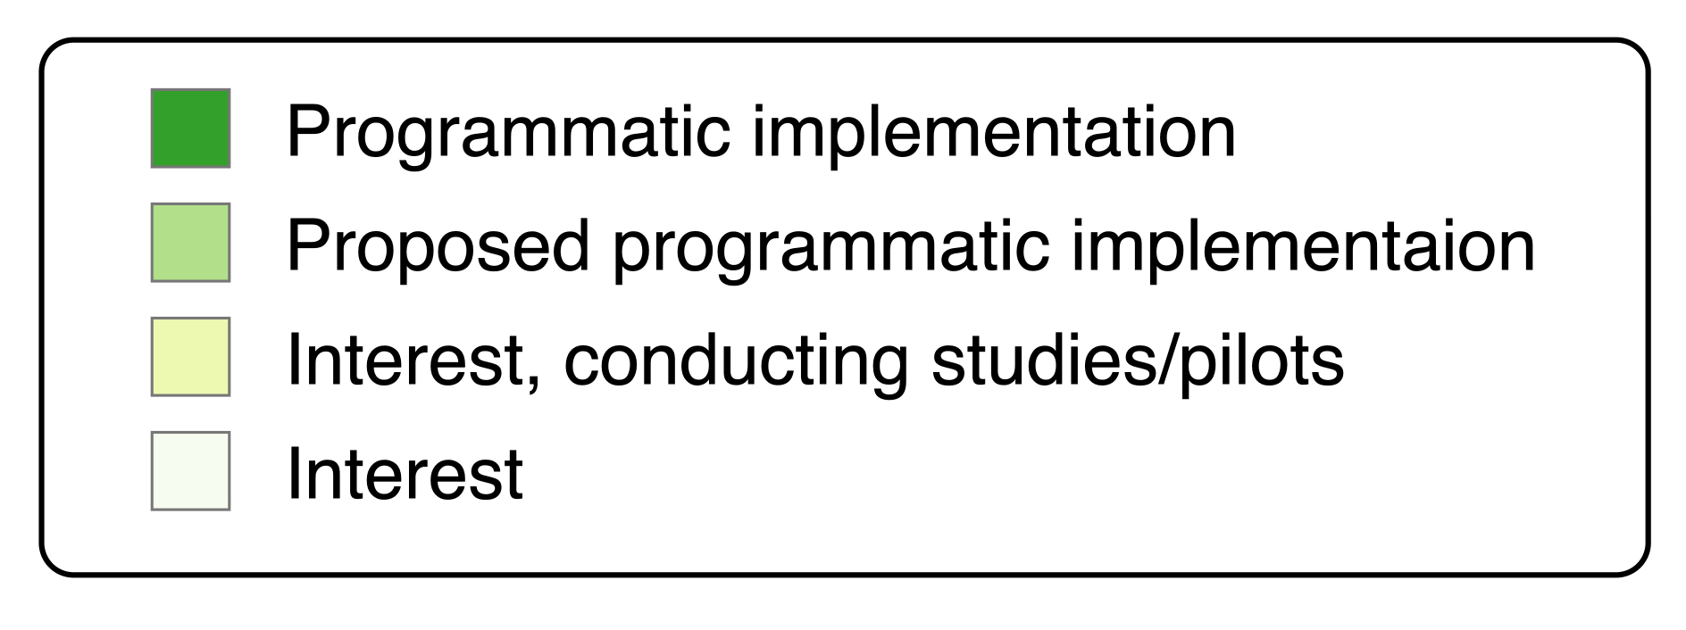
Need for IPTsc M&E Framework
Only Tanzania has programmatic implementation of IPTsc, including country specific M&E plan
Currently no generalized M&E Framework
Need indicators to track adoption and progress
Need Framework to support countries in developing plans
Align with other chemoprevention approaches to increase efficiency and aggregation
Intermittent Preventive Treatment of
school-age children
Map developed by LEARN Malaria network;
created with mapchart.com
Notes:
I will update this map based additional information gathered during the first two days of the meeting

Slide 25
Proposed Progress Indicators
Level | Indicator | Definition (How is it calculated?) | Aggregation level | Frequency | Source | Challenges & considerations
Readiness | Included in National Policy | Y/N | Country | Annual | National policy documents
 | Total number of IPTsc eligible districts | Number of IPTsc eligible districts as defined by country’s microstratification | Country | Annual | National policy document; program records | Definitions of IPTsc eligible districts may vary across countries
 | Total number of districts implementing IPTsc | Number of districts with ongoing IPTsc implementation | Country | Annual | National policy document; program records | May include districts with IPTsc implemented as part of research and national policy
 | Number of scheduled IPTsc doses delivered | Maximum number of possible contact points included in the IPTsc schedule | Country | Annual | National policy document; program records | May vary by district within a country based on seasonality

Slide 26

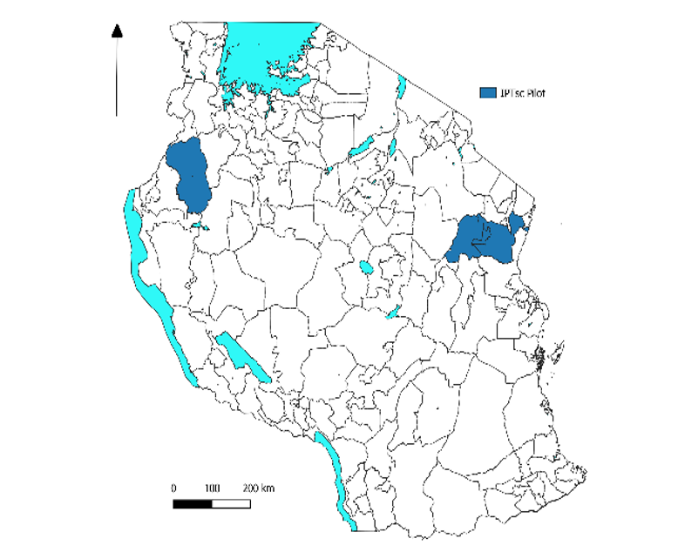
IPTsc in Tanzania
Progressed from clinical trials, implementation, to programmatic implementation in 5 councils in 2024
Support teachers to deliver IPTsc to all primary school students once per school term (=3 cycles/year) with dihydroartmisinin-piperaquine
Implementation guide and M&E indicators developed
Developed with Geofrey Makenga (NIMR), Glory Mlagwa and Abdullah Lusasi (TZ NMCP)

Slide 27
M&E in Tanzania – Logical Framework
Inputs | Activities | Outputs | Outcomes | Impact
IPTsc medications (DHA-PQ) | Distribute medication to schools and CHWs | #/proportion of SAC receiving 3-day IPTsc courses | High adherence and complete dosing | Reduced parasitaemia in SAC
Trained CHWs and teachers | Conduct IPTsc administration rounds | Proportion of children reached per round | Improved supply chain and reduced wastage | Reduced malaria incidence and absenteeism
School and health systems infrastructure | Monitor adverse events and adherence | Adverse events reported, doses used, doses wasted | Improved reporting and timely response to safety signals | Improved academic performance among SAC
M&E tools, reporting forms, supervision | Collect, analyze, and report IPTsc round data | IPTsc reporting data collected from each school and community round | Better-informed decision-making by district and national health managers | Long-term impact on malaria control and education sector collaboration

Slide 28
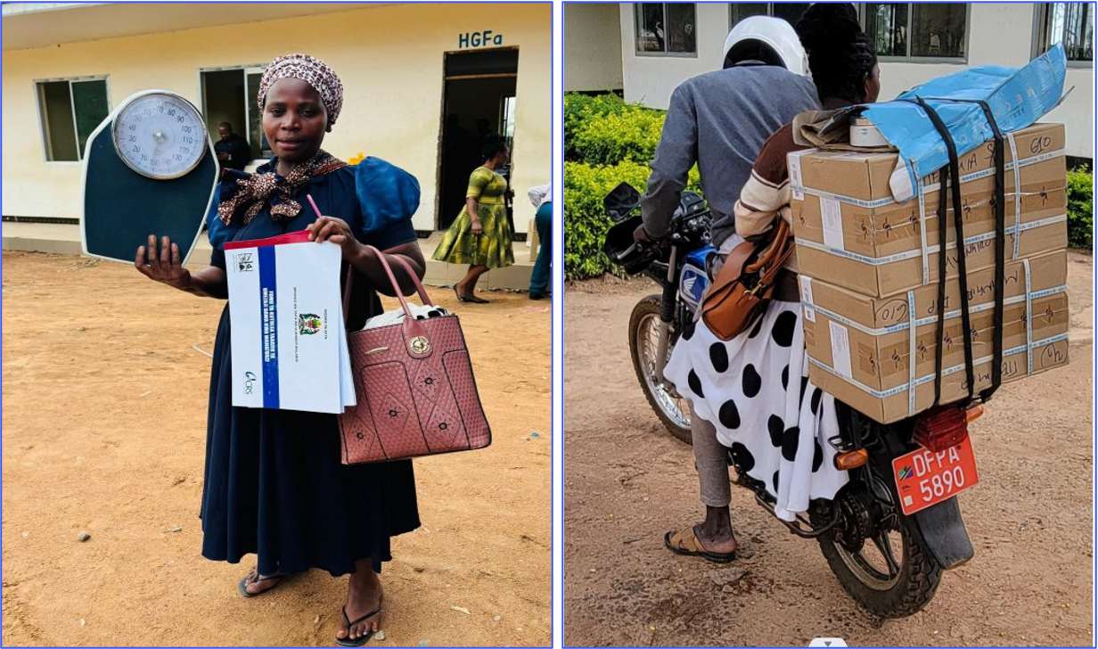
Lessons learned from Tanzania
Paper registers and manual compilation of reports is time consuming and potentially error prone
--> desire for digitalization
Desire to link with M&E of other school health interventions, e.g. deworming
Impact is challenging to assess using routine data due to binary aggregation of data (<5yo vs >=5yo)

Slide 29

Next steps
Formally assess country-level interest and progress
Develop M&E framework
  Generalize Tanzania's indicators incorporating lessons learned
  Align terminology and structure with SMC and PMC frameworks
Advocate for age disaggregated routine data to support prioritization (disease-based) and impact indicators

Slide 30
Discussion and feedback on 3 priorities for M&E sub-group for 2026
    Facilitator: Jacques Kouakou

Slide 31
3 suggested priorities for M&E sub-group for 2026
    Initiative to have a ‘dictionary for SMC, PMC and IPTsc performance indicators’
      Idea is to have one document with performance indicators across these 3 areas of chemoprevention that countries can reference for ease of access – especially useful for countries starting with one of these activities.
      Document could have a similar lay out as current M&E frameworks:
        Input, output, outcome and impact indicators
        Outline core indicators
        Outline potential efficiencies & challenges
    Gathering sample country-level data collection tools for peer learning and exchange across countries. These tools would eventually be linked to indicators in the dictionary as example of forms that can be used to inform indicators. Google Drive link.
    Organize a series of webinars

Slide 32
Gathering your feedback through Mentimeter
  Move to mentimeter.com presentation

Slide 33
Wrap-up & Next Steps

Slide 34
Spare slides – Menti questions
(if online version doesn’t work)

Slide 35
Mentimeter questions
Which intervention(s) are you currently working on?
- SMC
- PMC
- IPTsc
- More than one
- Planning to introduce one
What is your primary role?
- NMCP / Government
- Implementing partner
- Donor / Technical partner
- Research / Academic
- Other

Slide 36
Mentimeter questions
Would the reference of dictionary document be useful for your work in SMC, PMC and IPTsc?
  1. Not useful, 5 = extremely useful
What are key features that you would be the most important for you? (example: core vs optional indicators, methods of data collection, frequency of data collection, etc.)?
  Open-ended
Do you have any concerns with the development of such a dictionary?
  Yes/No & Why? (Open-ended)

Slide 37
Mentimeter questions
How often should the M&E sub-group organize webinars?
- Trimestriel
- Deux fois par an
- Chaque année
- Seulement lorsque c’est nécessaire
Quarterly
- Twice per year
- Annually
- Only when needed

Slide 38
Mentimeter questions
What topics would you propose for our webinars?(across SMC, PMC, IPTsc)? (Open-ended question)
What do you think about these specific webinar topics (Likert Scale?) – RANKING SCALE
Using M&E historical data (as opposed to modeling) to support quantification
Age disaggregation
Office hours for GC8 applications (linked to RBM Gap Analysis)
Microplanning
Post-cycle surveys
Interoperability-based approach to Chemoprevention M&E systems
Learning from countries where integration of chemoprevention intervention have been deployed – from an M&E perspective

