Slide 1

SMC Alliance Research Subgroup
Antimalarial Drug Resistance in Chemoprevention

Slide 2

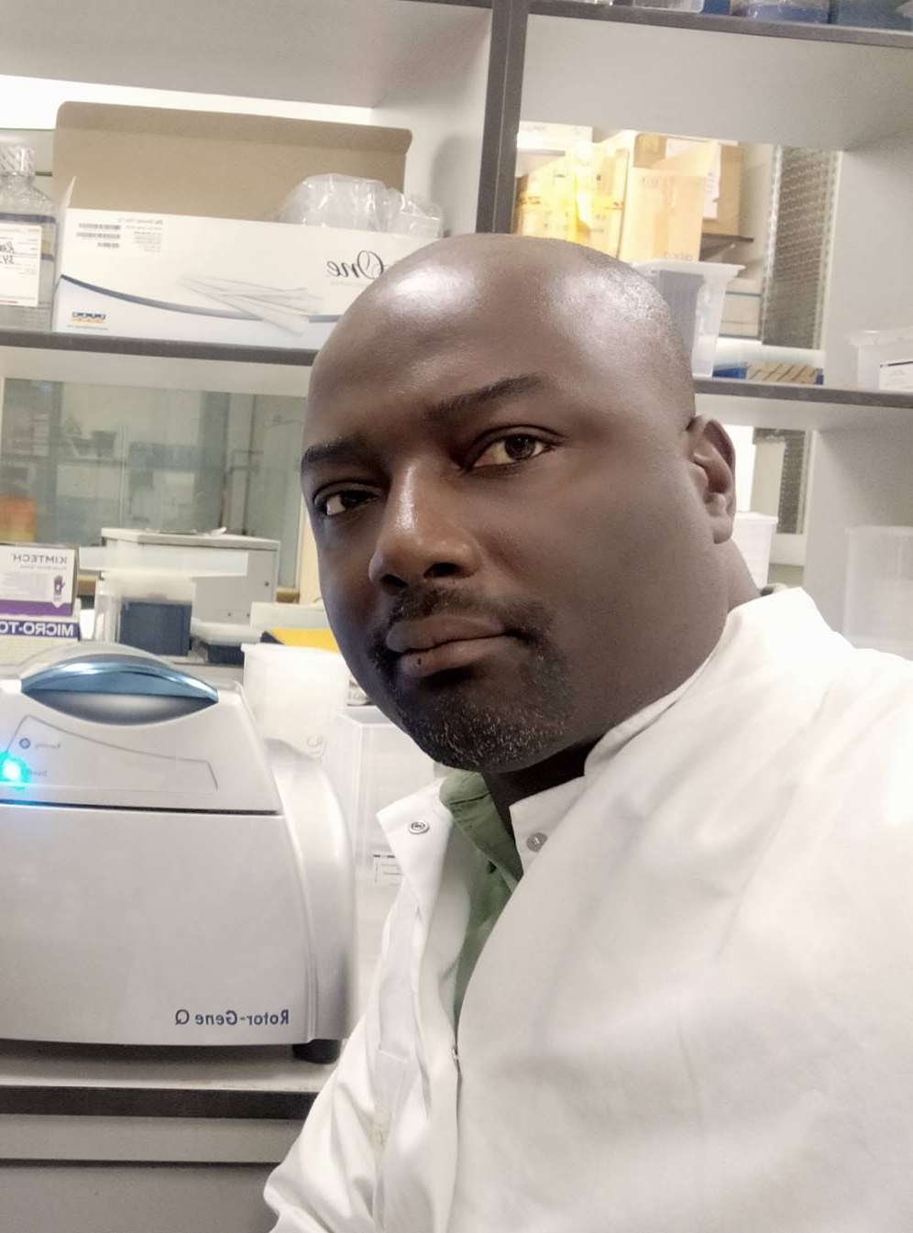

Research Subgroup Coordinating Team
Chair:
Chair:
Secretariate:
Secretariate contact points:
Dr. Chuks Nnaji
Malaria Consortium
London
c.nnaji.86@malariaconsortium.org
Bronwen Davies
Malaria Consortium
London
b.davies.23@malariaconsortium.org
Dr. Issiaka Soulama
IRSS/ANRP
Burkina Faso
iss.soulama@gmail.com
Dr. Innocent Mbulli Ali
University of Dschang/ University of Yaounde Cameroon
dr.alinn@gmail.com

Slide 3
Research Subgroup Presentations 2025-26
24th April 2025
Prof. Halidou Tinto- “How best to deliver malaria vaccine in the seasonal transmission settings”
26th June 2025
Dr. James Watson- “Developing a WWARN data platform for malaria chemoprevention in Africa to optimise deployment and track resistance”
17th September 2025
Dr. Lauren Cohee- “An introduction to IPTsc and the current state of research”-
12th November 2025
In-person ASTMH meeting- “Introductions, funding cuts, and aligning and integrating research agendas of chemoprevention interventions in a period of limited resources”
11th February 2026
David Ekai and Dr, Wendy Prudhomme O’Meara- “Scale-up and delivery of Seasonal Malaria Chemoprevention in pastoralist communities of northwest Kenya”
26th February 2026
In-person annual meeting- “Drug resistance in chemoprevention targeted at children”
TBC April 2026
Theme TBC

Slide 4
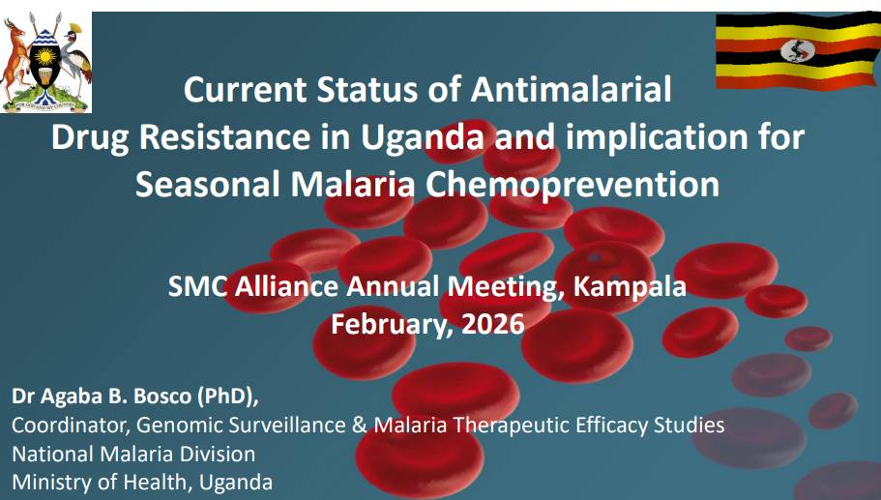

Slide 5
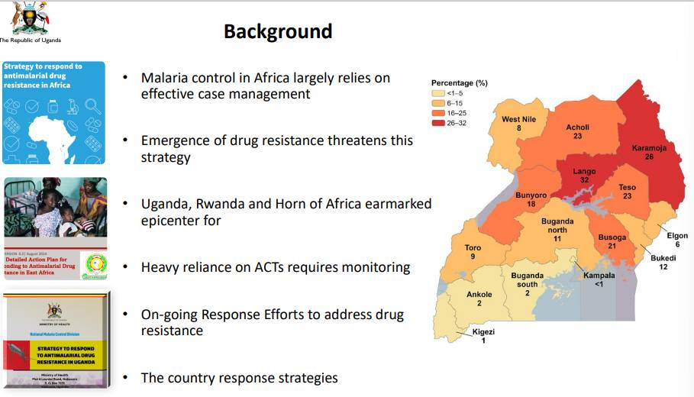

Slide 6
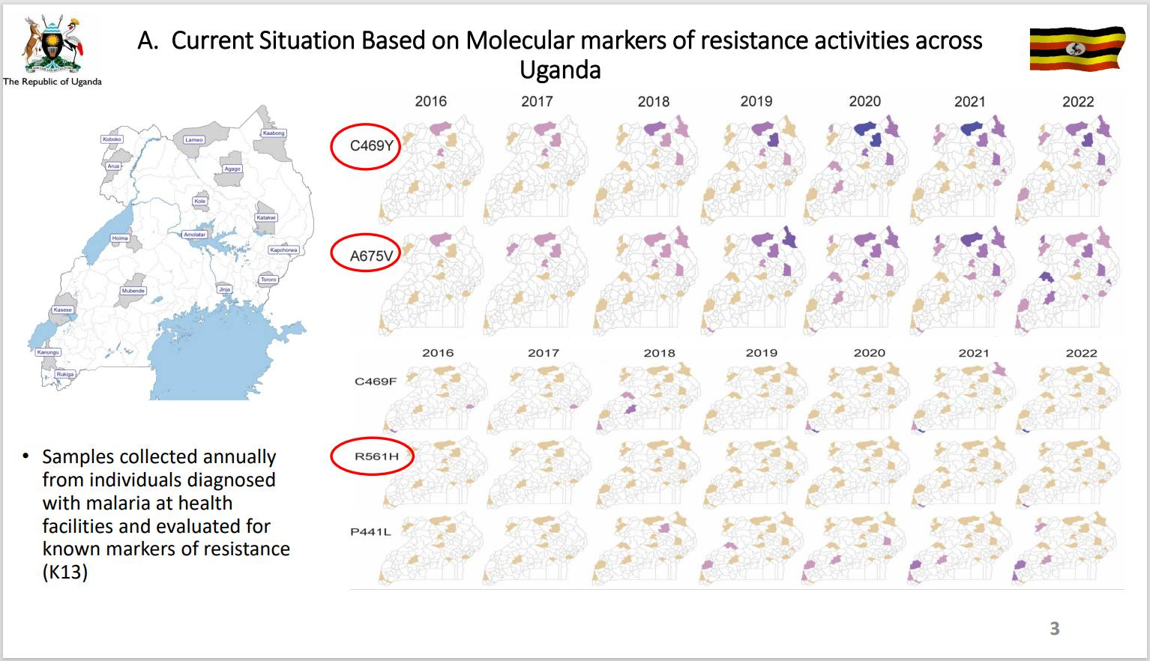

Slide 7
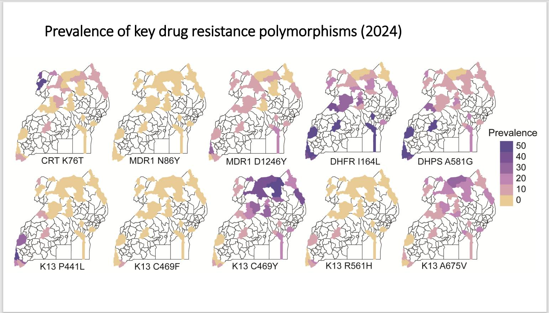

Slide 8
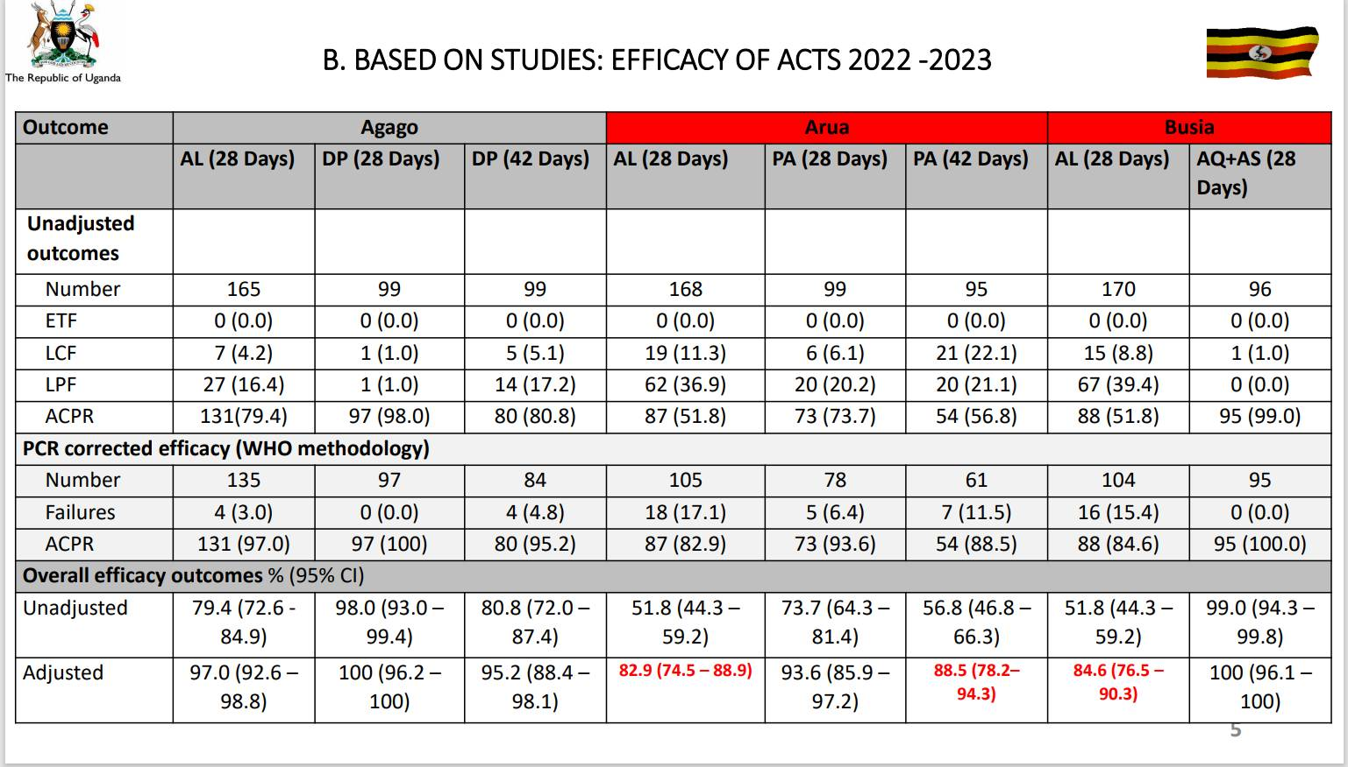

Slide 9
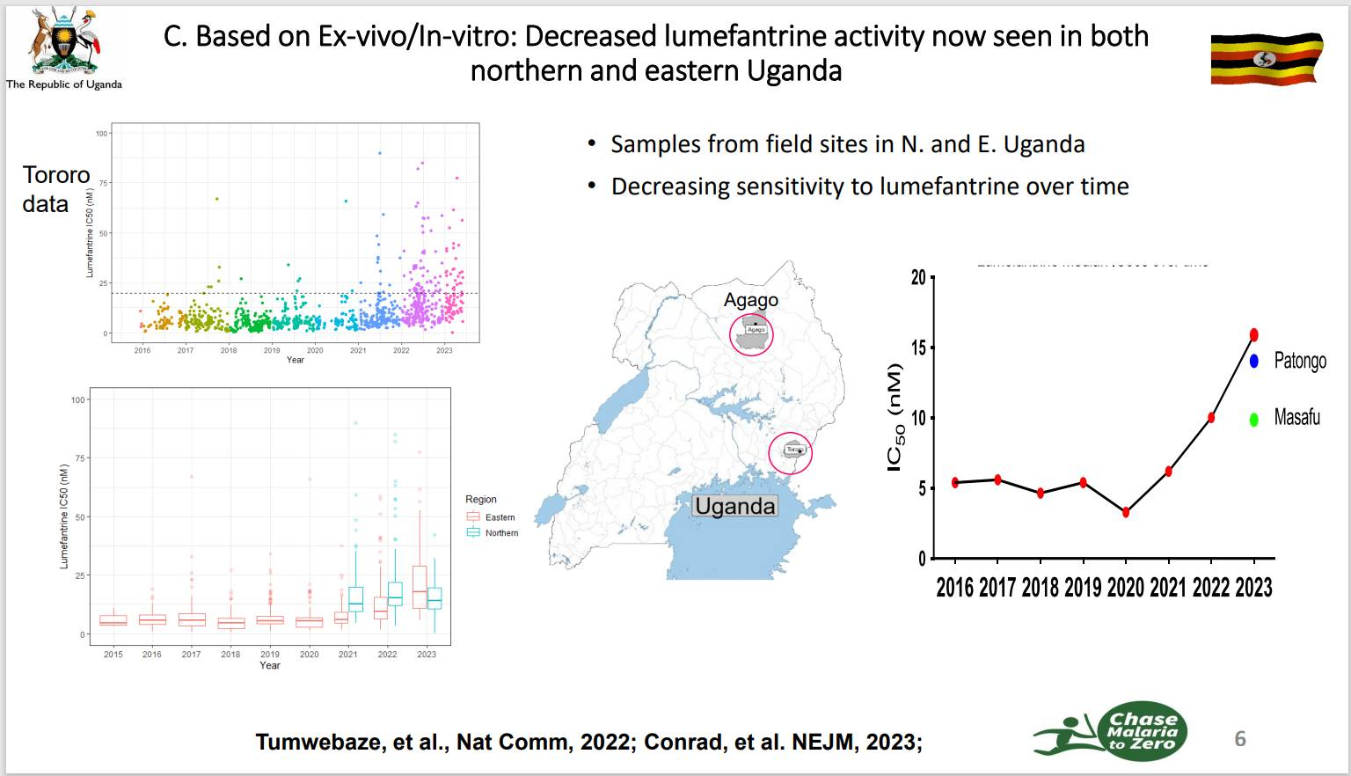

Slide 10
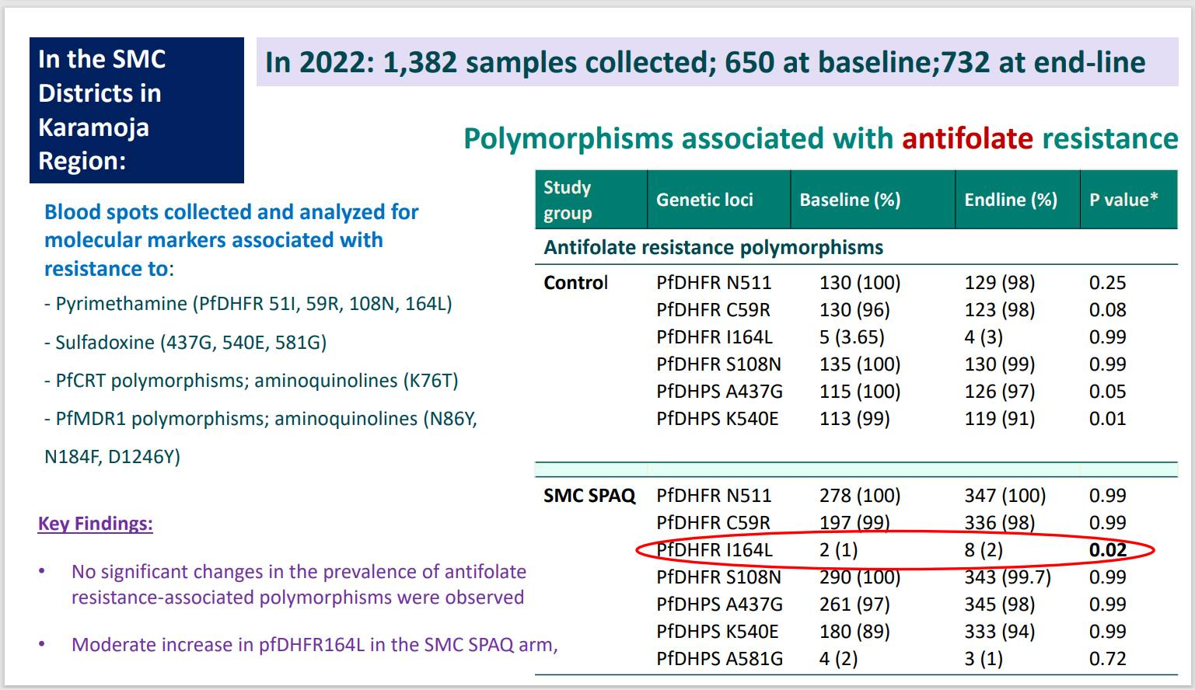

Slide 11
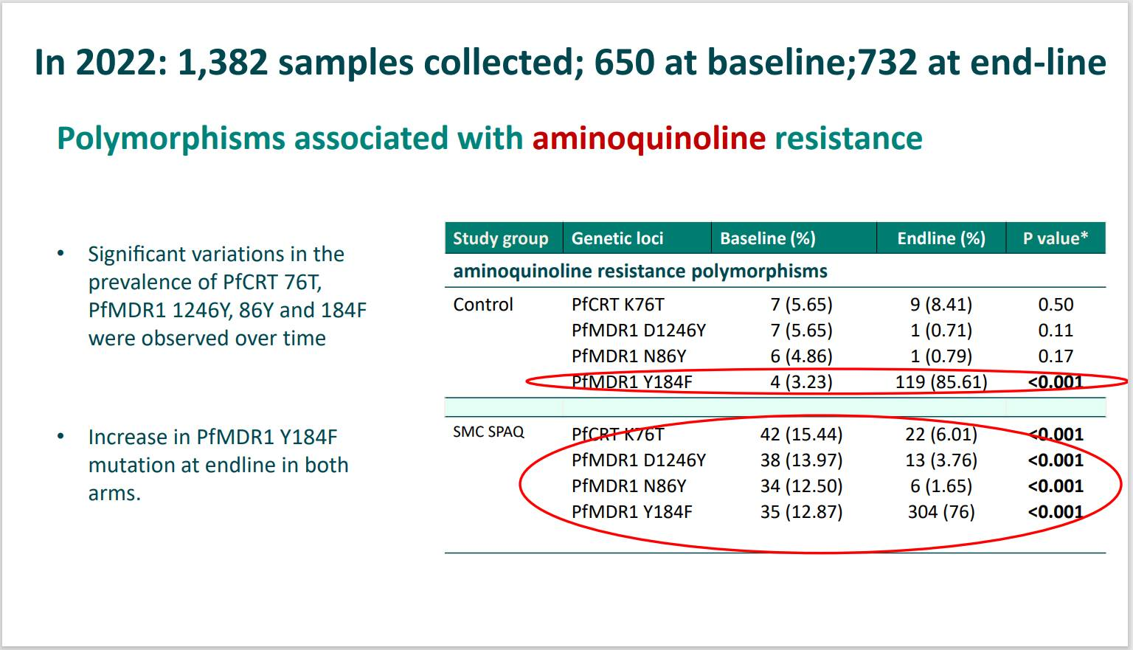

Slide 12
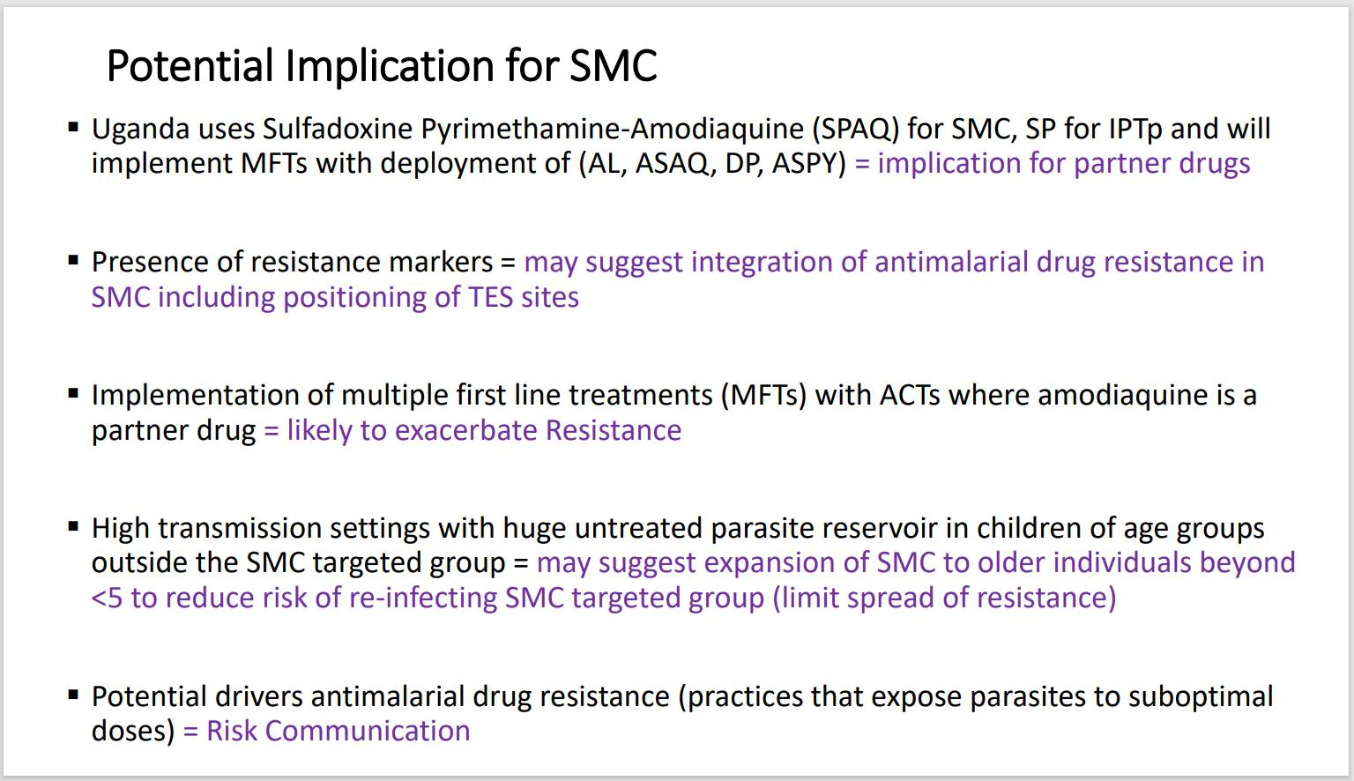

Slide 13
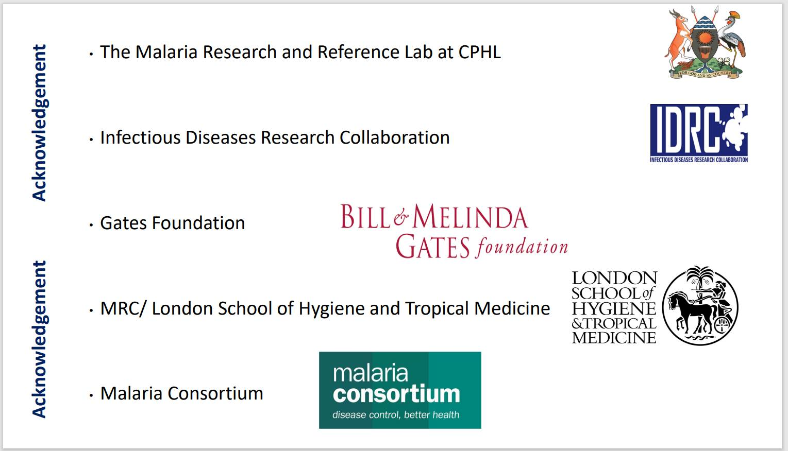

Slide 14

SPAQ Resistance Marker Surveillance in Nigeria
Molecular signals under sustained SMC use: evidence from Kwara State (2023)
Presented at the 2026 SMC Alliance meeting

Slide 15
Content
Introduction
Purpose of Surveillance
Study objective, design and scope
Study Design and Setting
Analysis results
Regional Context and Implications for SPAQ Resistance
Next Steps
Conclusion

Slide 16
Introduction
Seasonal Malaria Chemoprevention (SMC) using sulfadoxine–pyrimethamine plus amodiaquine (SPAQ) is a core malaria prevention strategy in Nigeria, delivered at scale across multiple states over successive years.
Sustained, large-scale use of SPAQ creates selective pressure on Plasmodium Falciparum, underscoring the importance of routine molecular resistance surveillance.
Molecular markers provide early signals of emerging resistance and help inform programme vigilance, complementing effectiveness and coverage data.

Slide 17
Introduction
The SP resistance marker analysis is the first arm of the study that also has a Chemopreventive Efficacy Study arm. Both are complementary but methodologically distinct investigations conducted within the same broader research framework and both provide important context for interpreting the findings of the other.
This presentation summarizes findings from a 2023 resistance marker surveillance study in Kwara State and interprets their implications for Nigeria’s SMC programme

Slide 18
Purpose of Surveillance
Why does molecular resistance surveillance matter for Nigeria’s SMC programme?
  Nigeria has one of the largest and longest-running SPAQ-based SMC programmes globally
  Sustained, large-scale drug exposure necessitates active resistance monitoring
  Molecular surveillance provides early-warning signals to inform programme vigilance
This study asks: Are molecular signals emerging that warrant closer programme-level attention?

Slide 19
Study objective, design and scope
Objective: To investigate the presence of SPAQ resistance markers due to SMC implementation among the target population of 3–59 months’ children.
Design and scope:
Health facility–based cross-sectional surveillance
Conducted during the 2023 SMC cycle in Kwara State
Population: children aged 3–59 months with RDT-confirmed P. falciparum
Sample size: 94 dried blood spot samples
Designed to detect circulating resistance signals, not estimate population prevalence

Slide 20

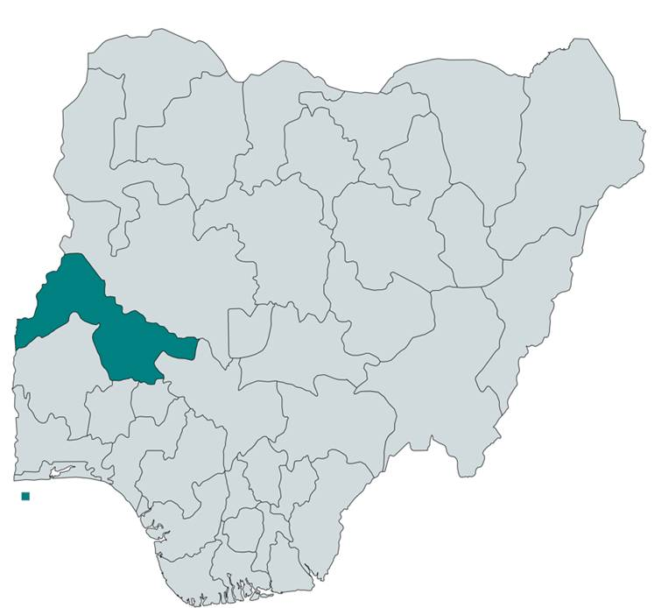
Study Design and Setting
Health facility–based cross-sectional molecular surveillance conducted in Kwara State, north-central Nigeria
• Sampling performed prior to commencement of the 2023 SMC campaign
• Dried blood spots (DBS) collected from 94 children aged 3–59 months
• Molecular analysis conducted using restriction fragment length polymorphism (RFLP) to detect SP- and AQ-associated resistance markers:
– Pfdhfr (codons 51, 59, 108, 164)
– Pfdhps (437, 540, 581)
– Pfcrt (76)
– Pfmdr1 (86)
Kwara State is in western Nigeria with an estimated population of 2,365,353 and a malaria prevalence of 6% among children aged 3–59 months, where P. falciparum is the dominant malaria parasite
Figure 1: Map of Nigeria showing Kwara State

Slide 21
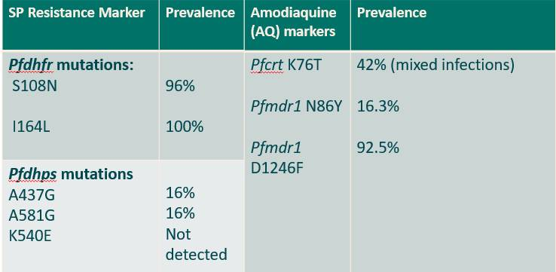
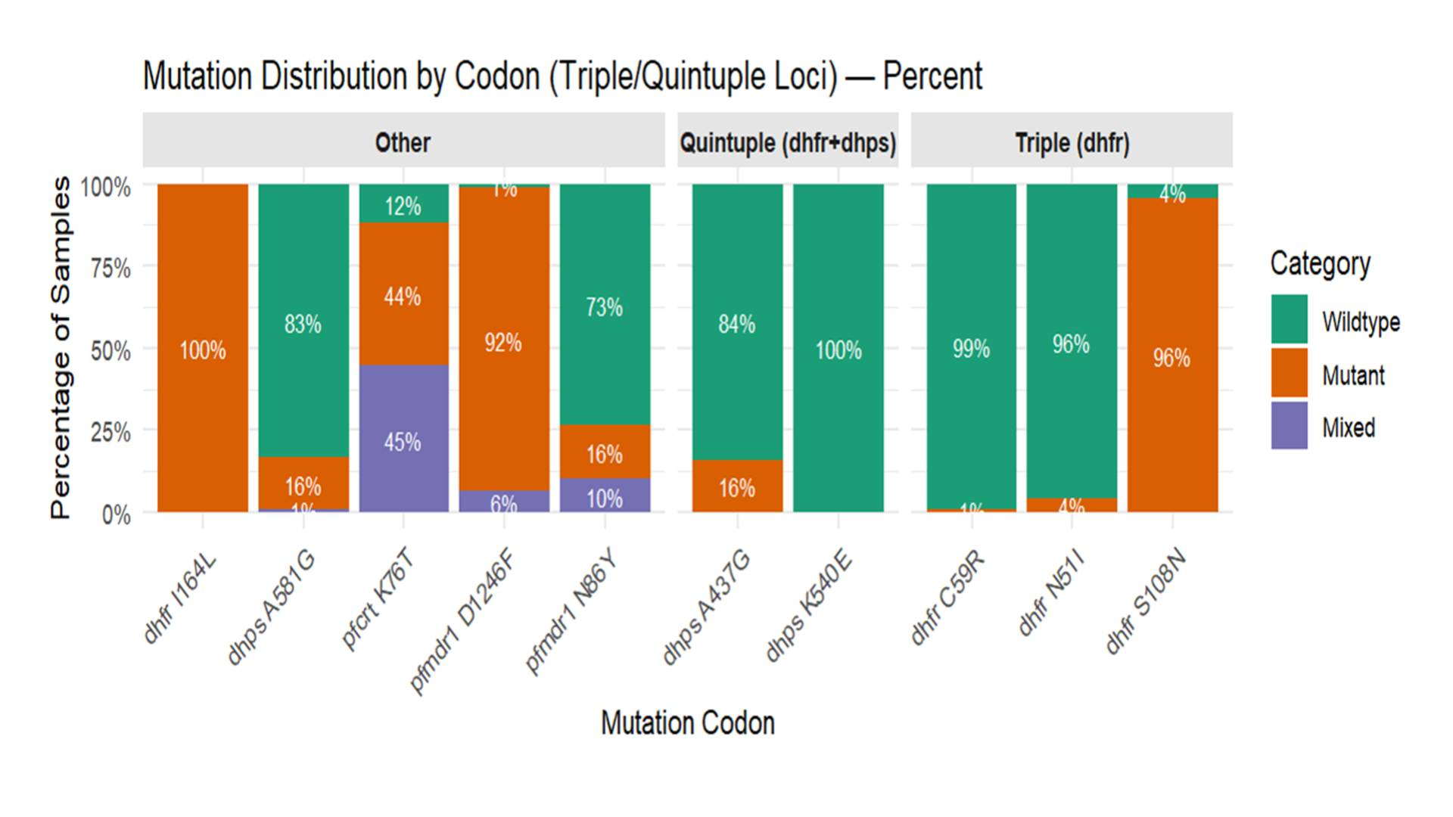
Analysis results
Genomic DNA (gDNA) Yield and Quality
Genomic DNA successfully extracted from all 94 DBS samples with adequate concentration and purity for downstream molecular analysis.
Ten SPAQ resistance-associated loci were successfully genotyped.
Interpretation of results
Sustained SP molecular signals indicate ongoing selection pressure under repeated SMC exposure, reinforcing the need for integrated molecular and clinical surveillance.
Absence of K540E and lack of a dominant AQ resistance pattern are reassuring; however, continued monitoring is essential to detect early shifts in susceptibility.

Slide 22
Regional Context and Implications for SPAQ Resistance
SP markers:
High Pfdhfr prevalence in Kwara mirrors patterns observed across SMC and non-SMC settings in Africa, reflecting widespread historical SP pressure rather than a signal unique to SMC in Nigeria.
However, Pfdhps mutations associated with higher-level resistance remain comparatively moderate (~16%) in Kwara, unlike the substantially higher levels reported in parts of East and West Africa.
AQ markers:
Moderate Pfcrt K76T and low-to-moderate Pfmdr1 N86Y do not demonstrate a dominant molecular profile consistent with widespread amodiaquine resistance.
The observed pattern may reflect historical chloroquine selection, regional parasite flow, or informal antimalarial use, underscoring the need for continued molecular and clinical monitoring.

Slide 23
Next Steps
Complete the chemopreventive efficacy study (CPES): Provide clinical context to molecular findings and assess whether observed mutation patterns translate into reduced protective effectiveness.
Integrate pharmacokinetic assessment in breakthrough cases: Measure drug concentrations to distinguish subtherapeutic exposure from true parasite resistance.
Genotype parasites from chemoprevention failures: Strengthen linkage between specific mutations and clinical outcomes to refine predictive resistance markers.
Establish ongoing molecular surveillance: Monitor resistance marker trends over time to enable early detection of shifts in susceptibility and support timely programmatic and policy decisions.

Slide 24
Conclusion
The interim analysis of SPAQ resistance markers in Kwara State reveals a concerning prevalence of molecular mutations associated with sulfadoxine-pyrimethamine and amodiaquine resistance.
Although classical high‑level SP resistance haplotypes were not fully established, these findings highlight the urgency of integrating molecular resistance monitoring into routine SMC evaluations and adapting intervention strategies to sustain malaria prevention efforts in Nigeria.
Key considerations include expanding molecular resistance surveillance across additional SMC-implementing states with larger sample sizes, closely monitoring high-prevalence SPAQ resistance markers, assessing SPAQ effectiveness in settings with elevated resistance signals while exploring alternative or rotational regimens, and strengthening complementary malaria prevention measures such as insecticide-treated net ownership and use.

Slide 25

Thank you

Slide 26






Results from a double-blinded, placebo-controlled, randomised trial of presumptive treatment of asymptomatic children 3-5 years in Cameroon: Unpacking the clinical effects of parasite resistance to SP and SPAQ
Joint Annual Meetings of the SMC Alliance and the Alliance for Malaria Prevention
Kampala, Uganda
24-27 February 2026
R. Matthew Chico, PhD, MPH
Professor of Global Health & Infectious Diseases
Department of Disease Control
London School of Hygiene & Tropical Medicine

Slide 27
PCPI = Parasite clearance & protection from infection
Objective | Measure the effect of parasite genotype on clearance and appearance of new infection when exposed to chemoprevention
Population | Asymptomatic children 3 to 5 years old
Follow up | 70 days total Days -7, -6, -5, -4, -3, -2, -1 Days 0, 2, 5, 7, 14, 21, 28, 35, 42, 49, 56, and Day 63
Measurement | PCR on dried blood spot (all time points) Microscopy slides read retrospectively (Days 0-28)
Rescue Rx | Any child who is RDT positive
To be consistent with WHO’s malaria chemoprevention efficacy study protocol (CPES)
Notes:
PCPI can answer these key questions.
PCPI participants will be followed for 63 days. For SP specifically this will allow us to estimate an independent genotype-specific drug effect in protective efficacy, accounting for transmission levels and circulating genotype frequencies
Microscopy slides - aligned with WHO’s Malaria Chemoprevention Efficacy Study Protocol up to day 28.
Outcome 2 focuses on the chemoprevention aspect. We expect resistant infections to be detected earlier , as sensitive parasites will be killed by the drug , shortly following administration
PCPI is specifically designed to examine the impact of resistance on protective efficacy of chemoprevention, and to provide first evidence on the impact of the novel 431V mutation in chemoprevention.

Slide 28
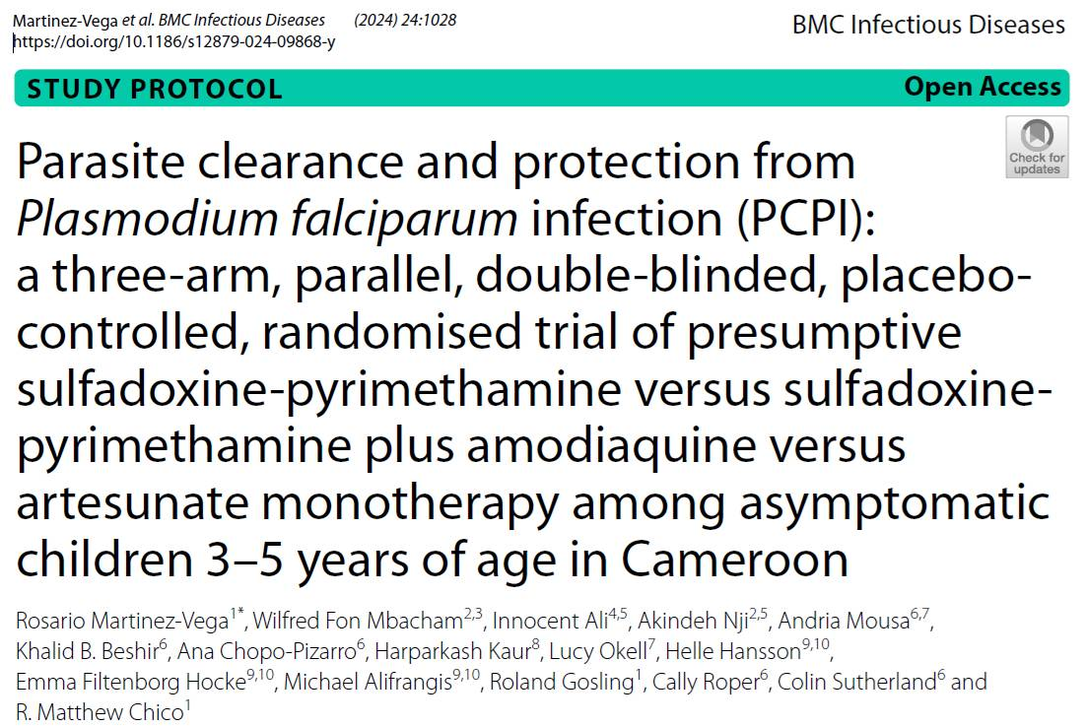
PCPI Cameroon
Treatment arm | Regimen | Days
Control Group (n= 200) | Artesunate SP placebo and AQ placebo | 7 days 3 days
SP Group (n= 450) | Artesunate placebo SP and AQ placebo | 7 days 3 days
SPAQ Group (n= 250) | Artesunate placebo SP AQ | 7 days 3 days
Registration
https://clinicaltrials.gov/study/NCT06173206
Protocol publication
Martinez-Vega R, Mbacham WF, Ali I, Nji A, et al.;
BMC Infectious Diseases (2024) 24 (1), 1028
https://doi.org/10.1186/s12879-024-09868-y.

Slide 29
Results: Parasite clearance
Among participants with asymptomatic parasitaemia on Day 0

Slide 30
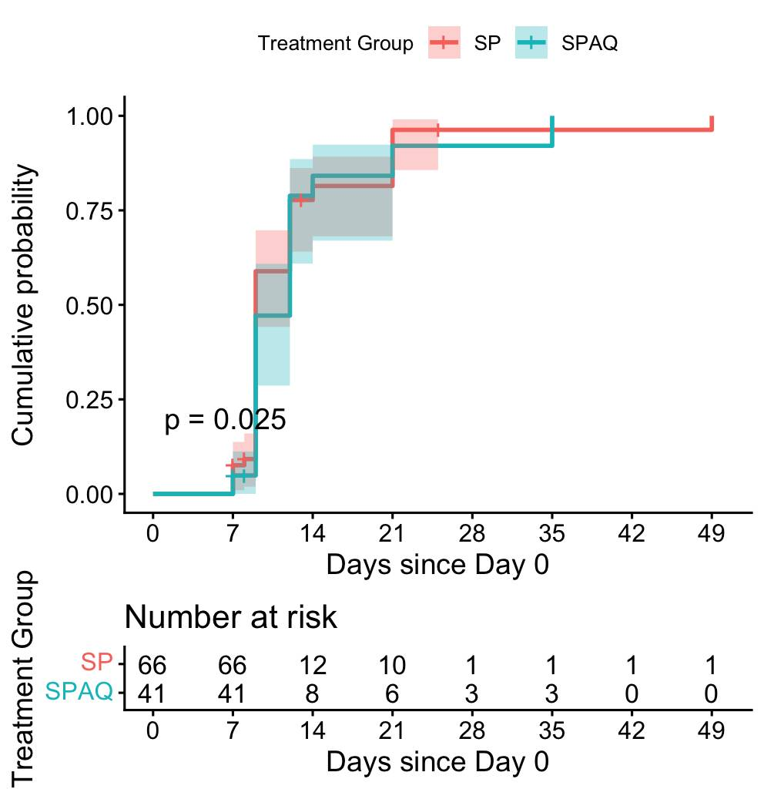
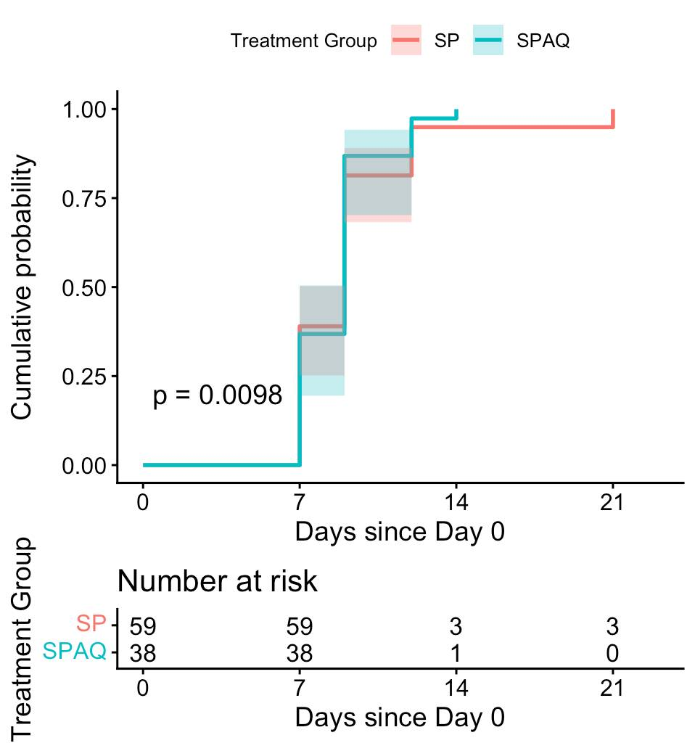
Time to clearance* among all genotypes
By microscopy
By qPCR
*clearance unadjusted for new infections

Slide 31
Time to clearance* by microscopy and qPCR, by treatment group and all genotypes
Outcome | Treatment | Median days to clearance (IQR) | Hazard Ratio (95%CI) | P-value
Microscopy negative | SP | 9 days (7-9) | Ref | 0.515
 | SPAQ | 9 days (7-9) | 1.15 (0.76–1.73)
qPCR negative | SP | 9 days (9-12) | Ref | 0.634
 | SPAQ | 12 days (9-12) | 0.90 (0.60-1.37)
*clearance unadjusted for new infections and parasite density
Notes:
Need to run the code again excluding AS, with SP as comparator.

Slide 32
Time to clearance* by microscopy and qPCR, by dhps 431 genotype
Outcome | Treatment | Genotype | Median days to clearance (IQR) | Hazard Ratio (95%CI) | P-value
Microscopy negative | SP | 431I | 7 days (7-9) | 0.57 (0.33–1.01) | 0.055
 |  | 431V (mutant) | 9 days (9-9)
 | SPAQ | 431I | 9 days (7-9) | 0.71 (0.36–1.42) | 0.335
 |  | 431V (mutant) | 9 days (9-9)
qPCR negative | SP | 431I | 9 days (9-21) | 0.83 (0.47–1.46) | 0.520
 |  | 431V (mutant) | 9 days (9-12)
 | SPAQ | 431I | 9 days (9-14) | 1.06 (0.54–2.09) | 0.860
 |  | 431V (mutant) | 12 days (9-12)
*clearance unadjusted for new infections and parasite density
Notes:
Need to run the code again excluding AS, with SP as comparator.

Slide 33
Results: Protection from infection
Among participants with no infection on Day 0

Slide 34
Keep in mind…
Having an active control group with artesunate monotherapy – which is eliminated from the body within hours of dosing – allowed us to:
1. Measure directly the force of infection with a clarity and precision not otherwise possible
2. Compare SP against ‘no protection’ to quantify ‘true’ protection

Slide 35
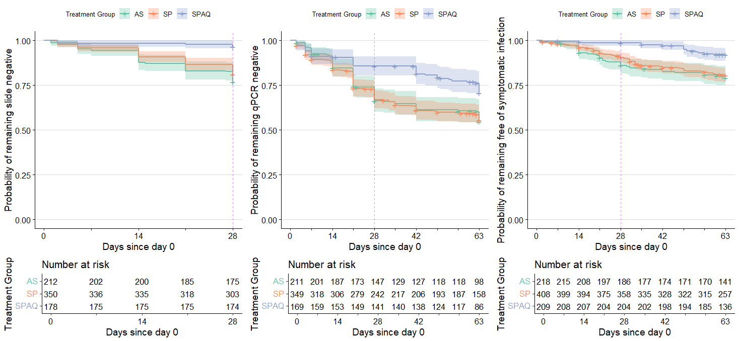
Protection from infection by treatment arm among all genotypes
Microscopy positive
qPCR positive
Symptomatic infection *
*Symptomatic infection is defined as fever (temperature ≥37.5) and a positive mRDT

Slide 36
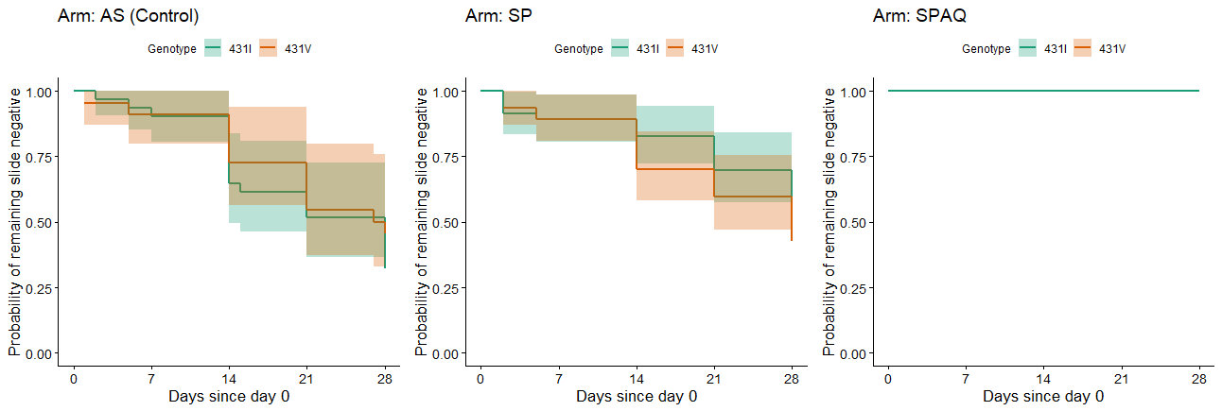
Time to microscopy positive infection by dhps 431 genotype
Outcome | Treatment | dhps 431V (Mutant) Day 28 Protective Efficacy (95% CI) | dhps 431I (Wildtype) Day 28 Protective Efficacy (95% CI)
Microscopy positive | SP | -53.2% (-100.0%, 23.7%) No protection | 56.2% (18.1%, 76.6%)
 | SPAQ | 100%(fully protective) | 100%(fully protective)

Slide 37
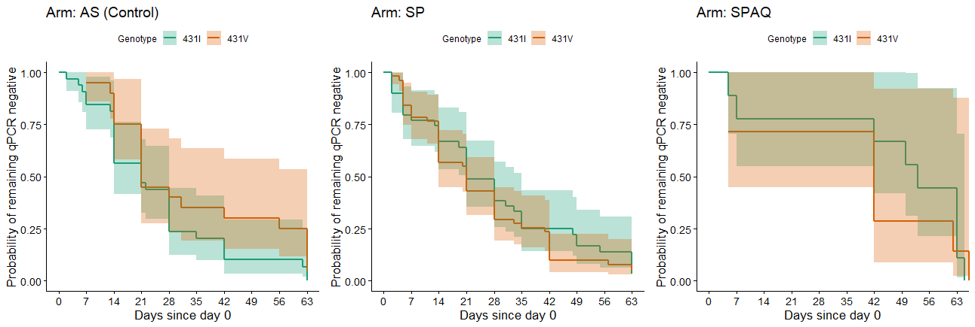
Time to qPCR positive infection by 431 genotype
Outcome | Treatment | 431V (Mutant) Day 28 Protective Efficacy% (95% CI) | 431I (Wildtype) Day 28 Protective Efficacy% (95% CI)
qPCR positive | SP | -10.8% (-93.7%,36.6%) | 52.1% (14.8%, 73.0%)
 | SPAQ | 100%(fully protective) | 100%(fully protective)

Slide 38
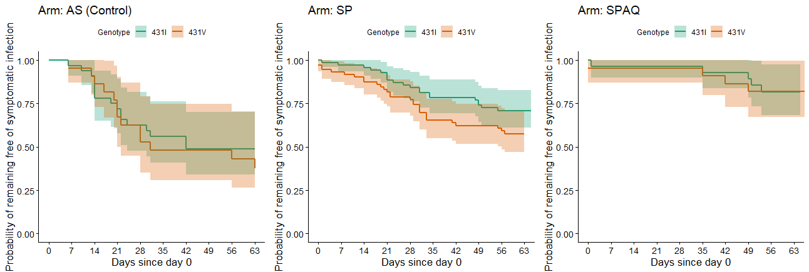
Time to symptomatic infection by dhps 431 genotype
Outcome | Treatment | 431V (Mutant) Day 28 Protective Efficacy % (95% CI) | 431I (Wildtype) Day 28 Protective Efficacy % (95% CI)
Symptomatic infection* | SP | 20.3%(-65.6%, 61.6%) | 62.9%(22.4%, 82.3%)
 | SPAQ | 100%(fully protective) | 100%(fully protective)
*Symptomatic infection is defined as fever (temperature ≥37.5) and a positive mRDT
Notes:
Andria to change Y Axis to “Symptomatic infection”

Slide 39
Key findings
On parasite clearance:
SP and SPAQ have similar clearance rates overall
Clearance of 431V mutant parasites is slower, however we observed no significant differences
On protection from infection:
SP protects against symptomatic infection compared to parasitological outcomes (microscopy + or PCR+)
SPAQ performs better than SP against all outcomes
Protective efficacy of SP against the 431V mutant for all outcomes is always lower than when compared to that against 431I

Slide 40
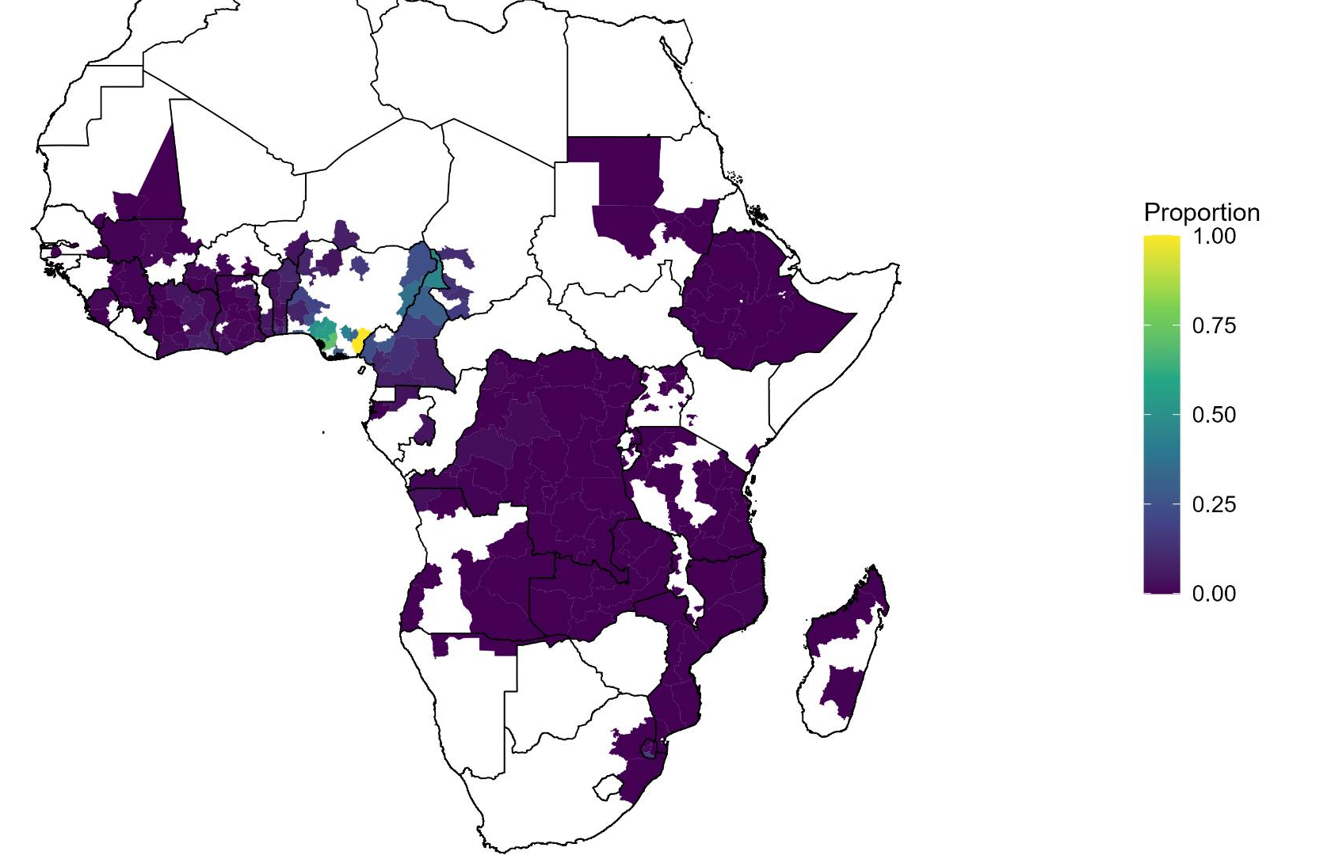
Prevalence of dhps 431V
Surveys 2010-2025
The dhps 431V mutation was identified in 25% of Plasmodium falciparum infections in the PCPI Cameroon trial site

Slide 41
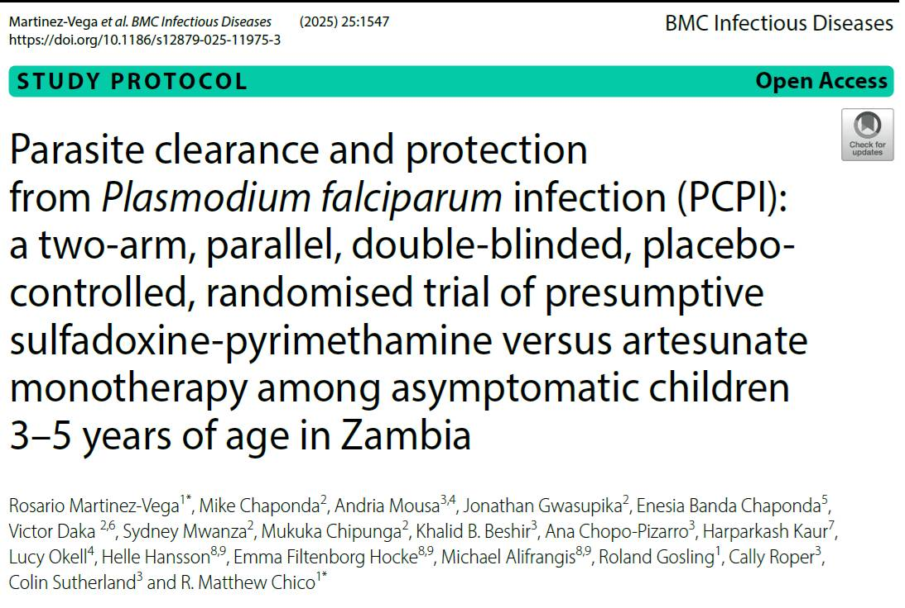
PCPI Zambia
Cleaning and analyses ongoing
Treatment arm | Regimen | Days
Control Group (n= 200) | Artesunate SP placebo | 7 days 1 day
SP Group (n= 400) | Artesunate placebo SP | 7 days 1 day
Registration
https://clinicaltrials.gov/study/NCT06166498
Protocol publication
Martinez-Vega R, Mbacham WF, Ali I, Nji A, et al.;
BMC Infectious Diseases (2024) 24 (1), 1028
https://doi.org/10.1186/s12879-024-09868-y.

Slide 42
Acknowledgments
FINISTECH
Wilfred Fon Mbacham
Innocent Ali
Akindeh Nji
Miriam Niba
Tah-Monundeh Mercy
Peter Thelma Niba
Albertine Lele
Asaah Fry Yvan
Ngope Claude Ericka
London School of Hygiene & Tropical Medicine
Rosario Martinez‑Vega
Andria Mousa
Khalid B. Beshir
Ana Chopo‑Pizarro
Roland Gosling
Cally Roper
Colin Sutherland
R. Matthew Chico
University of Copenhagen
Helle Hansson
Emma Filtenborg Hocke
Michael Alifrangis

Slide 43

From Signal to Action: Building Sustainable Systems for Routine Malaria Chemoprevention Resistance Surveillance and Response
Anna Yoko Burkhard and Ruth Kigozi
February 26th 2026 SMC Alliance Research Subgroup Meeting

Slide 44
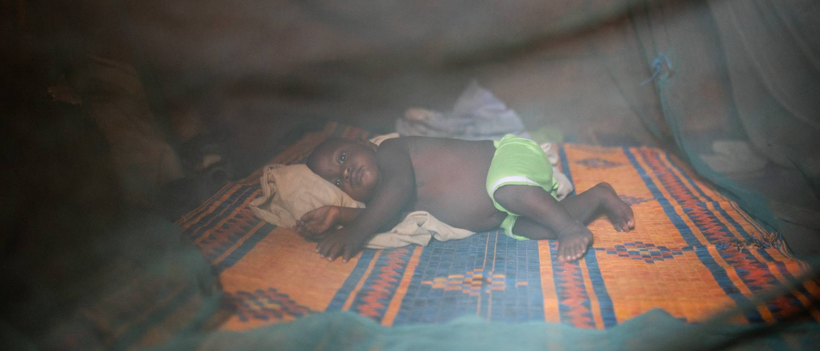
CPES and RM Studies at Malaria Consortium

Slide 45
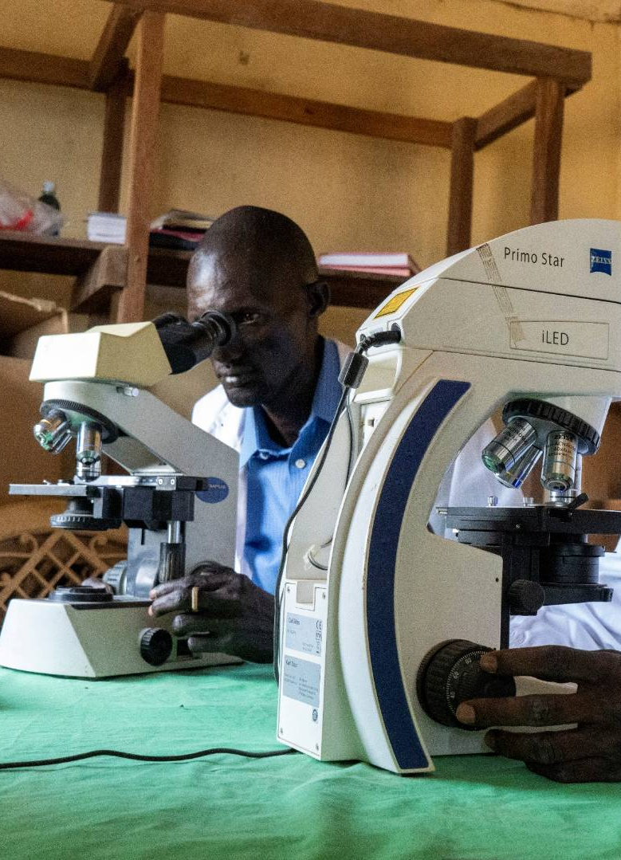
CPES and RM Studies
Malaria Consortium has conducted several Chemoprevention Efficacy Studies (CPES) and Resistance Marker (RM) monitoring in 5 countries across Africa
  Mozambique, Uganda, South Sudan, Nigeria and Burkina Faso
WHO CPES protocol and guidelines
Partnership with MoH, NMPs and Academic Institutions

Slide 46
Drug Resistance Markers

Slide 47
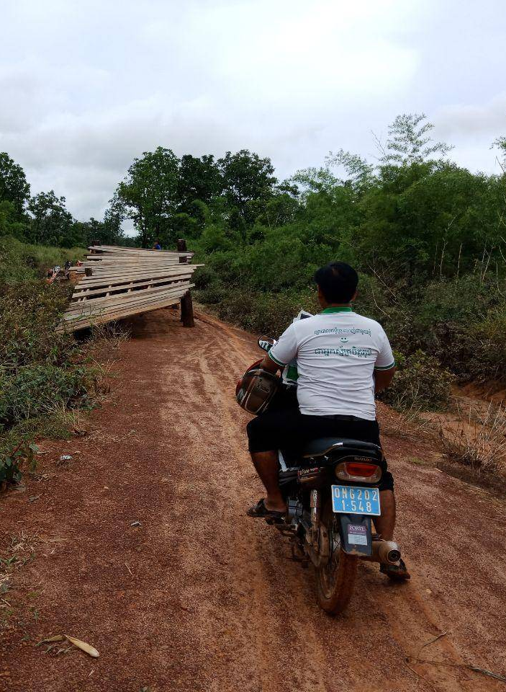
SPAQ Resistance
Today's presentation will focus on four main genes of interest
DHPS
  Dihydropteroate synthase gene
  Confers Sulfadoxine resistance
DHFR
  Dihydrofolate reductase gene
  Confers Pyrimethamine resistance
CRT
  Chloroquine resistance transporter
  Linked to Amodiaquine resistance
MDR1
  Multi Drug Resistance transporter 1
  Linked to multi-drug resistance including Amodiaquine resistance
SP resistance is most significantly conferred by mutation combinations:
  Triple PfDHFR (51I, 59R, 108N)
  Quintuple PfDHFR (51I, 59R, 108N) and PfDHPS (437G, 540E)
  Sextuple PfDHFR (51I, 59R, 108N) and PfDHPS (437G, 540E, 581G)

Slide 48
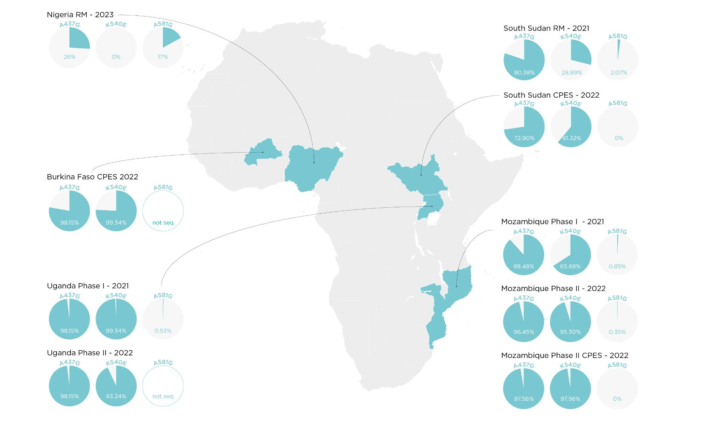
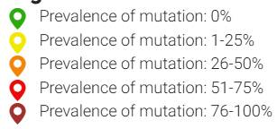
PfDHPS
​
Pending Studies
Nigeria CPES Study 2023
Burkina Faso RM Study 2022 ​

Slide 49
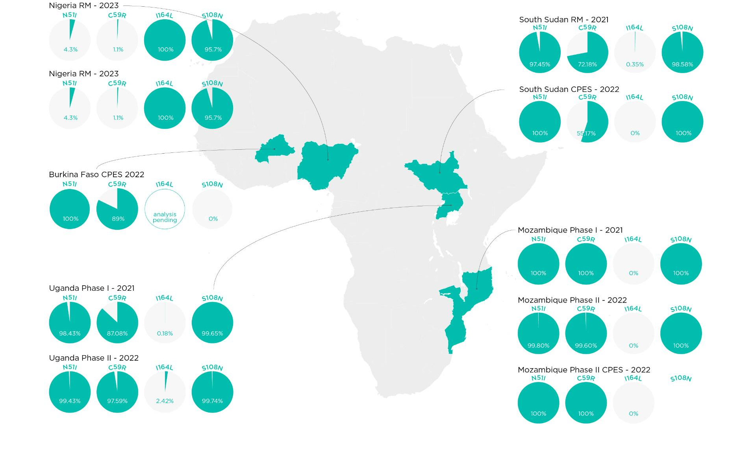
PfDHFR
​
Pending Studies
Nigeria CPES Study 2023
Burkina Faso RM Study 2022 ​

Slide 50
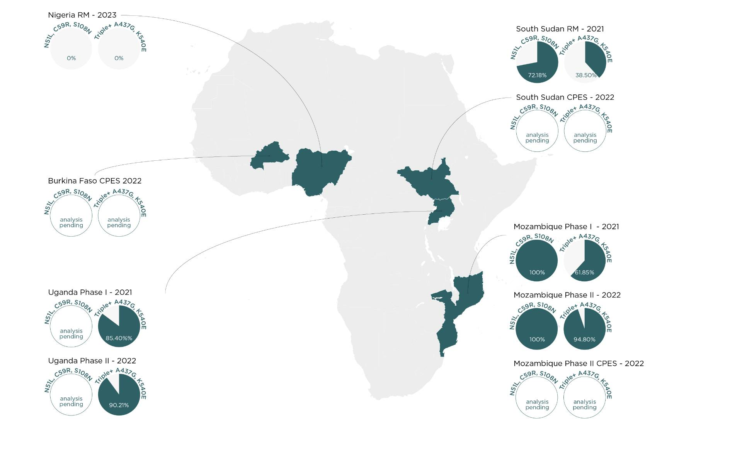
PfDHFR & PfDHPS
​
Pending Studies
Nigeria CPES Study 2023
Burkina Faso RM Study 2022 ​

Slide 51
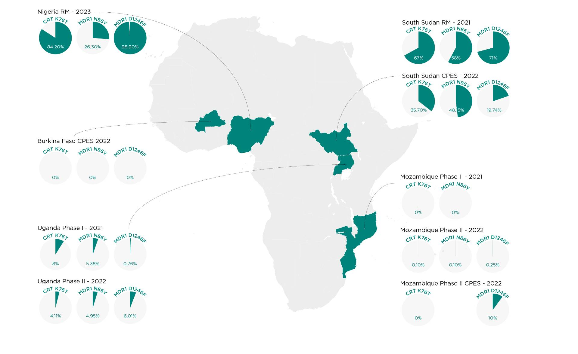
PfCRT & PfMDR1
​
Pending Studies
Nigeria CPES Study 2023
Burkina Faso RM Study 2022 ​

Slide 52
Effectiveness & Efficacy

Slide 53
Effectiveness & Efficacy
Effectiveness: Ability of SMC medicines to prevent clinical or symptomatic malaria cases under routine programmatic conditions.
cluster-randomised controlled trials/ case-control studies
Efficacy: Ability of SMC medicines to clear existing malaria parasites and prevent new infections
non-routine/enhanced programmatic conditions, laboratory analyses microscopy and/or PCR required

Slide 54
Effectiveness & Efficacy
Country | Effectiveness | Effectiveness Results | Efficacy | Efficacy Results QPCR (Microscopy) | Resistance Marker Study
ESA
Mozambique | nRCT (2021); cRCT (2022) | nRCT: 86% cRCT: 73% | 2022 | D0 Parasitemia: 71% D28 Parasitemia: 44% | 2021, 2022, 2024 (analysis ongoing)
South Sudan | nRCT (2022) | nRCT: ~70%* | 2022 | D0 Parasitemia: 45%** D28 Parasitemia: 55%** | 2022
Uganda | nRCT (2021); cRCT (2022) | nRCT: 92% cRCT: 94% | 2022 | D0 Parasitemia: 46% D28 Parasitemia: 31% (~5%) | 2021, 2022
WCA
Burkina Faso | Not conducted | - | 2022 | D0 Parasitemia: 38%** D28 Parasitemia: 29%** (~10%) | 2022
Nigeria | No conducted | - | 2023 | Analysis ongoing | 2023
Studies in South Sudan and Burkina Faso were conducted under programme conditions i.e. DOT on day 1 only. Efficacy results were calculated using qPCR data, rather than microscopy, and most (>90%) were asymptomatic and low-density infections.
* Converted from an 85% OR result **Preliminary analysis results

Slide 55
Routine Resistance Marker Surveillance

Slide 56
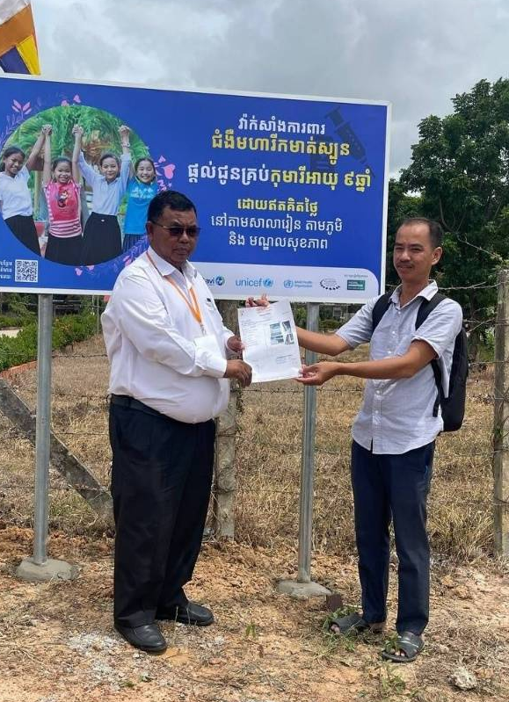
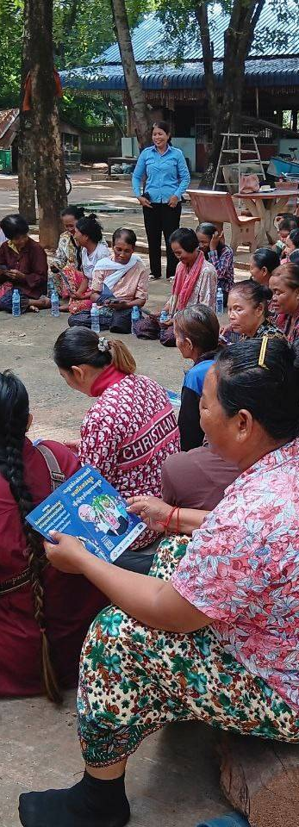
Introduction
The emergence and spread of drug resistance can undermine the protective benefits of chemoprevention
This calls for robust surveillance and monitoring of resistance to chemoprevention drugs
There is currently no global consensus on the design and deployment of a system for routine resistance marker surveillance and response in the context of chemoprevention

Slide 57
Proposed System Overview

Slide 58
Proposed System Overview
Proposed system Overview
Component 1: Formative - consisting of in-depth molecular analysis of collected blood samples to inform components of the routine surveillance system
Component 2: Routine malaria chemoprevention molecular surveillance system - Health facility-based surveillance supplemented by community surveys in SMC and Non-SMC areas
Component 3: CPES studies or case control studies following a predefined trigger
Component 4: Programmatic and policy actions
  Thresholds to guide action from CPES /case-control study results efficacy

Slide 59
Proposed System Overview
Cross-sectional community surveys at predefined time points
CPES,
Case-Control Studies
Molecular analysis of samples collected from previous and ongoing SMC studies
Routine health-facility based surveillance
International Network on resistance monitoring
TRIGGER
TRIGGER
National Technical Working Group
Objective 1a - To determine a compendium for priority resistance markers to monitor in addition to currently validated markers
Objective 1b - To inform RM prevalence thresholds for triggering programmatic and early warning actions
Objective 2a To monitor and track trends in resistance markers overtime
Objective 2b To determine the factors driving observed trends in resistance markers
Objective 3 To determine the longitudinal impacts of antimalarial drug resistance mutations on clinical outcomes
Objective 4 To inform prompt and effective surveillance data use and decision-making to delay and mitigate resistance emergence

Slide 60
Health Facility Based
Sample
collection site 1
Results management visualisations (DHIS2)
Regular discussions with (NMCPs, technical working groups,HMIS)
A network of health facilities located in various settings at which longitudinal samples will be collected during both seasonal transmission and the remainder of the year.
  Allows for the more accurate picture of selection or de-selection of markers.
Subsequently understanding the “ebbs and flows” of this dynamic will allow monitoring and eventual prediction on how markers are likely to change over time
Sites located in various transmission setting.
Expert laboratory
Sample
collection site 2
Sample
collection site 3
Sample tracking system
Sample management system

Slide 61
Cross-sectional community surveys
Community surveys in target areas surrounding selected health facilities will target individuals not presenting at the health facilities.
  Important as health facility surveillance misses asymptomatic carriers, may over-represent severe or treatment failure cases and often reflect care-seeking behavior
Conducted at pre-defined timepoints to provide representative population-level data on parasite prevalence, molecular resistance markers and real-world drug exposure in asymptomatic individuals.
Enabling early detection of reduced drug effectiveness.

Slide 62
Use of Data

Slide 63
Collaborative use of data for action
The system will emphasize and leverage existing engagement with relevant partners
  National
    NMCPs - malaria technical working groups; Case management, surveillance, monitoring and evaluation, scientific and technical advisory board, at the relevant Ministries of Health,
  International
    WHO, CDC,
Emphasizing linkage between the different components and various data (clinical, molecular, and epidemiological), this system will support discussions and consensus on meaningful triggers for action including
  Resistance prevalence thresholds requiring deeper investigation and appropriate response -tailored or generalized
  Thresholds to guide action from CPES /case-control study results efficacy
  Policy review mechanisms
  Mitigation road maps,

Slide 65


Malaria burden and molecular markers in children aged
5-15 years in Burkina Faso to inform age extension of SMC
Dr Issiaka SOULAMA
IRSS, BURKINA FASO
Annual Meeting of the SMC Alliance
February 24, 2026

Slide 66

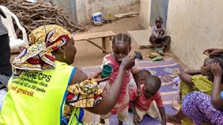
Introduction
Children under five remain the highest clinical‑risk group for severe malaria and death;
Many interventions (LLINs, SMC, case management, Malaria vaccination, IPTi) are therefore targeted to them.
School‑age children (roughly 5–15 y) often have lower clinical severity but can carry a high parasite reservoir, sustain transmission and suffer chronic consequences (anemia, impaired cognition).
They are less systematically reached by routine malaria programmes
School‑based and targeted strategies can reduce community transmission and improve child health.

Slide 67
Aim
However, very little data is available to assess the extent of the malaria burden in schools to inform and improve intervention measures.
Our study therefore aims to assess the burden of malaria in schools in the municipality of Koubri. This study will also evaluate the genetic diversity of the parasite and the resistance profile of P. falciparum in school-aged children to inform age extension of SMC.
Notes:
Then, considering the very littke availability of data to assess the extent of the malaria burden in schools to inform and improve intervention measures, we therefore design a study which aims to to assess the burden of malaria in schools in the municipality of Koubri. This study will also evaluate the genetic diversity of the parasite and the resistance profile of P. falciparum in school-aged children to inform age extension of SMC

Slide 68
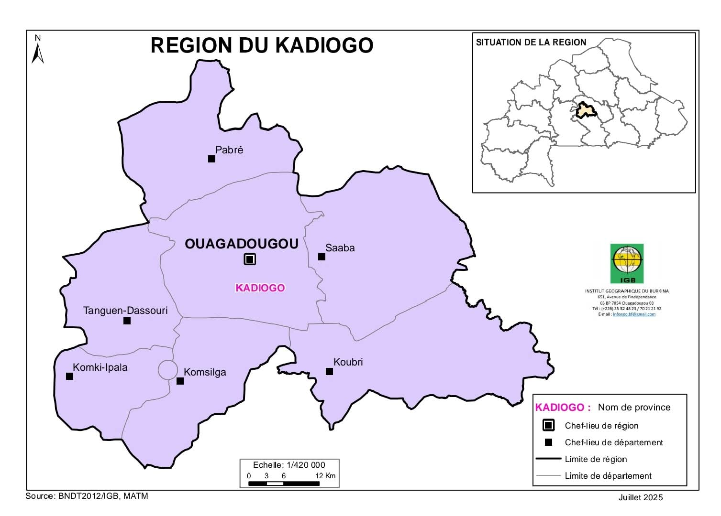
Study site
Koubri is located 25 km south of Ouagadougou, the capital of Burkina Faso. The rural community of Koubri is located in the Central Region and comprises 26 villages and a population of 60,802 inhabitants in 2020.
The Koubri locality has nearly seven water reservoirs, each covering an area of approximately 100 km², making it the locality with the highest density of water reservoirs in the country. The Koubri water reservoirs present a very high risk of malaria transmission compared to the rest of the municipalities in the Central Region.

Slide 69
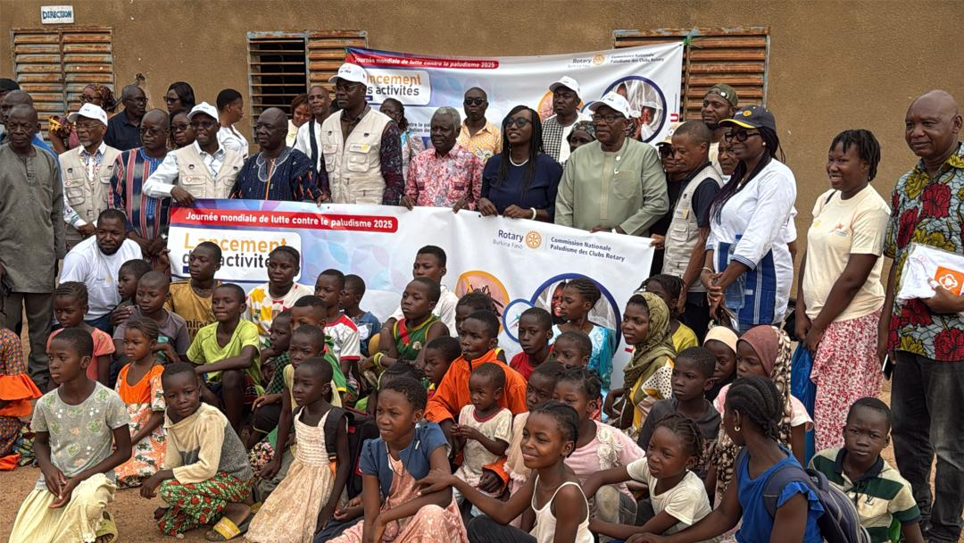
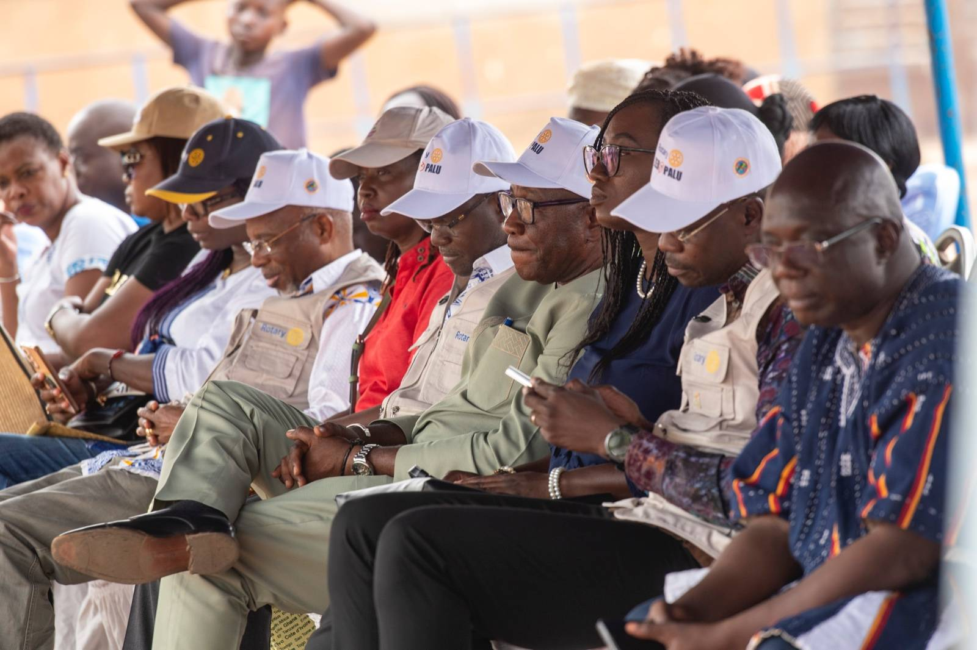

School children screening and enrolment
Selection of 3 schools based on proximity with the medical center of Koubri to
reach the target of 1500 School-age children
Approval from Public Health Institutional Review Board in January 2025
(Déliberation N°2025-001/MS/SG/INSP/CEI du 29 Janvier 2025)
Official launch of the project at school with MoH representative,
teachers, administrative official, rotarian, student and parents

Slide 70
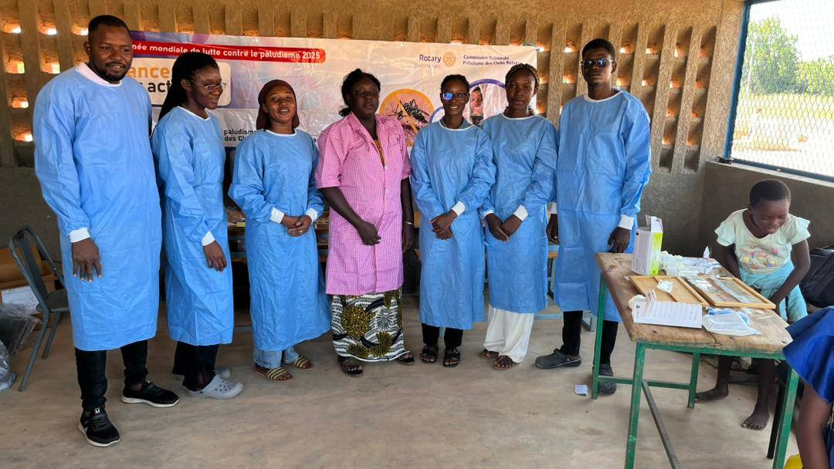
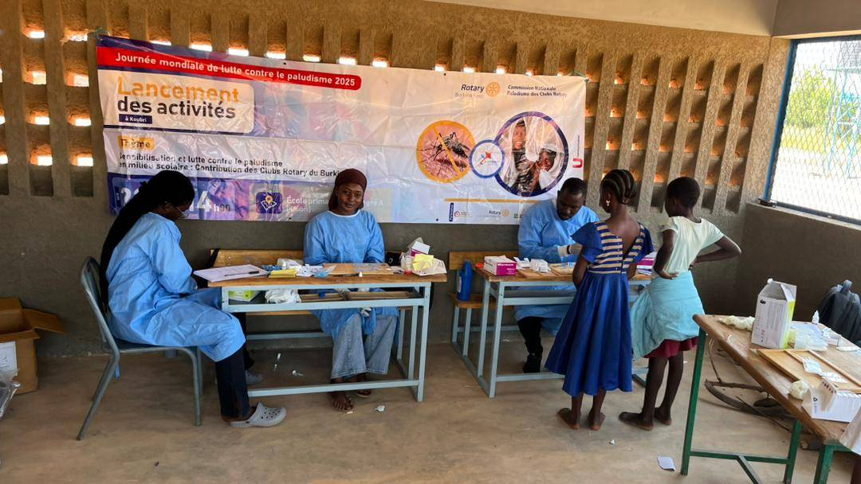
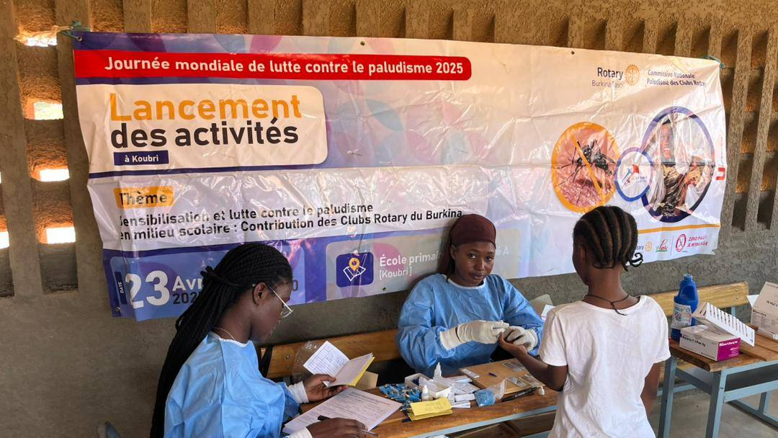
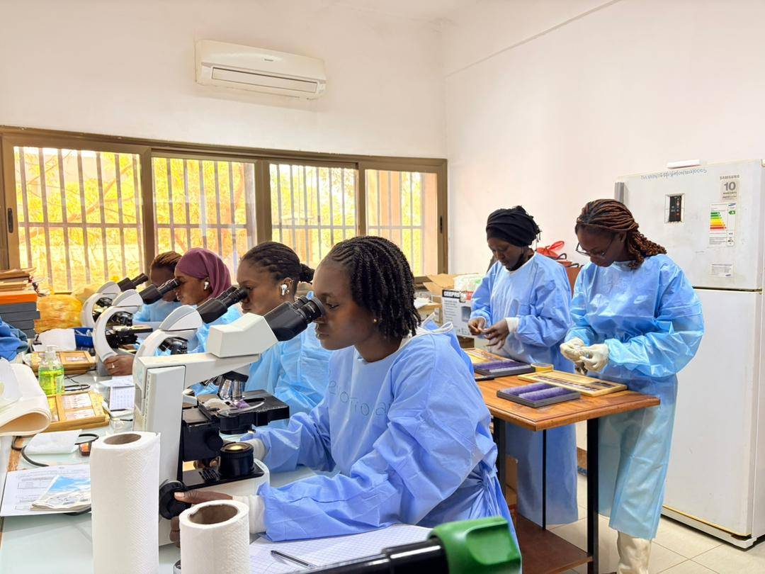
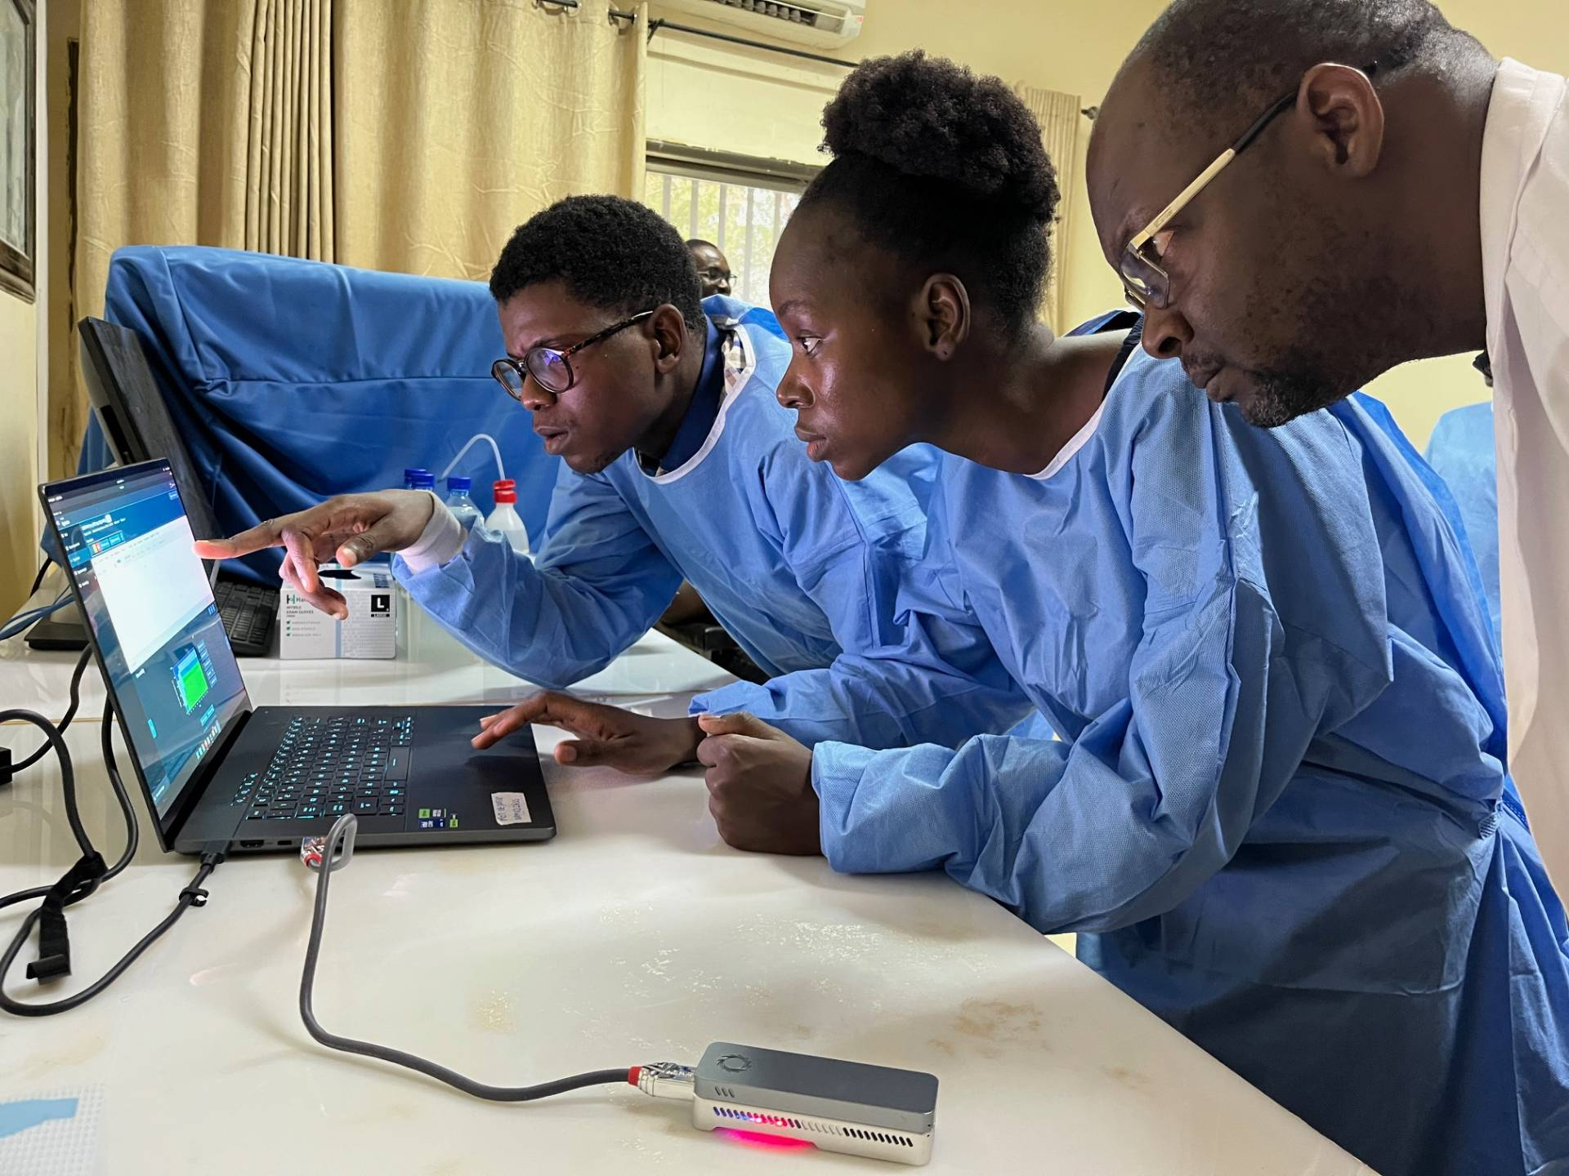
Conduct two cross-sectional surveys: June-July and October-November 2025
Obtention of informed consent and assent
Demographic data
Clinical data
RDT (provide malaria treatment/national guideline/ RDT positive and Temp> 37.5°C)
Slides for microscopy
DBS samples for PCR and sequencing

Slide 71
Number of children
Number of children enrolled according to the cross-sectional survey

Slide 73
RDT positivity (18.3%) Vs Microscopy positivity (16.8%)
Malaria treatment based on RDT: 88/233 (37.7%)
Se (RDT): 86.4%
Sp (RDT): 95.5%

Slide 74
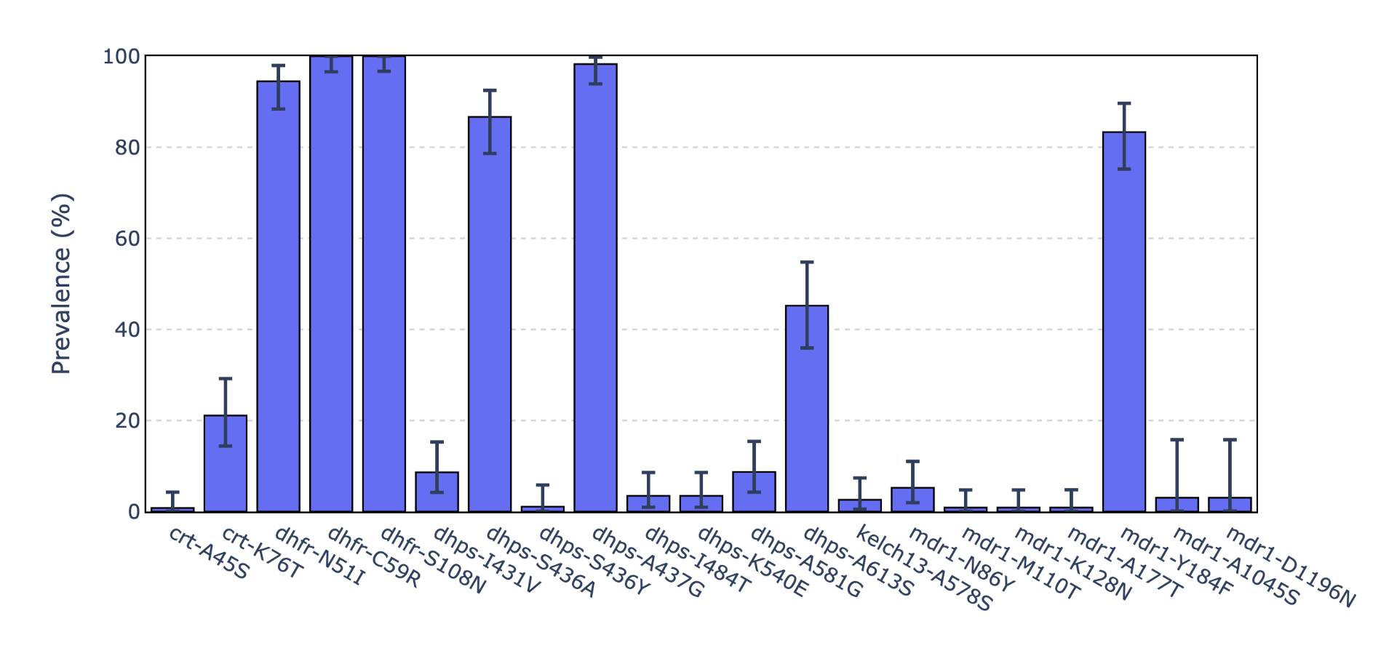
Prevalence of molecular markers
Global distribution of molecular resistance markers in School age children

Slide 75
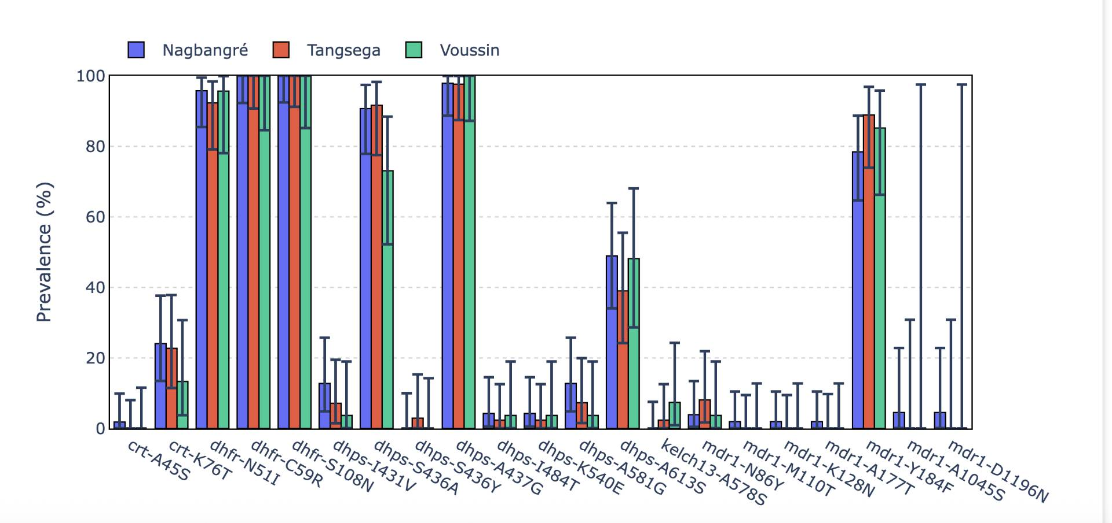
Global distribution of molecular resistance markers according the School location

Slide 76
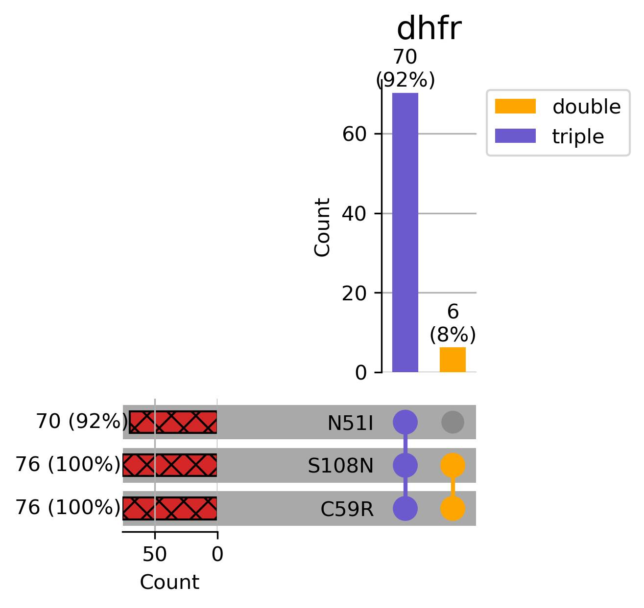
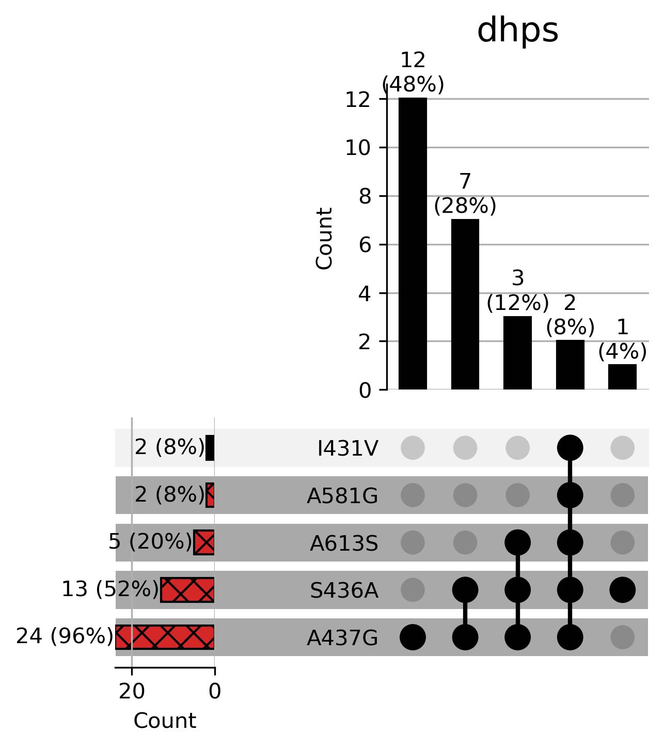
Prevalence of double, triple mutations on individual gene: dhfr, dhps

Slide 77
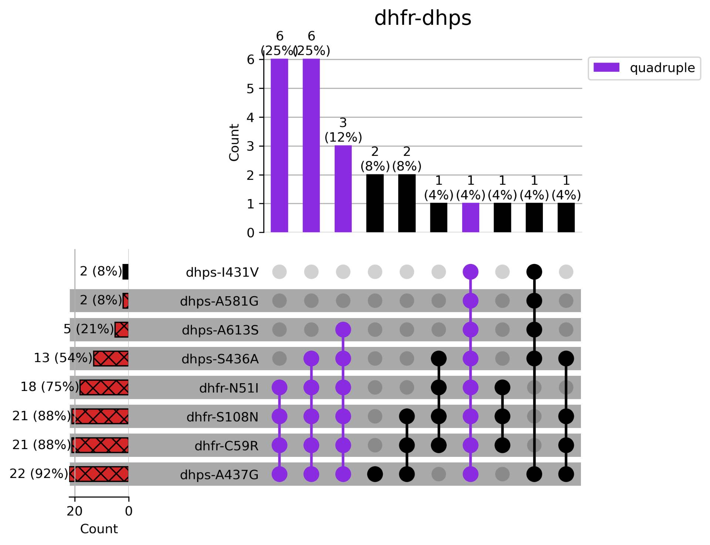
Prevalence of triple, quadriple and quintuples mutations of dhfr, dhps
Partial resistance vs full resistance (K540E, not associated) to SP

Slide 78
Conclusion
Prevalence of 18.3 % of P. falciparum infection in School age children using RDT from which 37.7% of malaria cases have been treated based on national guidelines
High prevalence of individual dhfr and dhps mutations
Presence of quadruple partially resistant haplotype (I₅₁R₅₉N₁₀₈ - G₄₃₇) the most common (25%), while the fully resistant haplotype (I₅₁R₅₉N₁₀₈ - G₄₃₇E₅₄₀) was absent.
It is important to continuously monitor the molecular markers associated with SP and AQ resistance to better implement intermittent preventive treatment policies and to inform the age extension of the SMC.

Slide 79







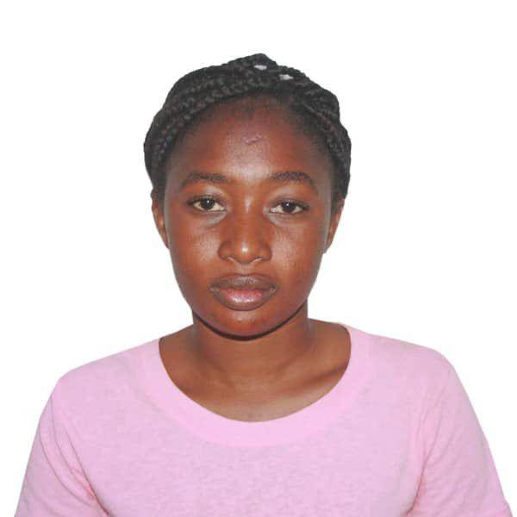
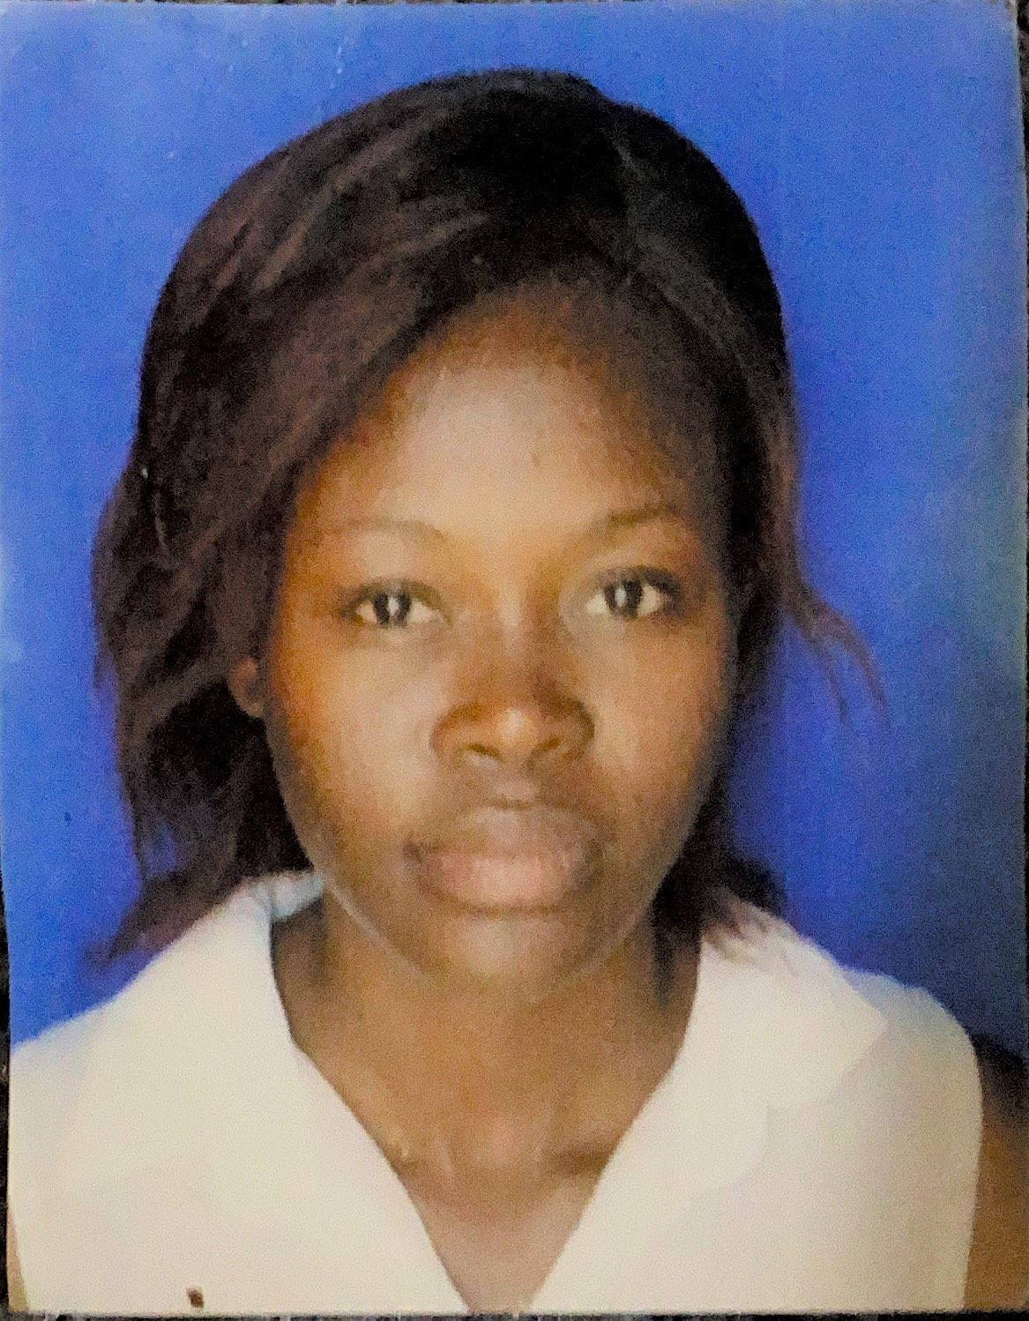


THANK YOU TO THE ENTIRE MALARIA MOLECULAR SURVEILLANCE TEAM
Dr. Issiaka Soulama
Research Lead Investigator
Dr. Oumar Ouédraogo
Immuno-parasitologist
Nadège Milogo
biologist
Dr Salif Sombié
Molecular biologist
Dr. Séni Nikiema
Molecular biologist
Nadège Tibiri
Julien Yanogo
Djamila Zouré
Raissa Illy
Salam Sawadogo
Sao Diarra
PhD Students

Slide 80



Aknowledgments

Slide 81
Thank you for your attention

Slide 82

WWARN SMC IPD repository:
Understanding drug resistance using historical data
Joint annual meeting SMC Alliance & AMP
24 - 27 February 2026
Adama Kazienga
Notes:
PG

Slide 83


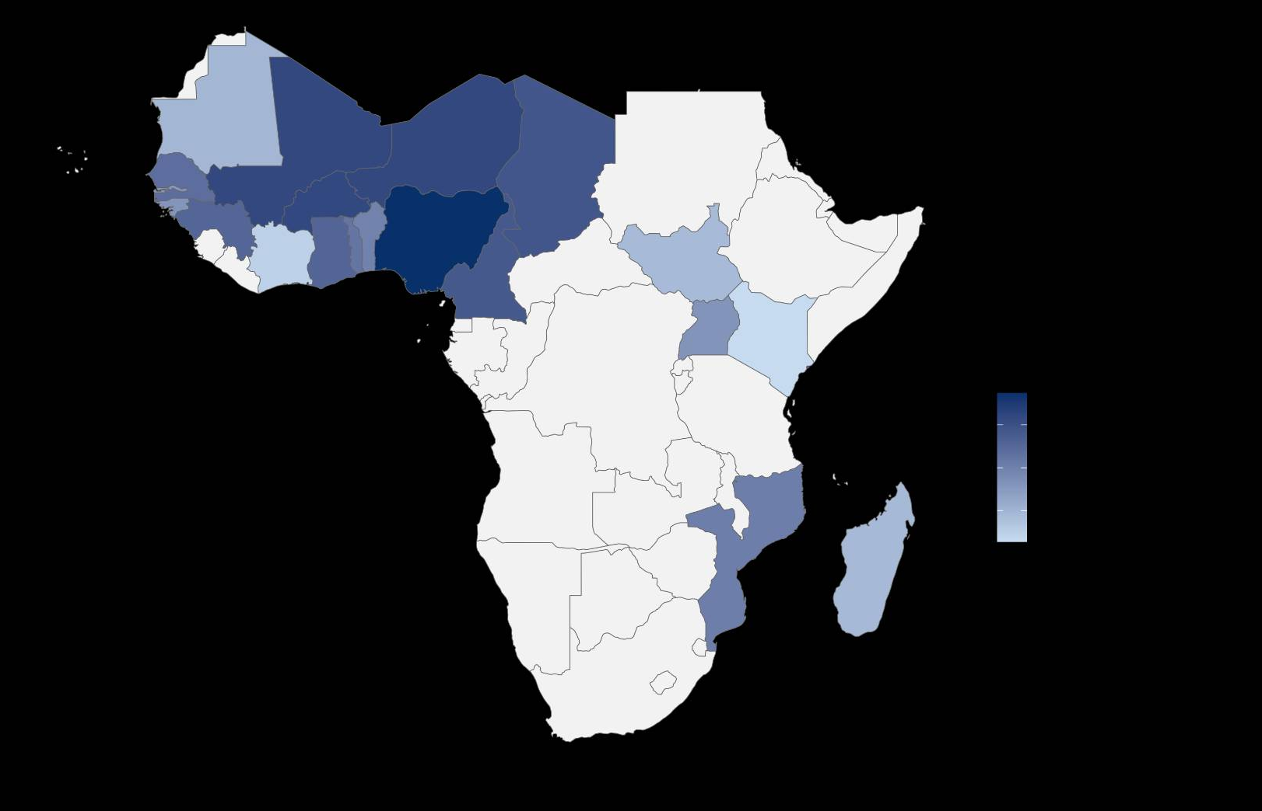

Number of treatment doses delivered
1.3 billion treatments administered across 900 districts.
Data source: MMV + WHO
Total number of treatment doses delivered per year
Total number of SMC treatment doses delivered by country
Zinsou et al., unpublished

Slide 84


Modelling: Predicting the spread of resistance
a. Quadruple mutant
b. Quintuple mutant
Flegg et al., 2022
Source: IDDO/WWARN Surveyor

Slide 85

Impact of SP and AQ resistance associated mutations on SMC efficacy
a. Triple mutant
b. Quadruple mutant
Protective efficacy of SP varies by parasite genotype
SP resistance is associated with shortened post-treatment protection
c. Quintuple mutant
d. Sextuple mutant
Moussa et al., 2025, Source: IDDO / WWARN CTL

Slide 86

Evidence gaps in optimal SMC deployment
Critical modifiers of SMC efficacy in young children are insufficiently characterised
Age
Resistance to long acting antimalarials:
  Sulfadoxine-pyrimethamine
  Amodiaquine
Transmission intensity
Malnutrition

Slide 87


Seasonal Malaria Chemoprevention Study Group

Slide 88
Optimising the deployment of SMC in Africa
Objectives
  Explore heterogeneity in treatment effect of SMC against clinical and severe malaria
  Estimate the MIC values where pharmacokinetics data is available

Slide 89

Malaria Chemoprevention Evidence Map: Utility
Repository for malaria chemoprevention efficacy and safety studies in children
Broad inclusion criteria (interventions & outcomes)
Annually updated
  Minimise time and efforts for future chemoprevention systematic reviews
  Conduct aggregate meta-analyses on wide range of interventions and outcomes

Slide 90
Statistical analysis: IPD-MA
Outcomes
  Uncomplicated malaria
  Severe malaria
Age
Drug resistance
SMC
Malaria
Transmission
intensity
Malnutrition

Slide 91

WWARN Molecular surveillance
Repository for studies reporting molecular marker associated with SP, Artemisinin and ACT partners drug resistance

Slide 92

Research agenda on SMC
Resistance to SP and Amodiaquine
Chemoprevention-related drug pressure
Programmatic monitoring of drug resistance
  Ideal method for monitoring resistance to
  SMC drug
  Frequency of drug resistance monitoring in programmatic settings
ASTMH 2025, Toronto, Canada

Slide 93
Current progress
Assembling IPD of SMC from 64 studies
  18 datasets received
  24 datasets with confirmed commitment
  22 remaining datasets, follows-ups ongoing and positive expectation
  Deadline for assembling IPD: June 2026
Data curation and harmonisation ➔ IPD repository of SMC studies
Statistical analysis plan for IPD-MA

Slide 94



SMC study group Collaboration: Call for Data
  We welcome collaborative participation in the SMC IPD initiative

Slide 95
Acknowledgment
  SMC study group members

Slide 96



Geographical Variation in Sulfadoxine-Pyrimethamine Resistance Markers and Implications for Malaria Chemoprevention in Cameroon
Dr Innocent Ali,
University of Dschang
Cameroon

Slide 97

Presentation Plan
1
Malaria situation in Cameroon in 2024
2
Evolution of dhps SNPs in Cameroon
Geographic variation in dhps resistance conferring mutations in Cameroon
3
Implications for PMC implementation in Cameroon
4

Slide 98


In 2023, Cameroon recorded:
11,300 deaths due of malaria.
7.3 million malaria cases
Seasonality: Seasonal in the Northern and Perennial in the South
  65% of malaria mortality in children <5 occurs in northern part.
Drug regime:
  AL, AS-PYR, AS+AQ, DHA-PPQ against uncomplicated malaria
  AS or AM IV/IM or quinine against severe malaria
  Prevention during pregnancy: SP (IPTp), 51% Coverage of SP3
  Chemoprevention: SMC (SP-AQ) and PMC (SP) 5-dose schedule

Slide 99

Evolution of dhps mutations in Cameroon
VAGKGS (431Val-436Ala-437Gly-540Lys-581Gly-613Ser) pfdhps variant emerging.
Goal: Map DHPS resistance markers and model effect of markers on SP efficacy

Slide 100




1
DNA Extraction, qPCR and NGS sequencing & genotype determination
2
☛
Rainy season: June-October
☛
☛
☛
☛
☛
☛
☛
☛
☛
3
Modeled effects of known dhps haplotypes/ 30-day protective efficacy of SP and median duration of protection.
Collected 150 Plasmodium falciparum from between 2020 and 2025 from 10 regions across Cameroon

Slide 101



DHFR
DHPS
Moroua
83
dhps-431V evolves from south/west to north
Garoua
71
Strong N/S Differences
Littoral
Bertoua

Slide 102

North
Frequency of haplotypes from combined dhfr and dhps mutations vary in the same way
  High in the northern regions, and lowest in the South & East regions
  Moderate to high in the littoral coastline

Slide 103

Model predictions of genotype specific SP protective efficacy
24 days
Median duration of protection (days) projected to reduce with increasing proportion of dhps resistance bearing parasites.
55.1 days

Slide 104

30-day protective efficacy (PE) against new infection projected to increase with reducing % of dhps bearing parasites
74.9%
95.3%

Slide 105
Implications for PMC implementation in Cameroon
☞ dhps mutations conferring resistance still evolving in Cameroon very significantly by geography
☞ High proportions of VAGKGS haplotypes circulate rising from western to northern geographies associated with widespread SP use
☞ dhps-I431V bearing parasites projected to adversely affect both mean duration of protection and 30 days SP efficacy in the context of PMC use.

Slide 106
Implications for PMC implementation in Cameroon
☞ More information on dhps-431V effects from the 3-arm randomized trial in Ngounso-Magba is still being analyzed
☞ SP use in infants in the context of PMC is efficacious, but surveillance of evolution of resistance determinants in dhps gene mutations strongly warranted
☞ In the case of chemoprevention failure of SP, a safe alternative has been shown to work well in PMC: SPAQ, from genotype specific point of view.

Slide 107
FINISTECH (Fobang Institute for Innovation in Science and Technology, Yaoundé (Cameroon)
Wilfred Mbacham
Akindeh Nji
Indira Lontsie Saha
Bigoga Jude
Valery Pacome K. Tchuenkam
Peter Thelma Ngwa Niba
Nfor Emmanuel Nfor
University of Copenhagen (Denmark)
Emma Filtenborg Hocke
Helle Hansson
Michael Alifrangis
Louise Wellmann Thomsen
LSHTM (Genotyping and Impact team)
Ana Chopo Pizarro
Khalid Beshir
Andria Mousa
Emma Manning
Ayah Jewhar
Cally Roper
Colin J. Sutherland
Matthew Chico
Rosario Martinez Vega
Jonna Mosoff
Sham Lal
University of South Florida
Gillian Stresman
Michaela Gross
Presenter Dr Innocent Mbulli Ali – dr.alinn@gmail.com

