Slide 1
CHoice of Anti-Malarial drugs for chemoPrevention in Malawi
(CHAMP Drug)
Donnie Mategula. MBBS, MSc, MRes, PhD
Malawi Liverpool Wellcome Program/Liverpool School of Tropical Medicine
SMC Alliance meeting, Uganda. 26 Feb 2026

Slide 2

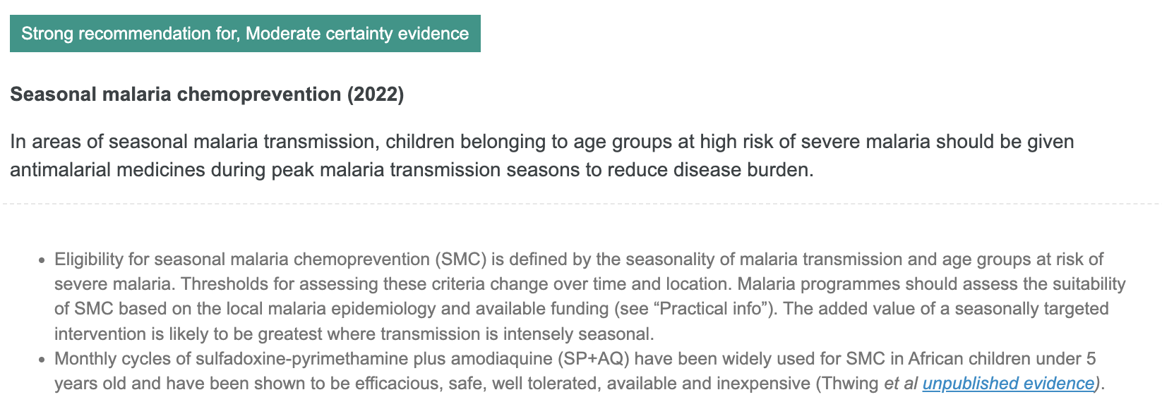
SMC outside the Sahel
Evidence supporting SMC effectiveness in outside the Sahel remains limited and uncertain
No individually randomized trials of SPAQ for SMC in East or Southern Africa
WHO Malaria Guidelines: MagicApp
Notes:
The 2022 WHO recommendation expanding Seasonal Malaria Chemoprevention (SMC) beyond the Sahel represents a major shift in malaria prevention policy.

Slide 3
Will chemoprevention achieve the same impact in East and Southern Africa as observed in the Sahel?
Sahel characterized by:
    Highly seasonal transmission
    Predictable malaria peaks
    Established SP+AQ regimen
East and Southern African settings:
    More heterogeneous transmission
    Longer or bimodal seasons
    Different drug resistance patterns

Slide 4
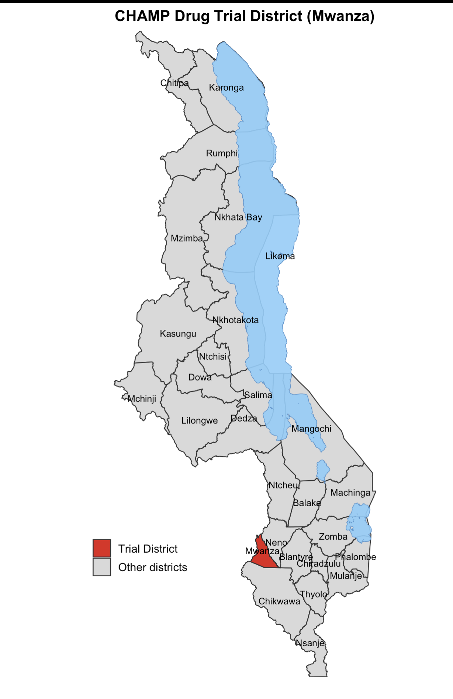
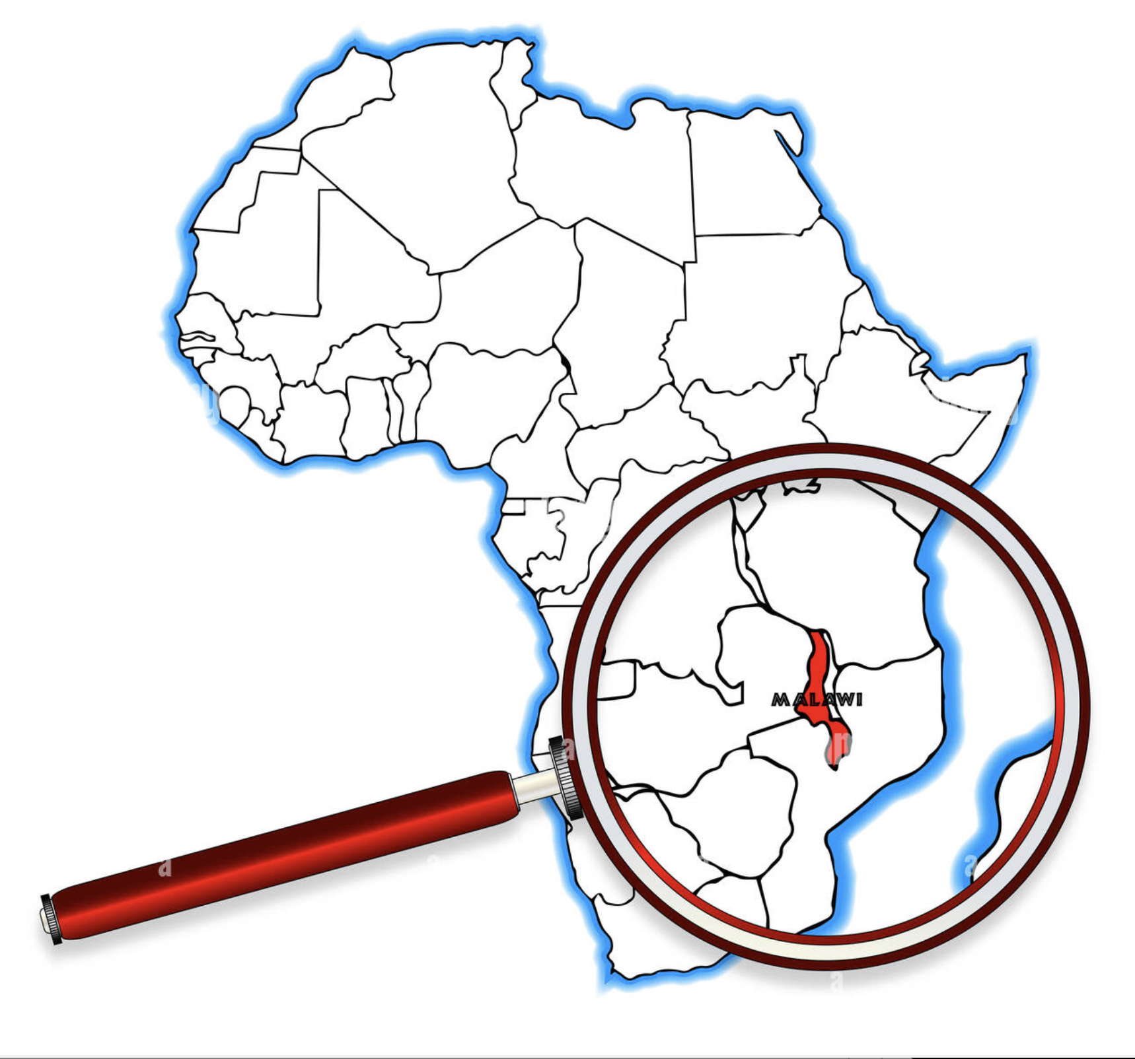
SMC and drug choice outside the Sahel
Transmission patterns in Malawi reflect East and Southern Africa realities
  Moderate to high transmission with seasonal peaks and geographical heterogeneity
High SP resistance may limit anti-malarial efficacy, but may have non-malaria benefits
Chloroquine is an attractive option as it is:
  Cheap
  Safe
  Not used for treatment
  No molecular evidence of resistance
Artimovich et al JID, 2015; Laufer et al NEJM, 2006.
Notes:
Ideal Setting for testing Chemoprevention outside the Sahel

Slide 5
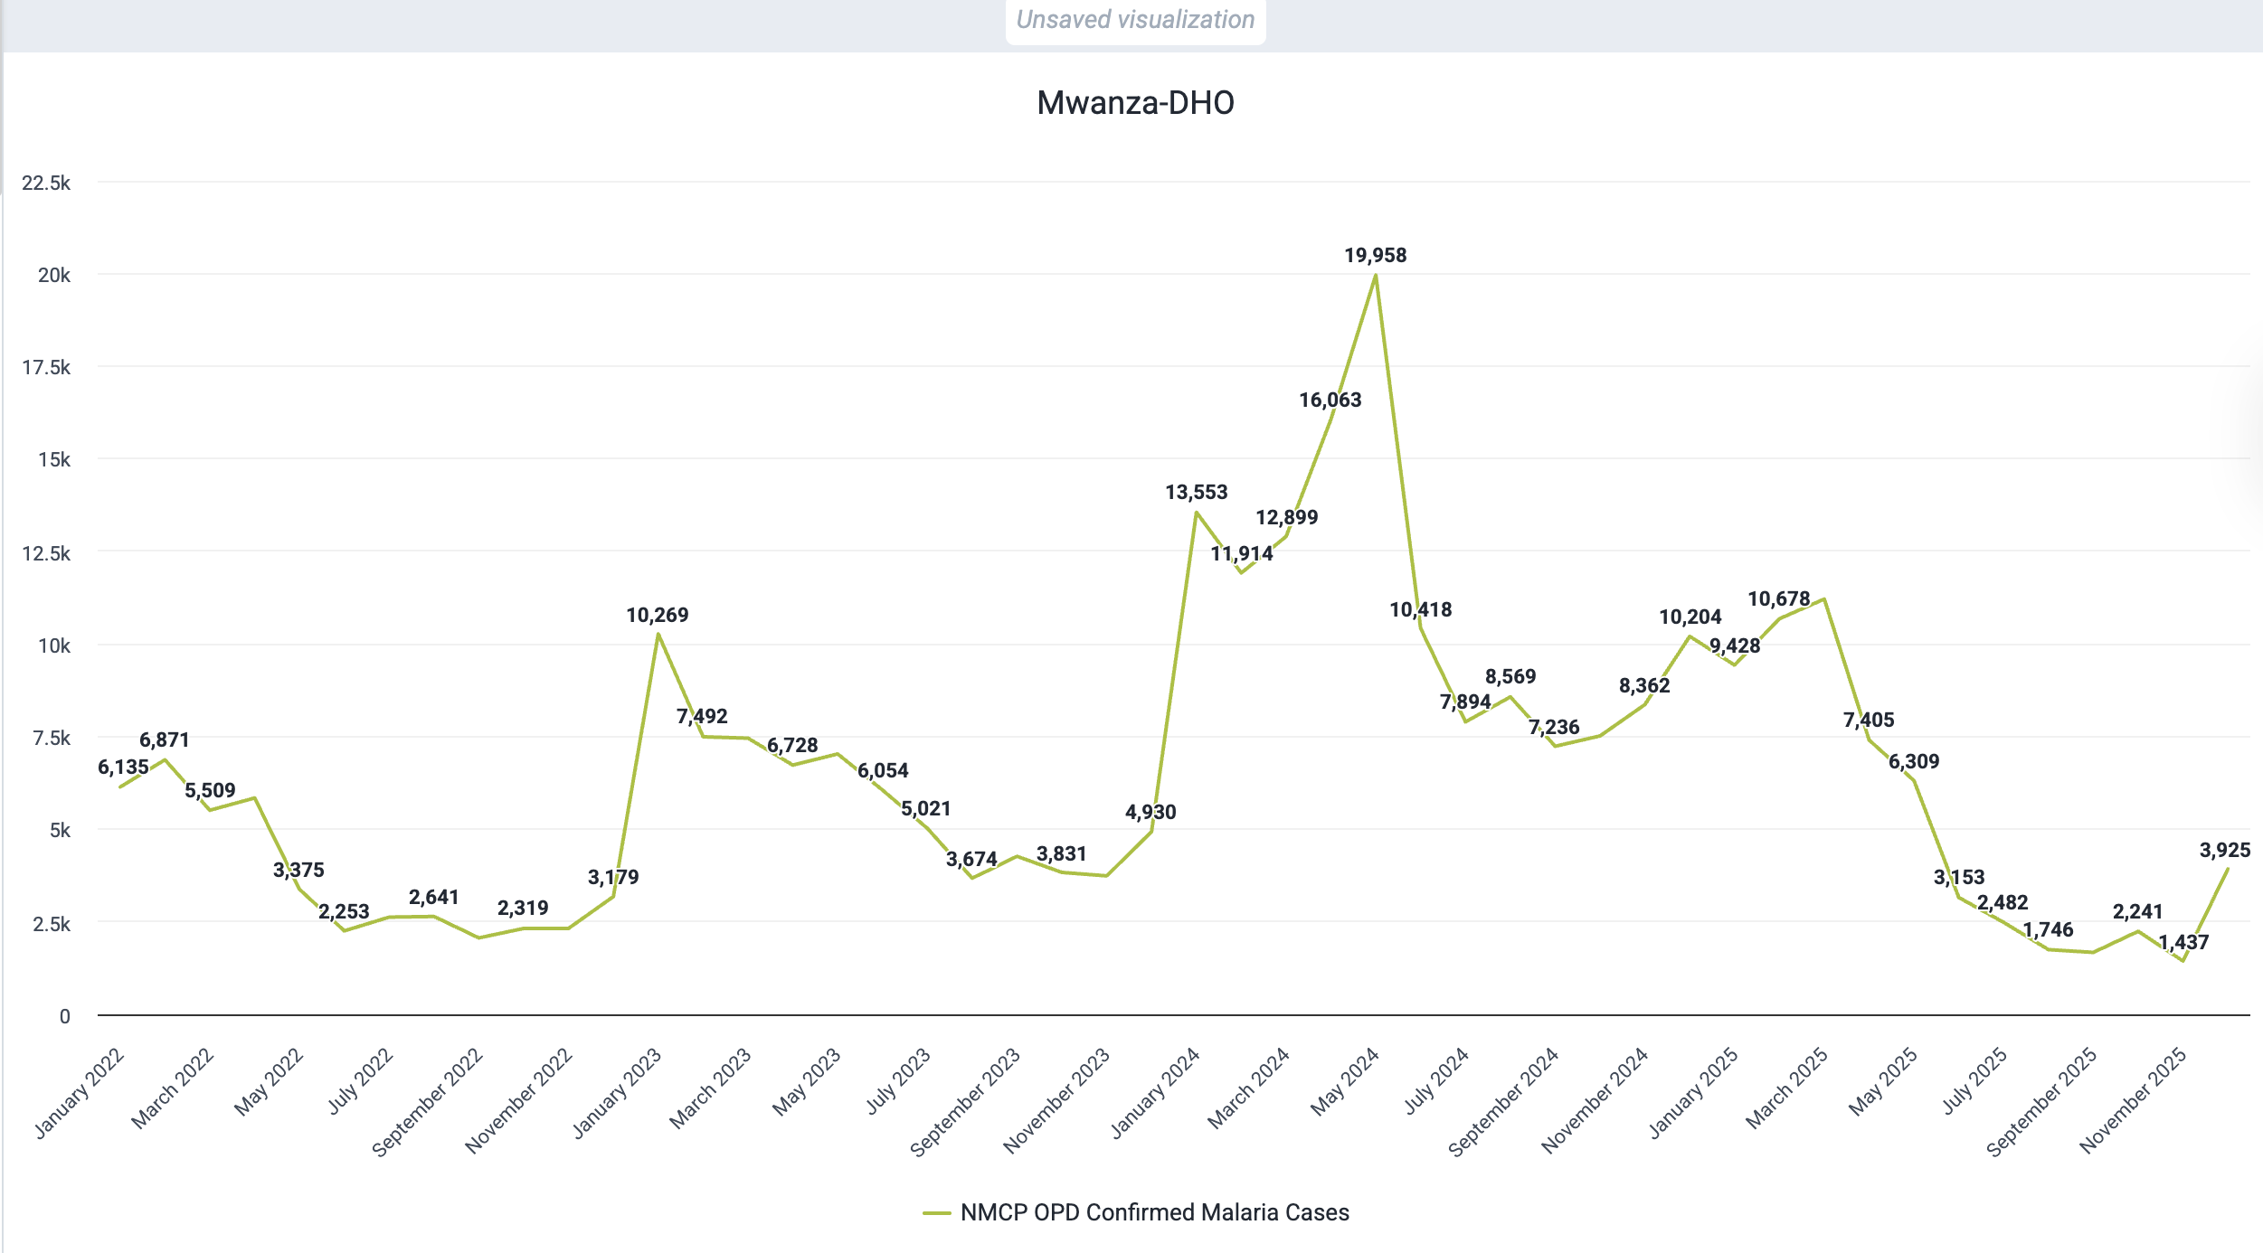
Seasonality of Malaria cases in Mwanza, Malawi
61% of annual cases occur Jan-May
(4-year average)

Slide 6
CHAMP Drug: Trial Design
Question: Which antimalarial drugs delivered as SMC provide the greatest protection against malaria attributable morbidity in young children in Malawi?
Study population: 6900 children 3-59months
Intervention: 5 monthly cycles of chemoprevention, all doses DOT
Allocation: Individual, factorial randomisation (6 arms)
Follow-up: Active follow-up through 1 month after last dones, passive follow-up for total of 1-year
Randomisation | 1
2 |  | Hydroxychloroquine | Amodiaquine | Placebo
 | SP | SP+HCQ | SP+AQ | SP+Placebo
 | Placebo | Placebo+HCQ | Placebo+AQ | Placebo+Placebo

Slide 7


CHAMP Drug: Outcomes
Co-Primary:
    Hospitalisation due to malaria
    Uncomplicated clinical malaria
Secondary:
    All cause hospital admissions and mortality
    Severe malaria meeting WHO definitions
    All infections requiring antibacterial or antimalarial treatment
    Parasite prevalence
    Change in haemoglobin concentration and growth parameters
    Drug resistance markers
    Safety and tolerability

Slide 8
CHAMP Drug: Timelines and Anticipated Impact
2026 | 2027 |  | 2028
Preparation Site Census Enrollment | D D D D D ↓ ↓ ↓ ↓ ↓ ↓ Active & passive follow-up | x Passive follow-up Preliminary results | x Analysis Final results
The trial will:
Determine chemoprevention drug efficacy, quantify SP’s malaria-specific and non-malaria impact
  Inform choice of drugs for SMC, PMC, and IPTsc
Measure impact of SMC outside the Sahel
  Inform policy in Malawi and the region

Slide 9


Acknowledgements
Malawi National Malaria Control Program
Lumbani Munthali
MORU/Oxford
James Watson
Dhruv Darji
Nick White
Funding:
Malawi Liverpool Wellcome Program
Henry Mwandumba
Tikhala Jere
Lumbani Makhaza
Liverpool School of Tropical Medicine
Lauren Cohee
Jane Rawlinson
1951-2026

